Slide 1
United states History
World War II: Economy [10.03]
Dr. King-Owen

Slide 2
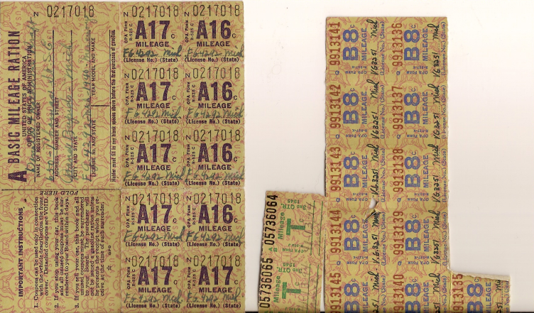
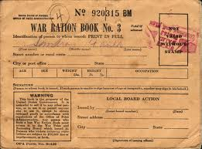
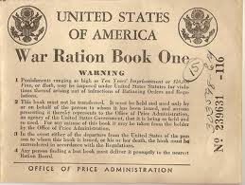
Economic Management
War Production Board, 1942
Controlled materials and production
Certain products banned (cans, bikes, fridges)
Office of Price Administration, 1942
Controlled inflation of prices of goods
Issued ration books to limit consumption of sugar, meat, butter, coffee, gas, and shoes

Slide 3
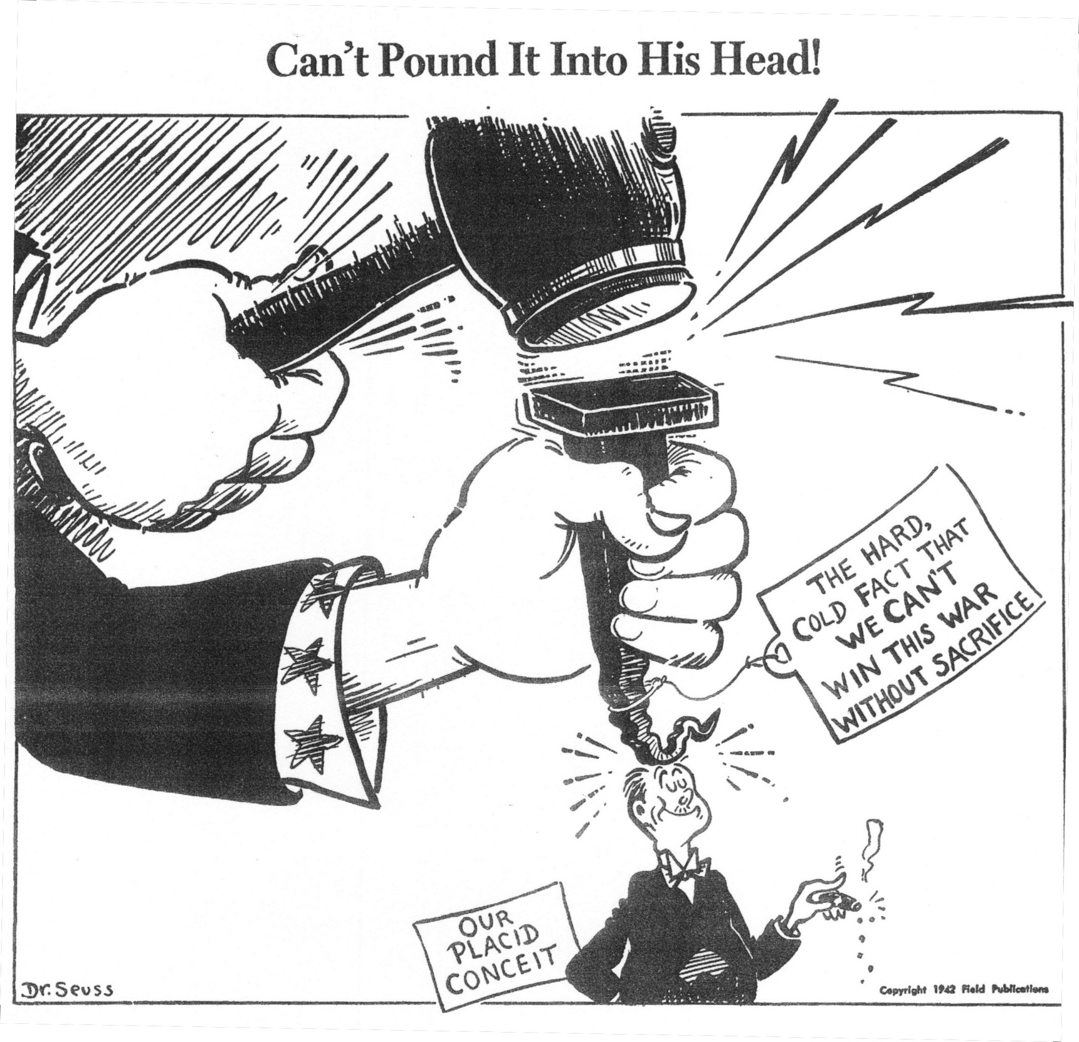

Slide 4
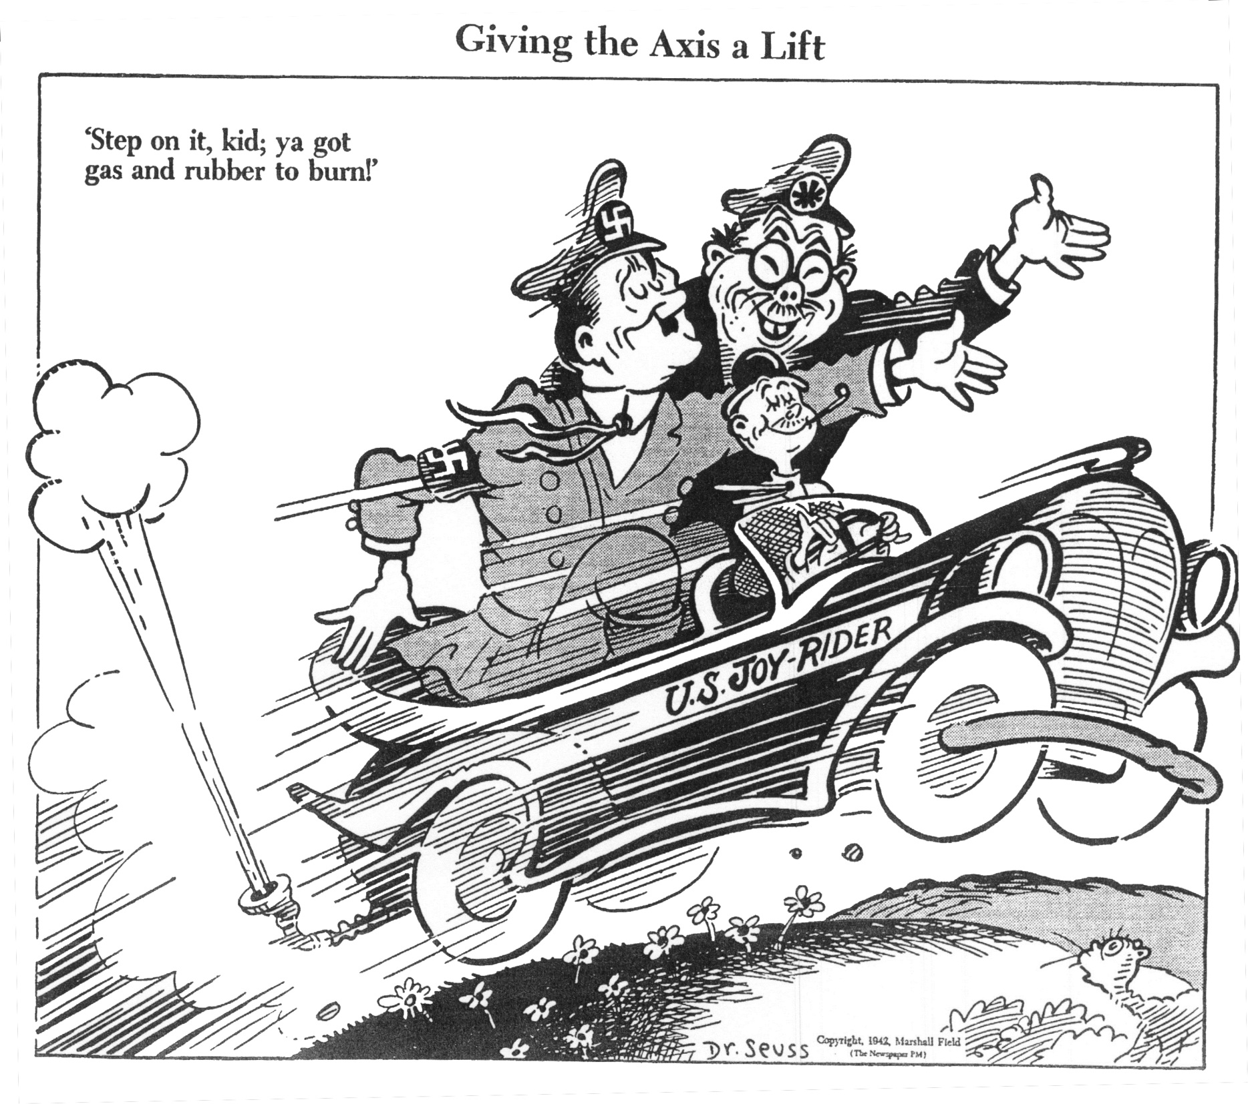

Slide 5
Just like in World War I, the government in WW2 encouraged citizens to plant Victory Gardens and can their own food.

Slide 6
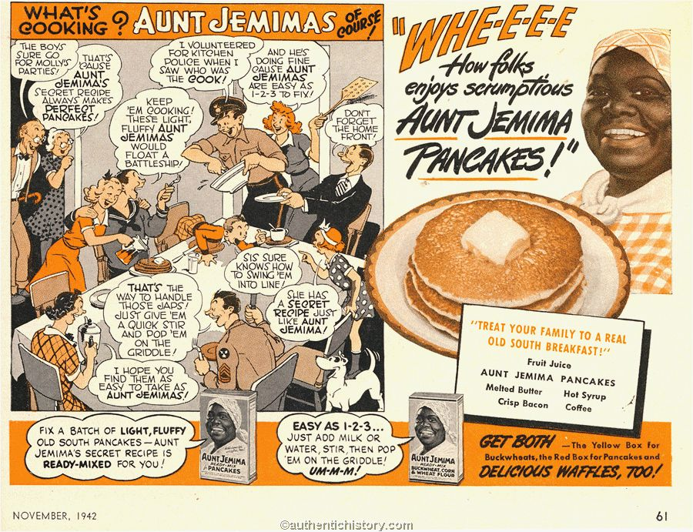

Slide 7
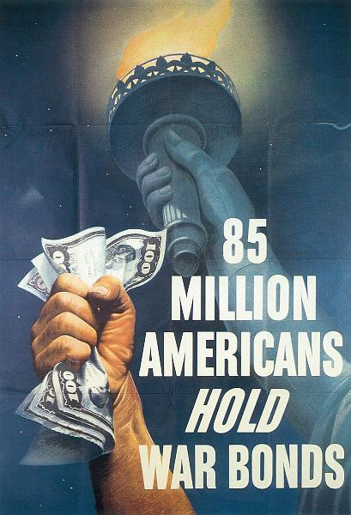
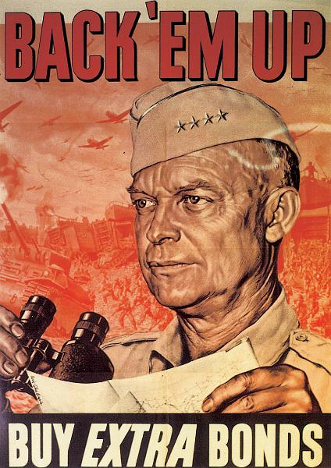

Slide 8
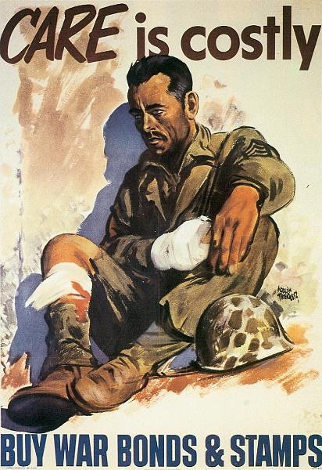
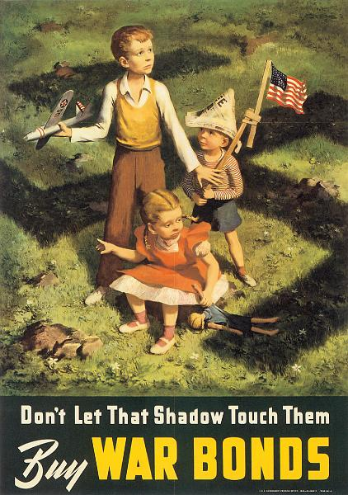

Slide 9
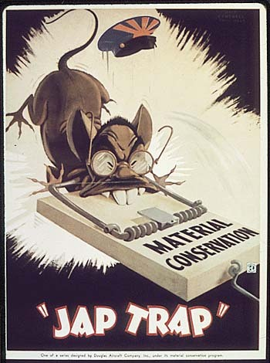

Slide 10
Labor Supply
Unions had non-strike policies (=patriotism)
Workers sometimes did wildcat strikes – not authorized by the union
Bracero Program, 1942
US imported workers from Mexico (4.5 million by 1964)
Worked in agriculture
Notes:
Prospective braceros were fumigated with DDT before entering the US! Yikes!

Slide 11
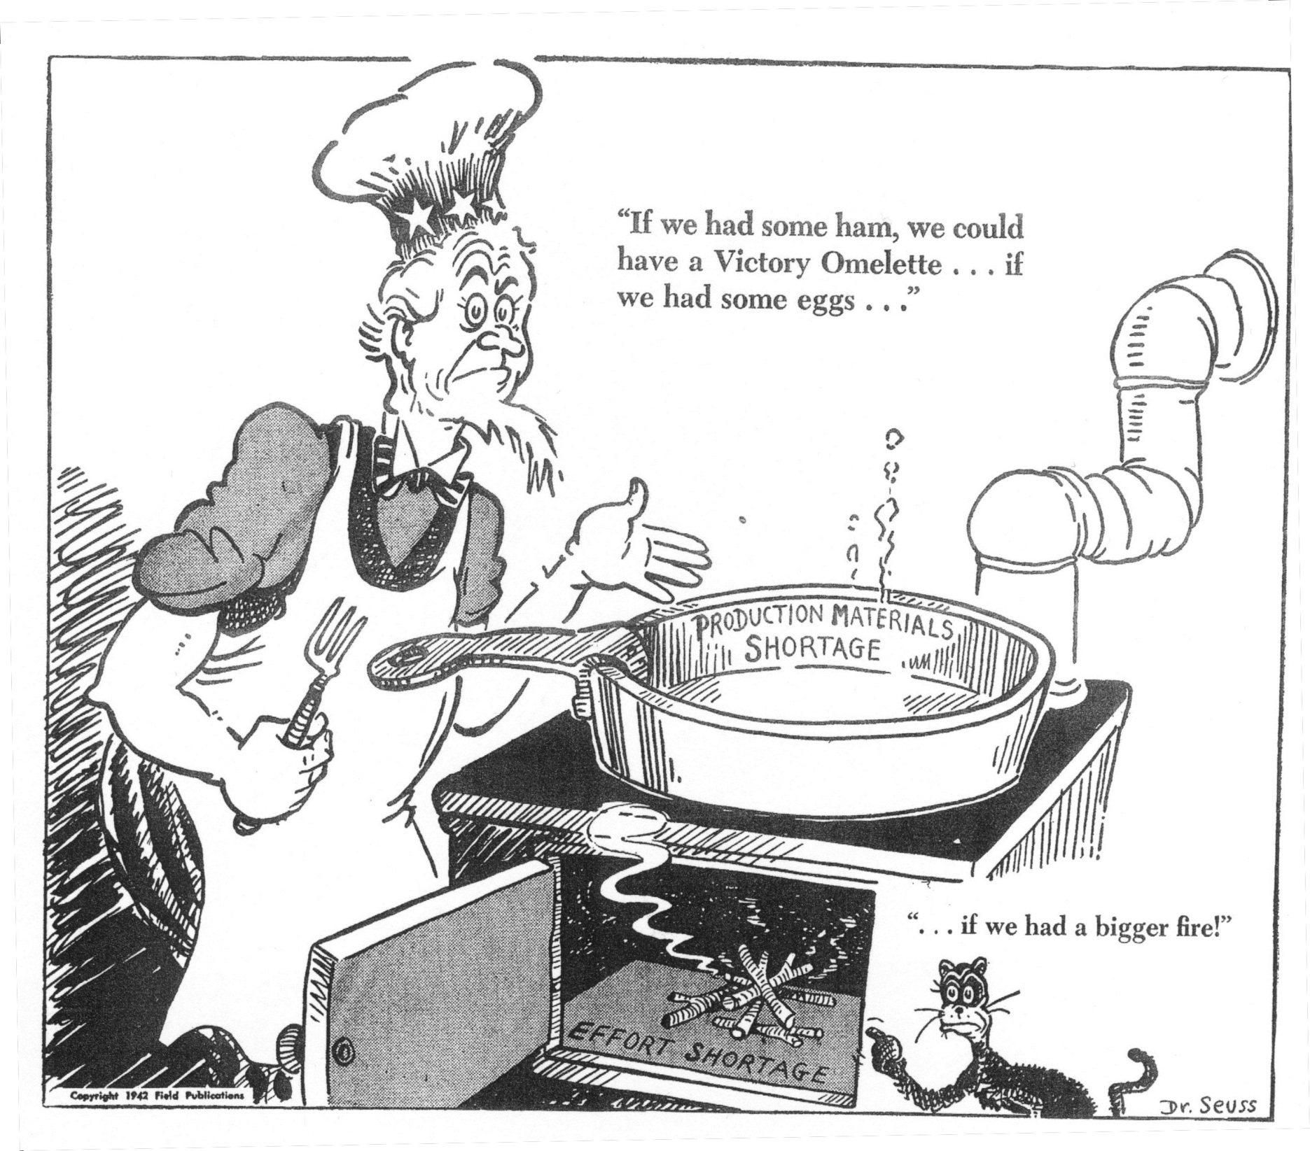

Slide 12
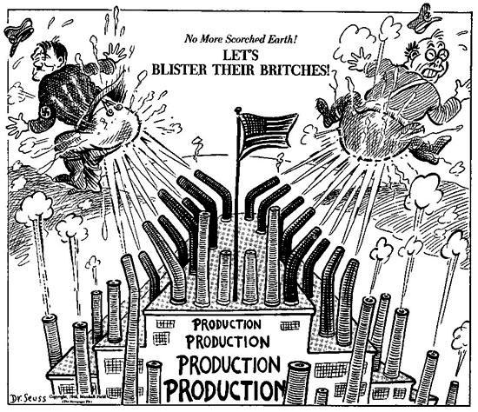

Slide 14
Paying for the War
Victory Loans
By selling bonds, the U.S. paid for 44% of the cost of the war
However, the national debt still increased 5 times between 1940-1945
Taxation
1940 – income tax extended to ALL Americans
Collected from paychecks

Slide 15
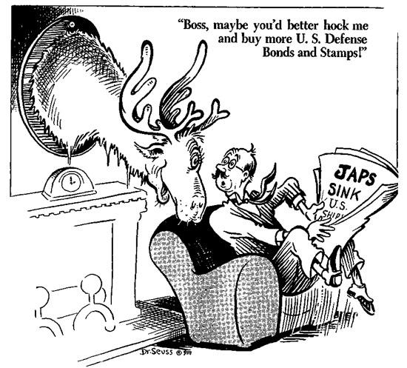

Slide 16
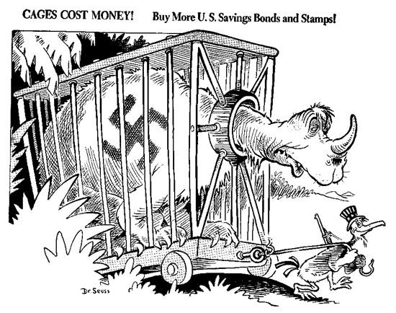

Slide 17
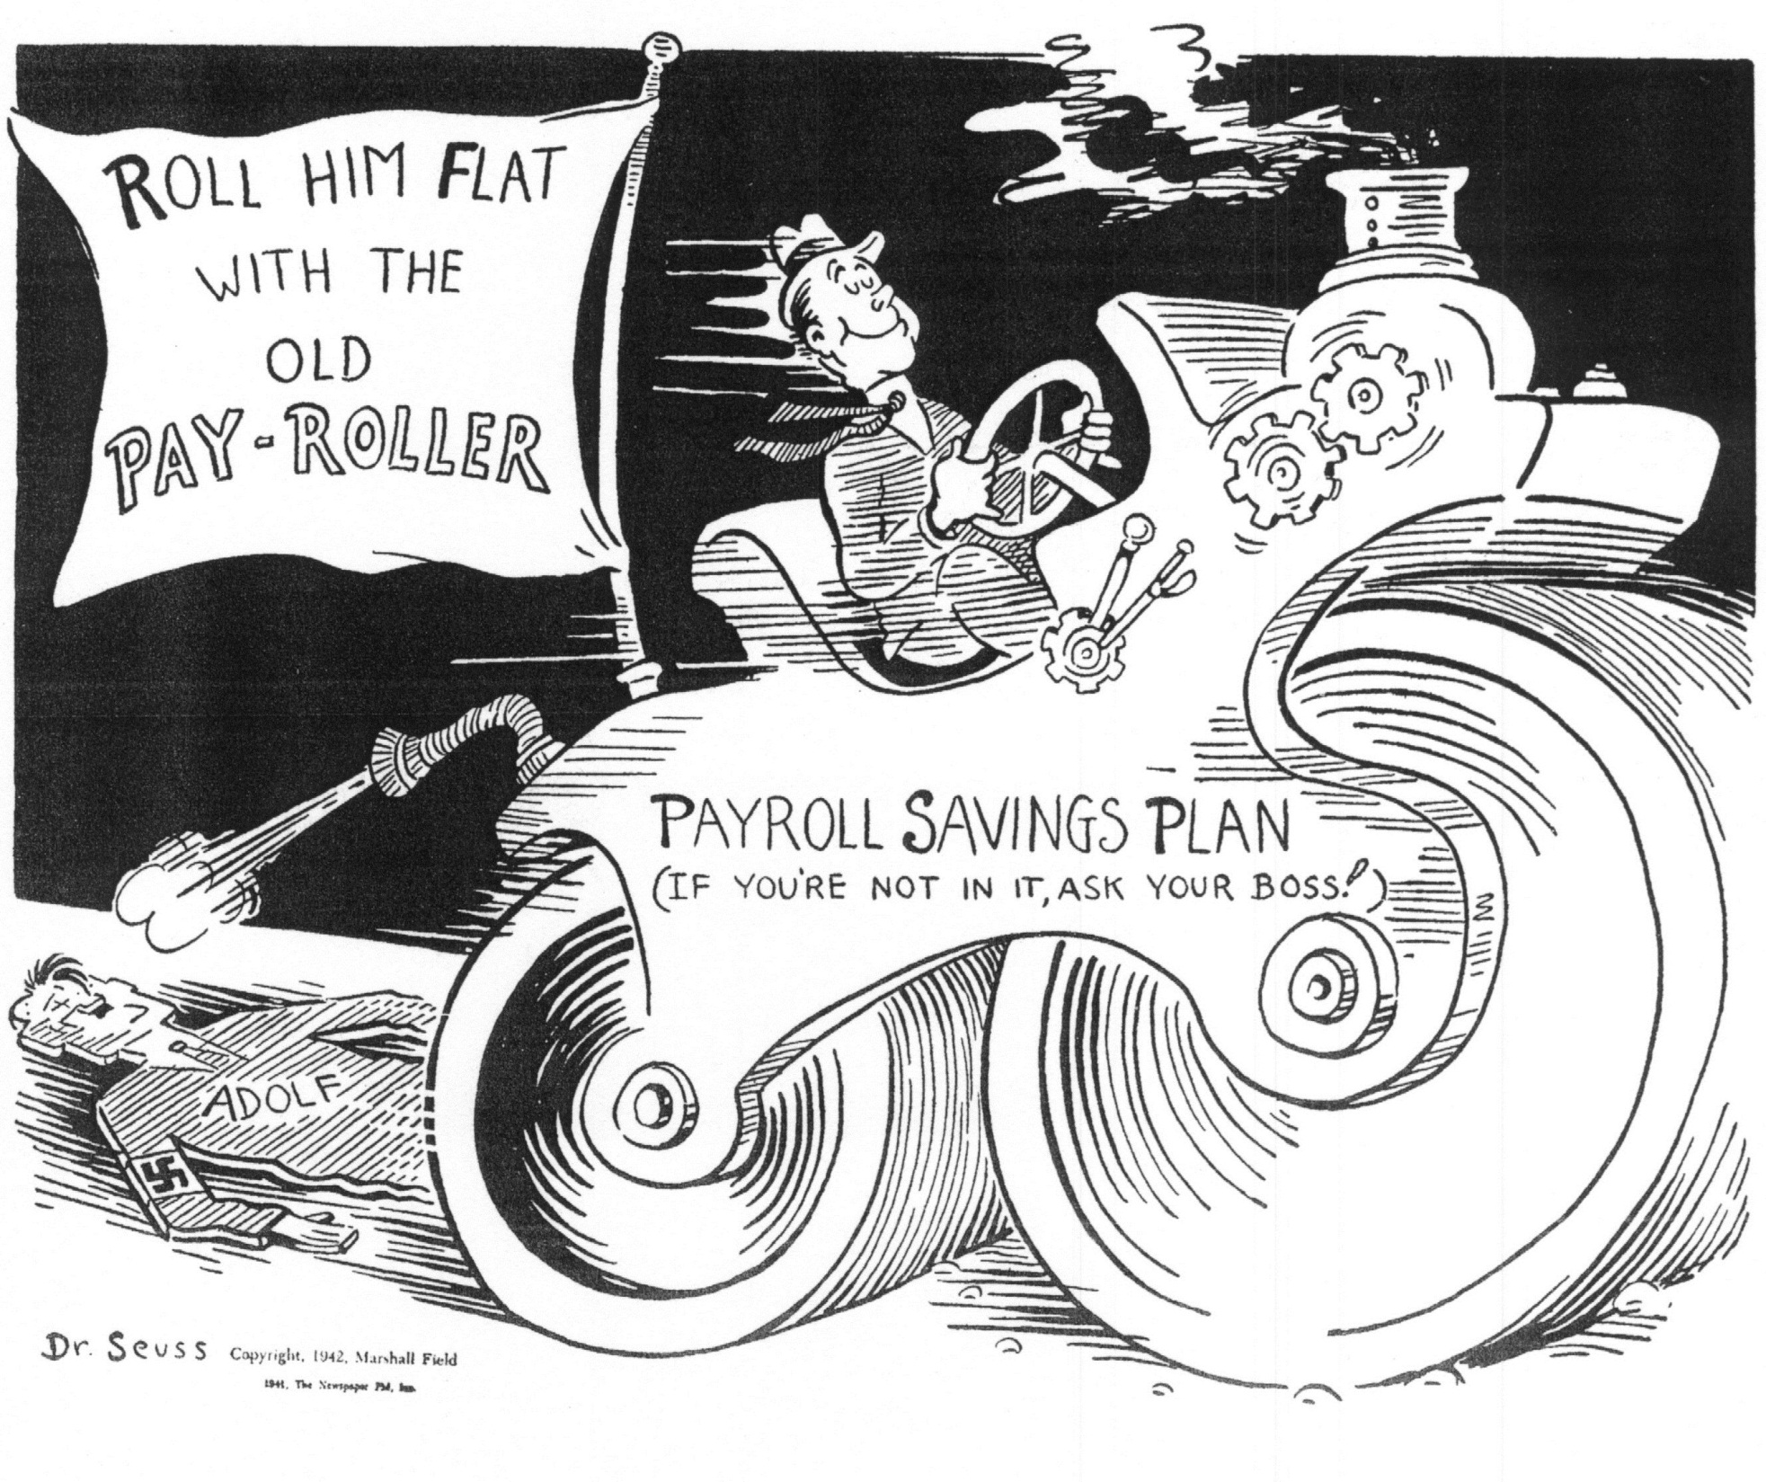

Slide 18
Year | Total Taxes (in trillions) | Taxes on Individuals (as a %) | Corporate Taxes (as a %) | Other Tax Sources (as a %)
1940 | $4.7 | 18.7% | 25.1% | 56.1%
1941 | $6.7 | 19.4% | 31.3% | 49.2%
1942 | $12.1 | 26.7% | 38.7% | 34.4%
1943 | $20.9 | 31.0% | 45.6% | 23.3%
1944 | $40.2 | 48.9% | 36.8% | 14.2%
1945 | $41.7 | 44.0% | 38.3% | 17.6%
Notes:
Data taken from the White House Office of Management and Budget -- http://www.whitehouse.gov/omb/budget/Historicals

Slide 19
 | Federal Spending |  | Defense Spending
Year | total $ | % increase | total $ | % increase | % of federal spending
1940 | 9.47 |  | 1.66 |  | 17.53%
1941 | 13.00 | 37.28% | 6.13 | 269.28% | 47.15%
1942 | 30.18 | 132.15% | 22.05 | 259.71% | 73.06%
1943 | 63.57 | 110.64% | 43.98 | 99.46% | 69.18%
1944 | 72.62 | 14.24% | 62.95 | 43.13% | 86.68%
1945 | 72.11 | -0.70% | 64.53 | 2.51% | 89.49%

Slide 20
Effects of the War on the Economy
Population shifts
Workers moved to West to defense plants
End of the Depression
War put people to work and increased incomes
Scientific innovation
Military technology: atomic bomb, DDT, bazookas, radar
Expanded Education
1944 GI Bill paid for soldiers to have education and home mortgages

