Slide 1
UNITED STATES HISTORY
Rosie the Riveter and Double-V [10.03]
Dr. King-Owen

Slide 2
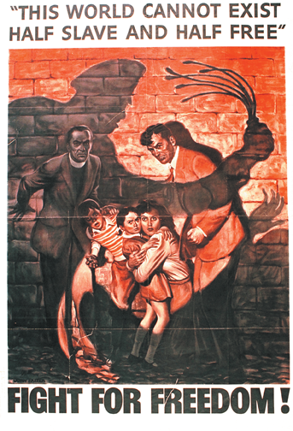
If it is wrong for Nazis to enslave and mistreat people, then why is it acceptable for America to have Jim Crow laws?

Slide 3
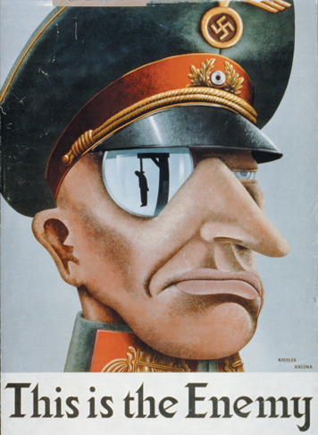
What does the image reflected in his sunglasses remind you of in American history?
Why is it wrong for Nazis to execute others on the basis of race but it is fine to lynch African Americans in the United States?

Slide 4
Discrimination
1941: 1 out of 5 African-American potential workers was jobless
In 1941, FDR outlawed discrimination in defense jobs
Caused a 2nd Great Migration to North and West for defense jobs
1942 CORE (Congress of Racial Equality) was founded
Worked to end NORTHERN urban segregation

Slide 5
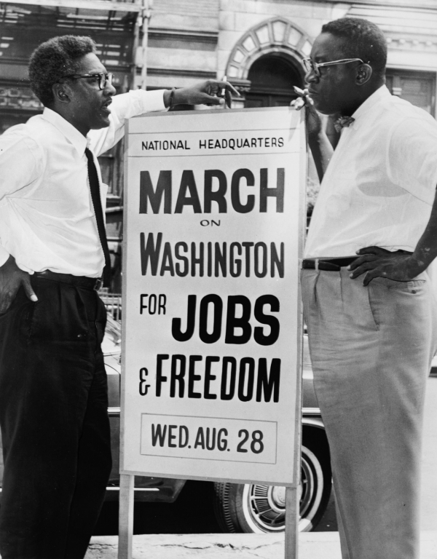

Slide 6
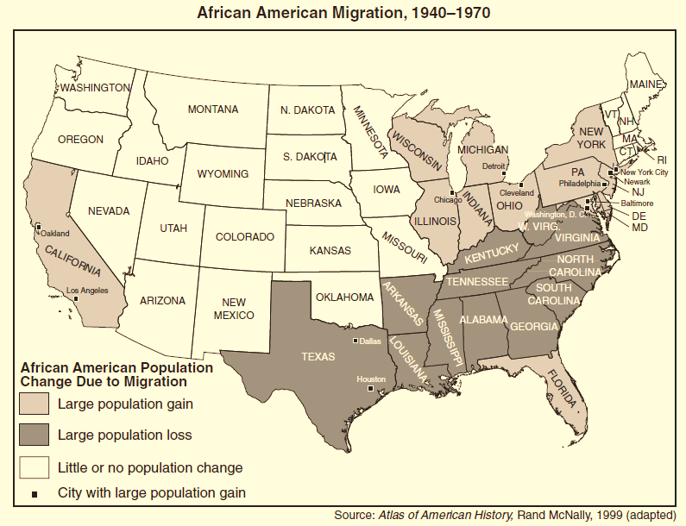

Slide 7
Black Soldiers
Served in military in segregated units until 1948
“Here lies a black man killed fighting a yellow man for the protection of a white man.”
African-American’s instructions for his tombstone on receiving his draft notice

Slide 8
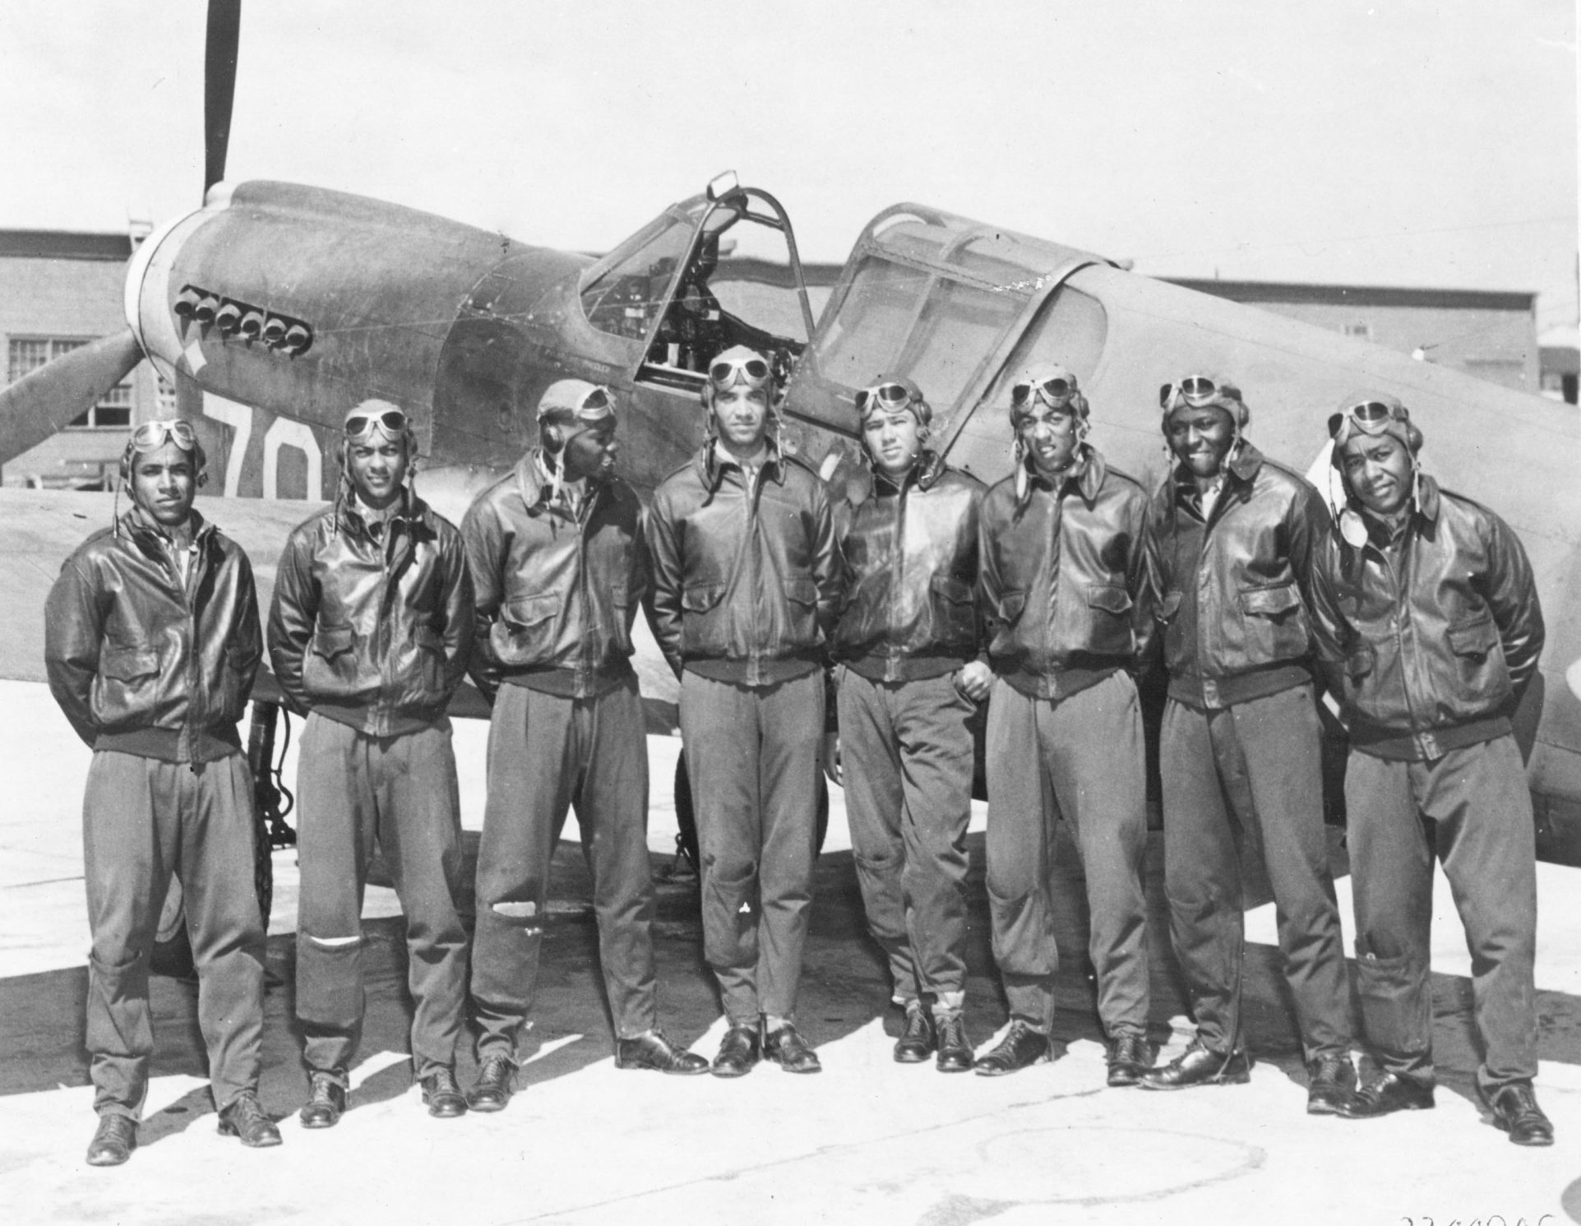

Slide 9
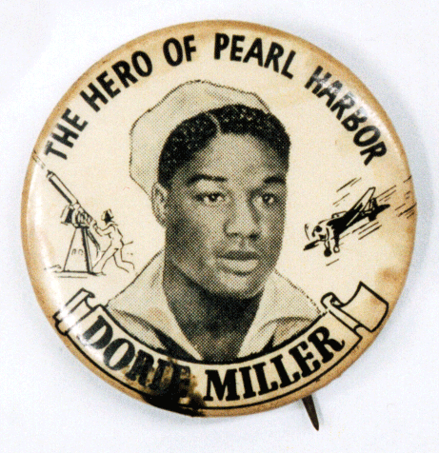
Double-V Campaign
While blacks fight Hitler, they also fight for civil rights
Victory over evil abroad AND over racism at home

Slide 10
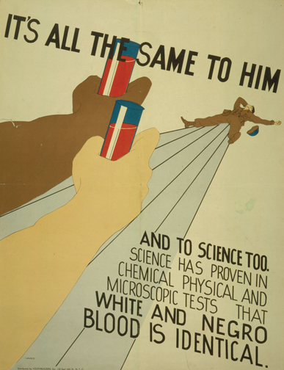
During World War II, Red Cross blood banks separated blood from black and white Americans—one illustration of the persistence of racial segregation. This 1943 poster by the NAACP points out that the concept of “Negro” and “white” blood has no scientific basis.

Slide 11
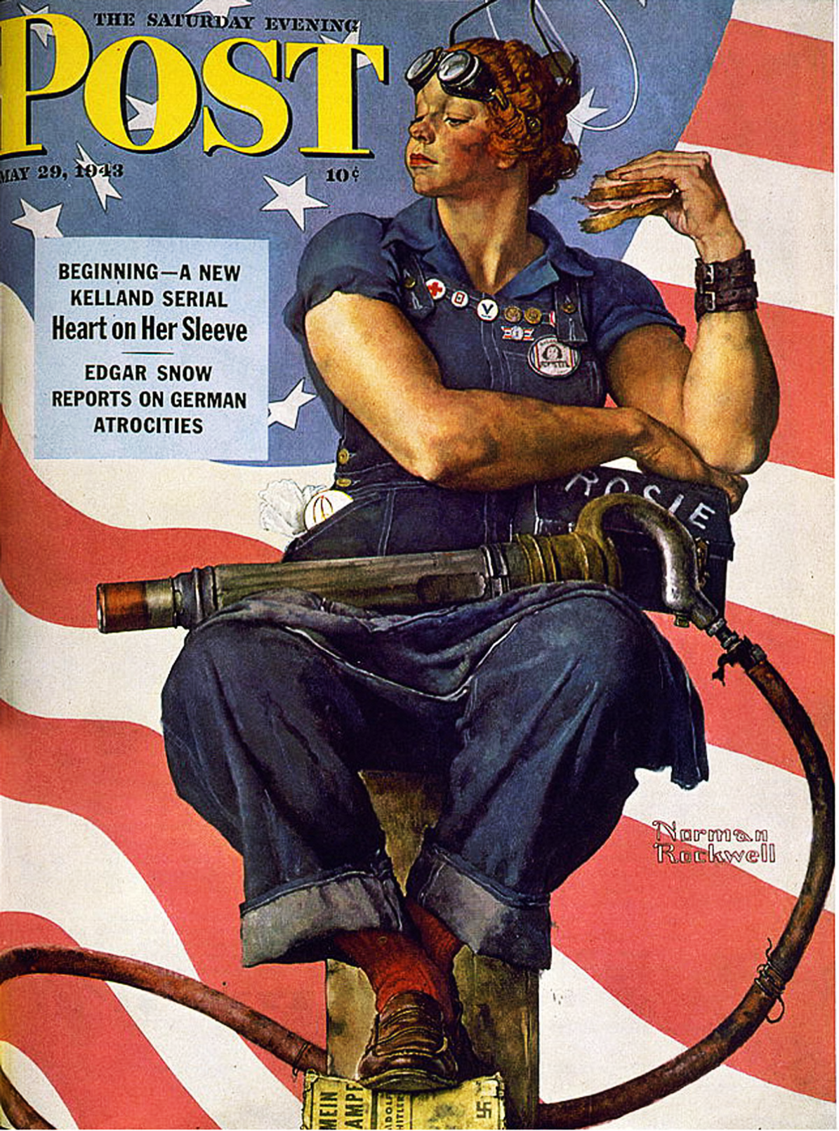
Can you tell who the subject of the painting is?

Slide 12
Can you tell now?

Slide 13
Here’s a little more:

Slide 14
Can you tell now?

Slide 15
Whoa! Look at them guns! Can you tell now?

Slide 16
Is the suspense killing you at this point?

Slide 17
It’s ROSIE THE RIVETER!
Why is she SOOOO masculine?

Slide 18
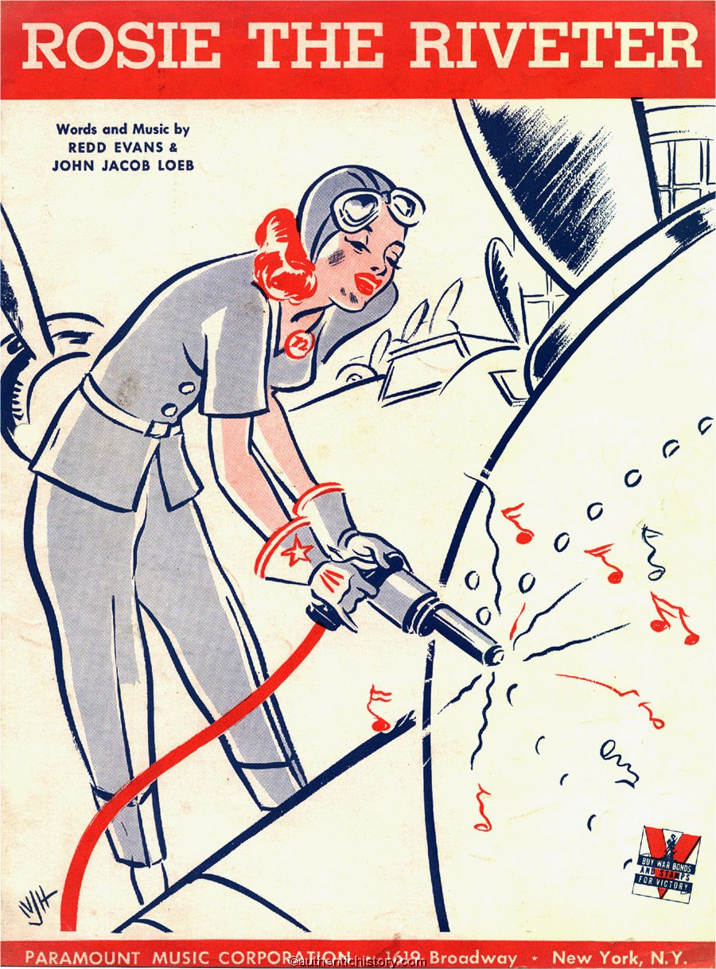
Rosie The Riveter (1942)
While other girls attend their fav'rite
cocktail bar Sipping dry Martinis, munching caviar There's a girl who's really putting them to shame Rosie is her name
All the day long whether rain or shine She's a part of the assembly line She's making histo'ry working for victory, Rosie Brrr the riveter.
Keeps a sharp lookout for sabotage Sitting up there on the fuselage That little frail can do More than a male can do, Rosie Brrr the riveter
Rosie’s got a boyfriend Charlies
Charlie, he’s a marine
Rosie, is protecting Charlie
Working overtime on the riveting machine.
They gave her a production "E" She was a proud as a girl could be, There's something true about Red, white and blue about Rosie, Brrr the riveter.
Ev'ry one stops to admire the scene Rosie at work on the B-Nineteen She's never twittery nervous or jittery, Rosie Brrr the riveter.
What if she's smeared full of oil and grease Doing her bit for the old Lend-lease She keeps the gang around They love to hang around, Rosie Brrr the riveter. Rosie buys a lot of war bonds That girl really has sense Wishes she could purchase more bonds Putting all her cash into national defense. Senator Jones, who is "in the know" Shouted these words on the radio, Berlin will hear about, Moscow will cheer about Rosie, Brrr the riveter.
Notes:
A production E was an Army-Navy excellence in service production pin (usually in sterling silver).

Slide 19
Women in the Economy
Women also took war-time jobs:
Paycheck = independence
Problems for women in the workplace:
Lack of childcare
Discrimination from men
Jobs were temporary

Slide 20
Working Women
6 million women worked during WW2
Fired once men came home from the war

Slide 21
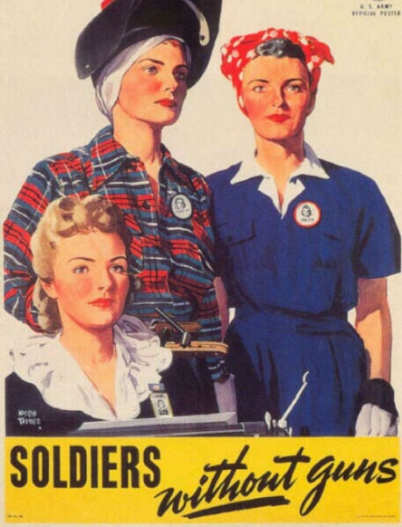
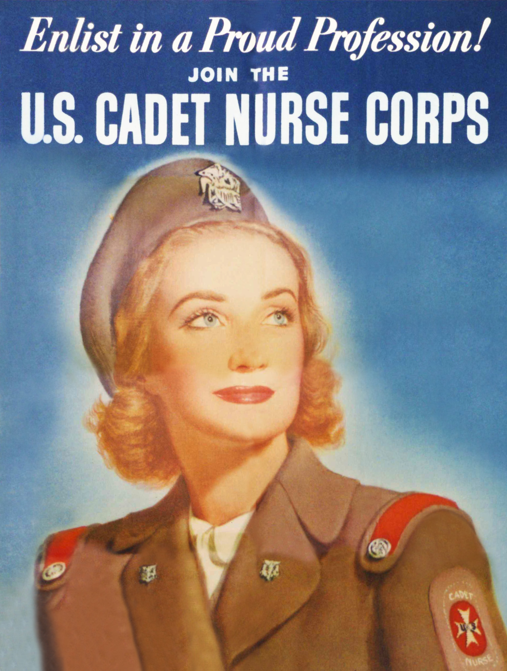

Slide 22
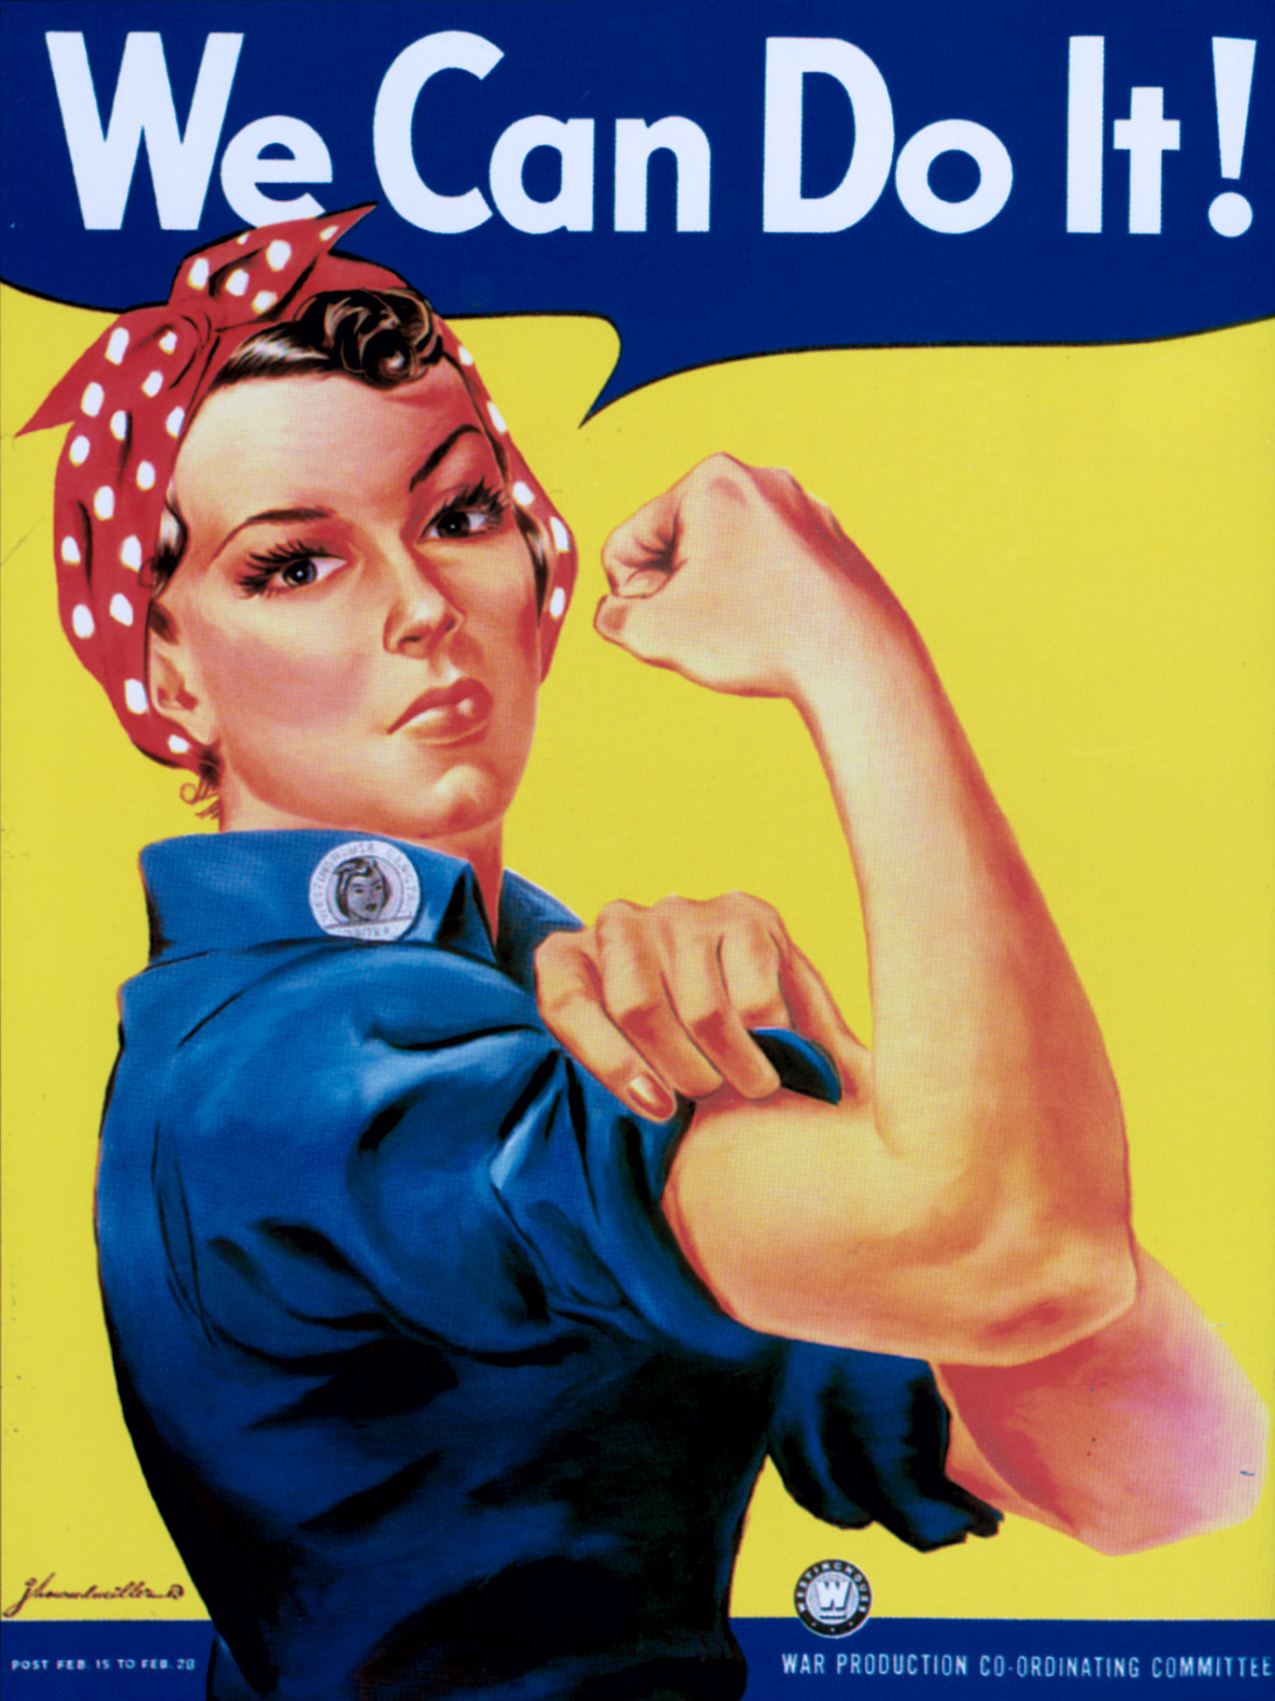
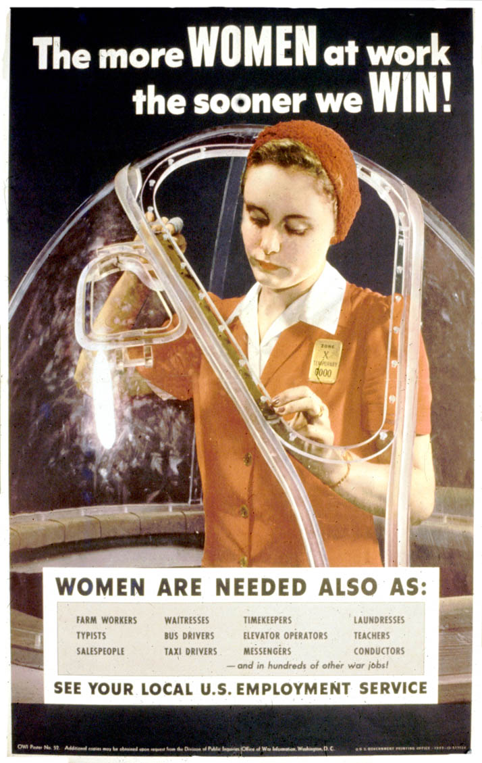

Slide 23
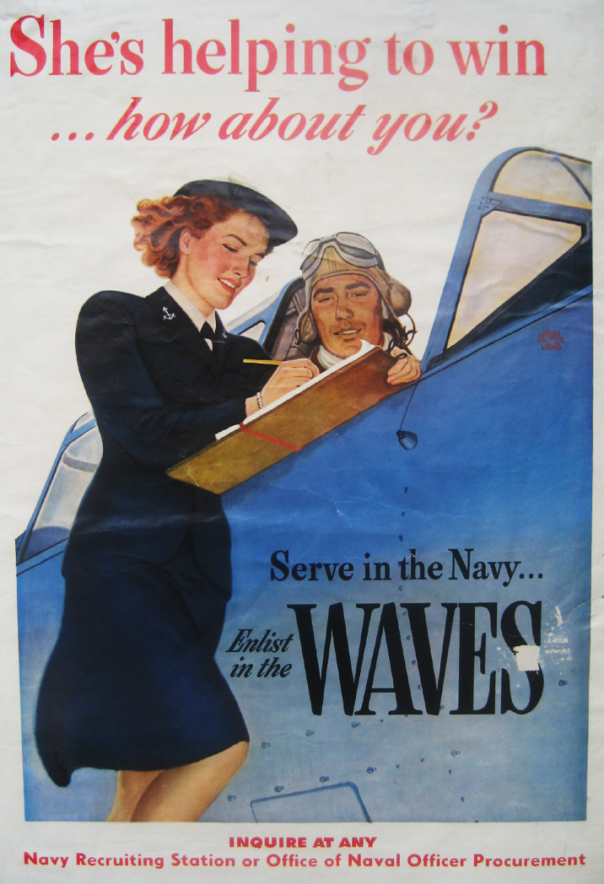
Women in the Military
Women could be part of the army and navy in the U.S.:
WAVES: served in the navy (but not in combat)
WACs: served in the army (but not in combat)

