Slide 1
United States History
Origins of the Cold War
[11.01]
Dr. King-Owen

Slide 2
Containment and the Marshall Plan
1947 – U.S. resolves to help Greece fight communists with $400 million
“Truman Doctrine” – U.S. will help other countries fight communists
Based on belief that communism will always expand
Echoed in Winston Churchill’s “Iron Curtain” Speech (1946)
1947 - Marshall Plan - $17 billion to rebuild Europe
Assumes that communists prey on weak economies

Slide 3
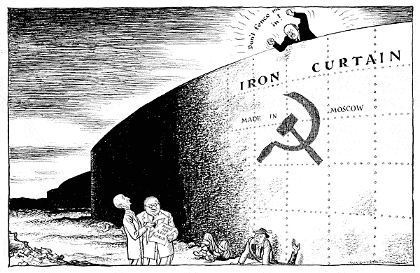

Slide 4
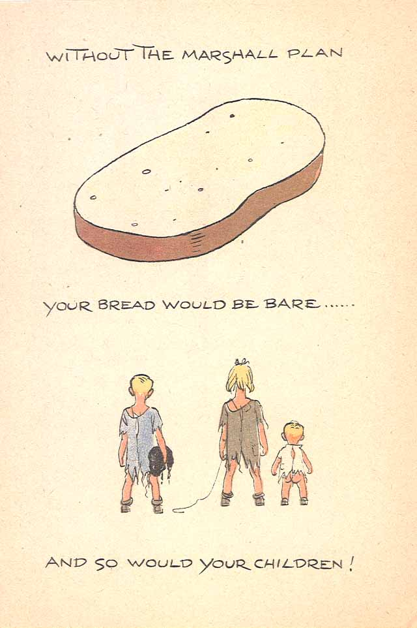
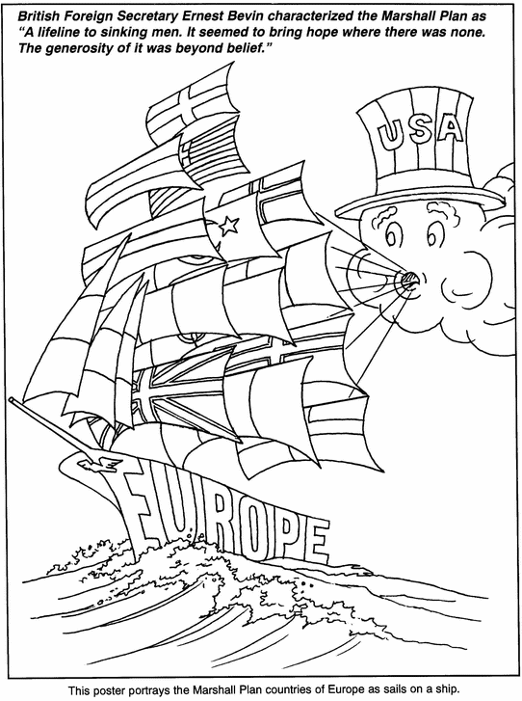

Slide 5
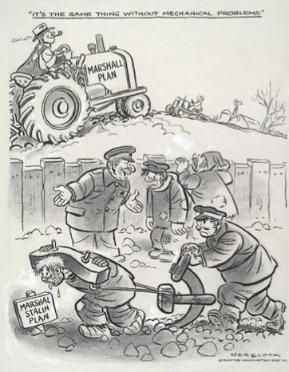
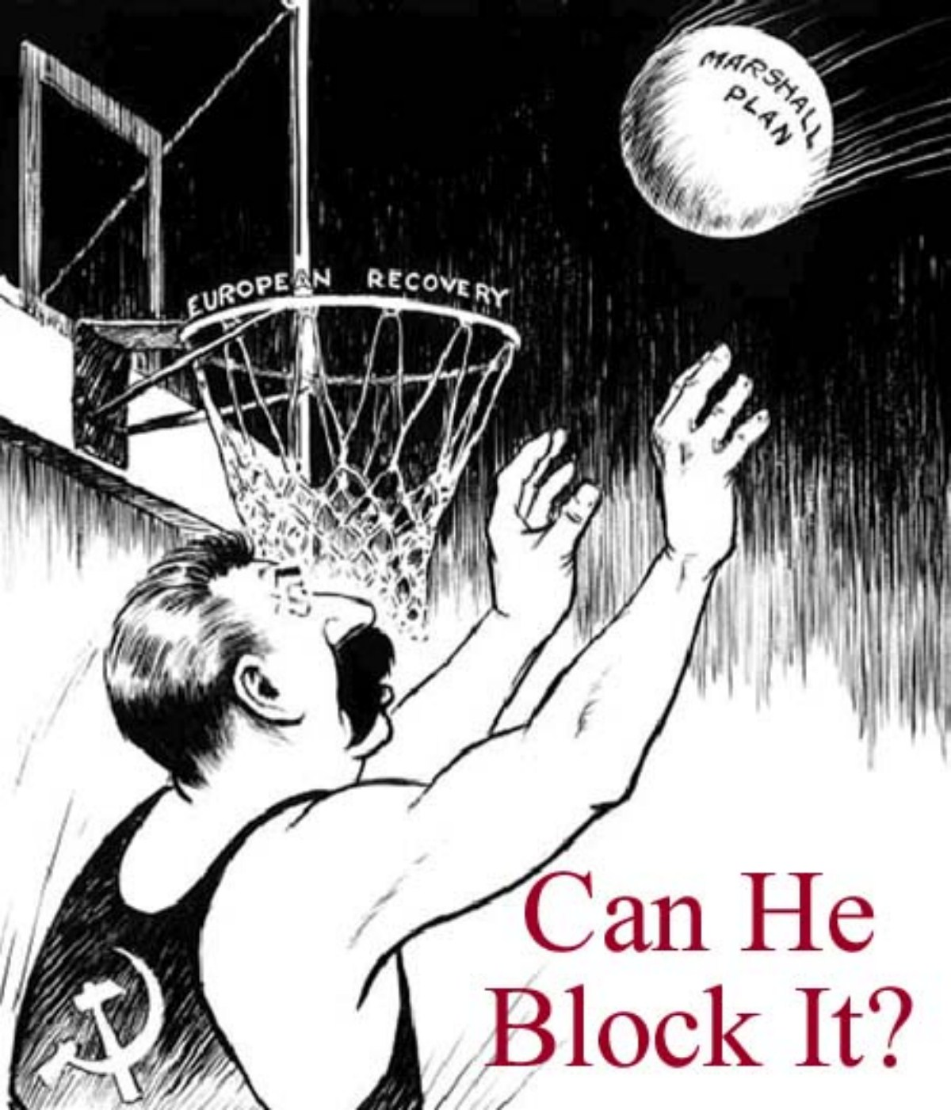

Slide 6
Getting Hot: Berlin and NATO
1948 – Soviets closed off access to Berlin
U.S. airlifted supplies in “Operation Vittles” for 15 months to feed West Berlin residents (cost: $500 million)
NATO – 1949
US, Canada, and Western Europe agree to defend each other from communist attack
There hadn’t been a US permanent alliance since 1778
Soviets formed their own alliance in response – Warsaw Pact

Slide 7
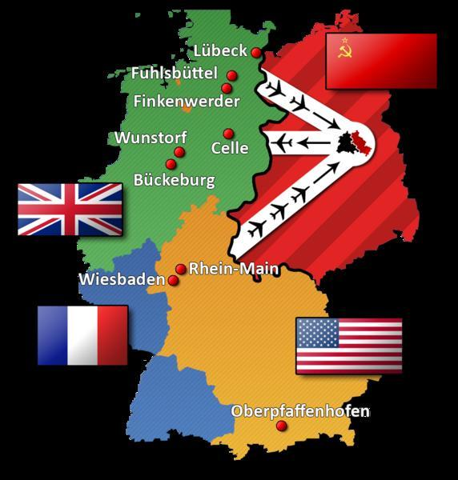
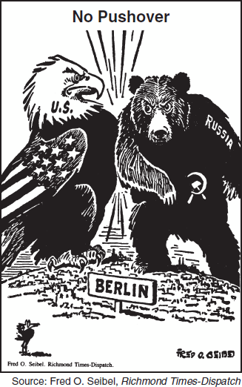

Slide 8
