Slide 1
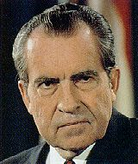
UNITED STATES HISTORY
Rise of Richard Nixon
Dr. King-Owen
[13.01]

Slide 2
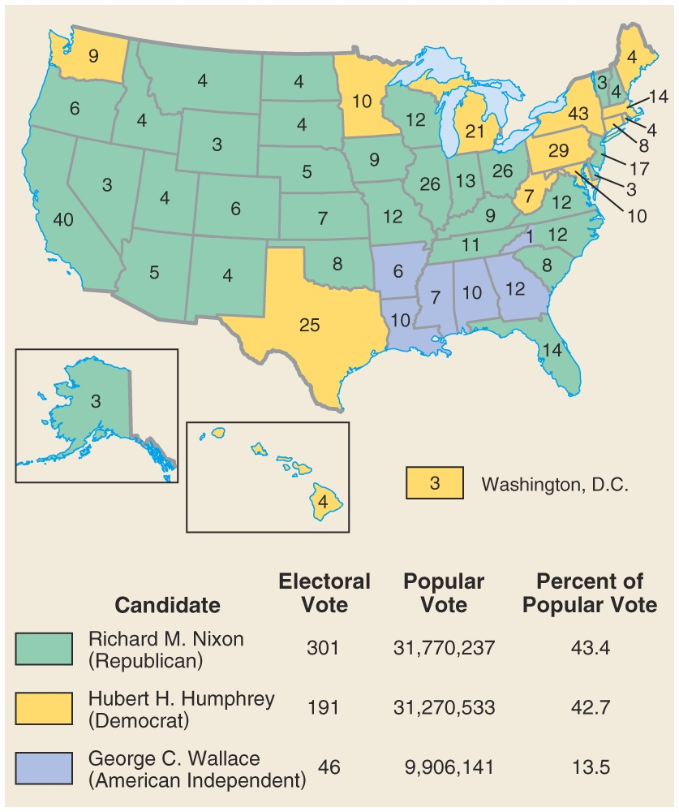
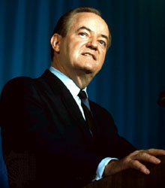
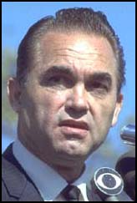
1968

Slide 3
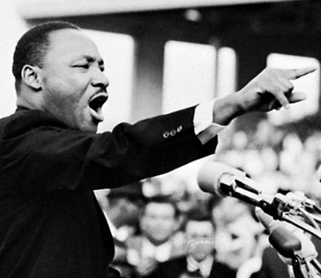
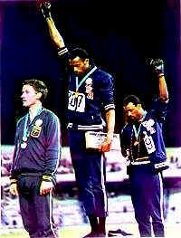
What went wrong in 1968?
LBJ and the Vietnam War disaster
Assassinations of Martin Luther King, Jr. and Robert F. Kennedy
Riots at the Democratic National Convention in Chicago
Public protests by “long-haired hippies” against the war
Black Power movement threatens violence

Slide 4
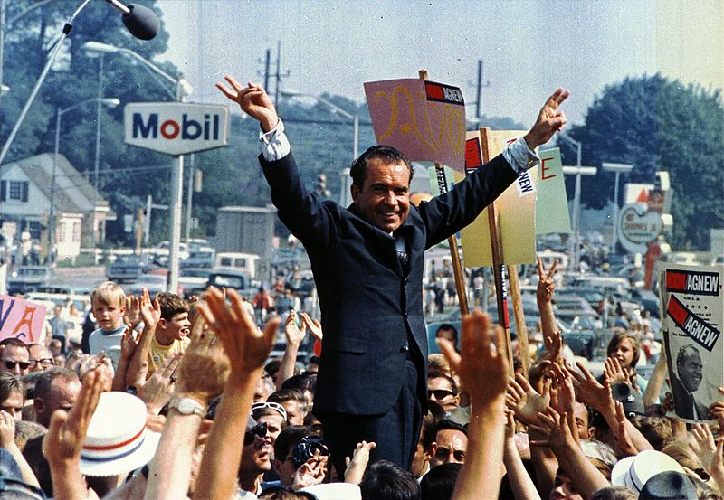

Slide 5
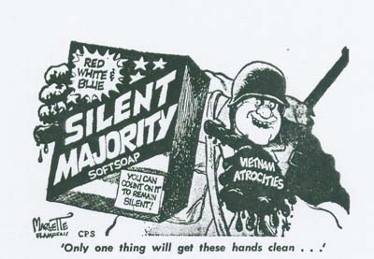
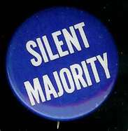
Silent Majority
Nixon appealed to
Anti-integration white southerners
Nixon opposed busing
“law and order” voters
Anti-Vietnam supporters
Pledged to end the draft

Slide 6
The Age of the Silent Majority
Estimates of Percent of Eligible Voters by Age Group, 1968
AGE GROUP | PERCENT VOTING
18-20 | 33%
21-24 | 51%
25-29 | 60%
30-64 | 72%
65 and up | 66%

Slide 7
The Wealth of the Silent Majority
The Income of Voters and Effect on Election, 1968
AGE GROUP | % of the Total Vote
Under $3,000 | 9%
$3,000-$5,000 | 13%
$5,000-$15,000 | 66%
$15,000 or more | 12%

Slide 8
The Race of the Silent Majority
Percentage of Eligible Voters and Total Votes by Race, 1968
RACE | % of Eligible Voters who Voted | % of the Total Vote
White | 69% | 91%
Non-White | 56% | 9%

Slide 9
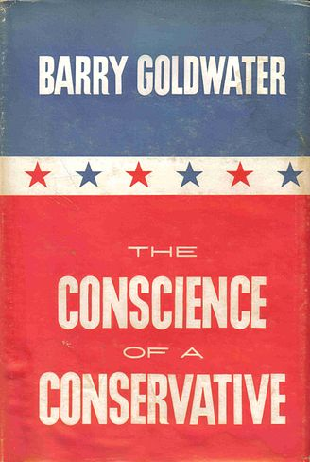
Conservatives
Barry Goldwater’s 1960 The Conscience of a Conservative attacked the liberal New Deal state
BIG IDEA: a big government cannot solve social and economic problems as well as individuals working privately can

Slide 10
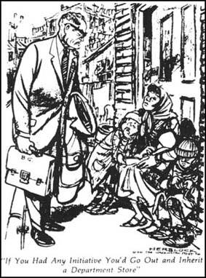
Conservatives
Conservatives argued that:
Every time the federal government tried to solve a problem, it only made it worse
Traditional values best protected society

