Slide 1
United States History
Quagmire
Dr. King-Owen
[12.04]

Slide 2
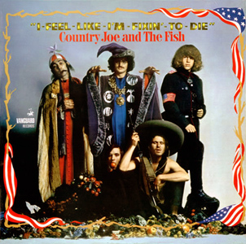
Yeah, come on all of you, big strong men, Uncle Sam needs your help again. He's got himself in a terrible jam Way down yonder in Vietnam So put down your books and pick up a gun, We're gonna have a whole lotta fun. And it's one, two, three, What are we fighting for? Don't ask me, I don't give a damn, Next stop is Vietnam; And it's five, six, seven, Open up the pearly gates, Well there ain't no time to wonder why, Whoopee! we're all gonna die.

Slide 3
Escalation
Operation Rolling Thunder, 1965
U.S. increased troops in Vietnam
Vietminh (North V. communists) and Vietcong (South V. communists) were hard to destroy
Had network of tunnels
People lived in jungles, not cities
U.S. dropped napalm (jellied gasoline) and Agent Orange to destroy the jungle

Slide 4
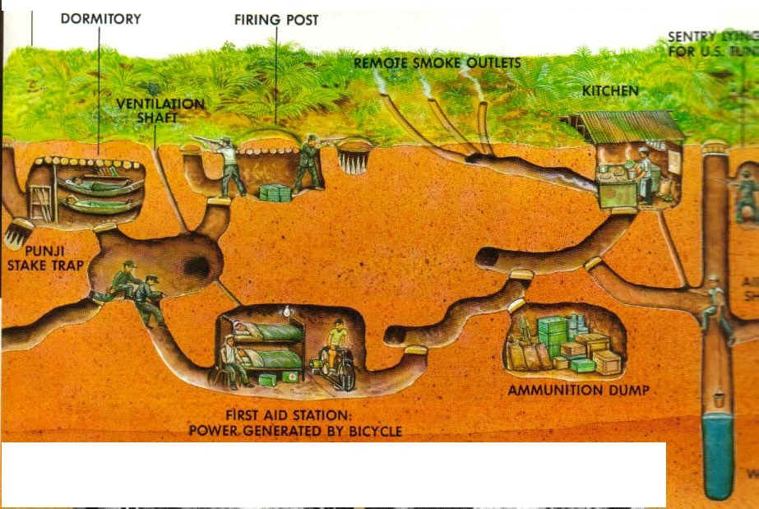

Slide 5
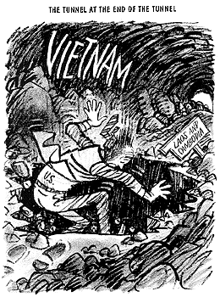
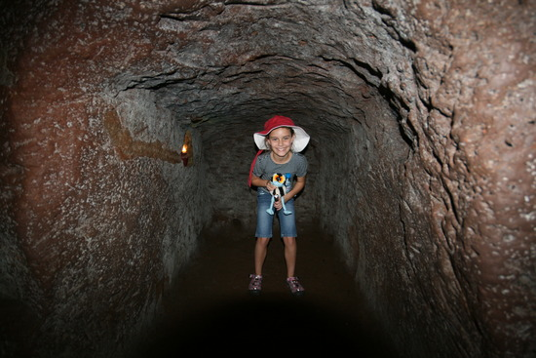

Slide 6
Credibility Gap
U.S. saw the war on television – and it did not look like the U.S. was winning
Pres. Johnson refused to give up and lied about U.S. success in the war
1968, My Lai Massacre – Americans murdered 500 civilians (women, children, elderly)
Americans resisted the draft – educated and wealthy could escape it
Black Americans in Vietnam were 20% of deaths but only 10% of U.S. population

Slide 7
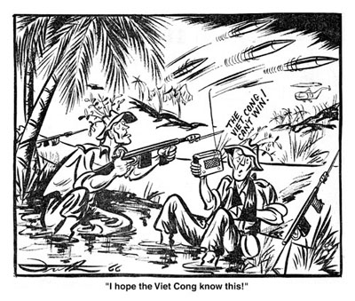

Slide 8
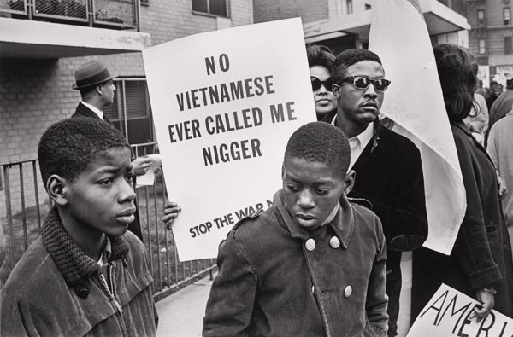

Slide 9
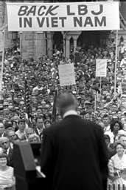
Protest
Students for a Democratic Society
College students held anti-war demonstrations
Students often burned draft cards
Hawks v. Doves
Hawks wanted to win
the war with more troops
Doves wanted to withdraw
from Vietnam

Slide 10
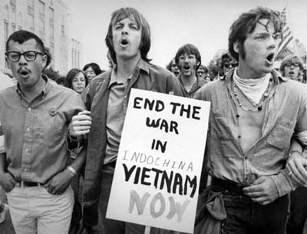
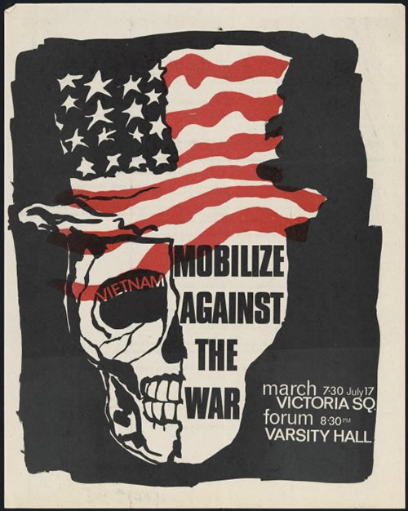
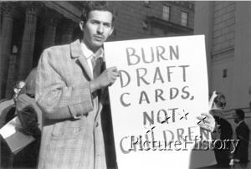

Slide 11
Hey, hey, LBJ
How many kids did you kill today?

Slide 12
Failure
Tet Offensive, 1968
N. Vietnamese attack the U.S. and destroy the idea that America was winning
Pres. Johnson does not run again
Kent State, 1970 -Ohio National Guard kills 4 protesting students
The Pentagon Papers, 1971 - Shows the government was lying about Vietnam
1973 – U.S. leaves Vietnam
1975 – Communists take South Vietnam

Slide 13
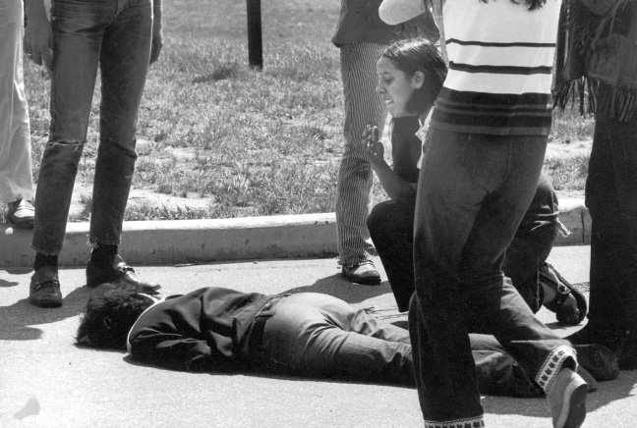

Slide 14
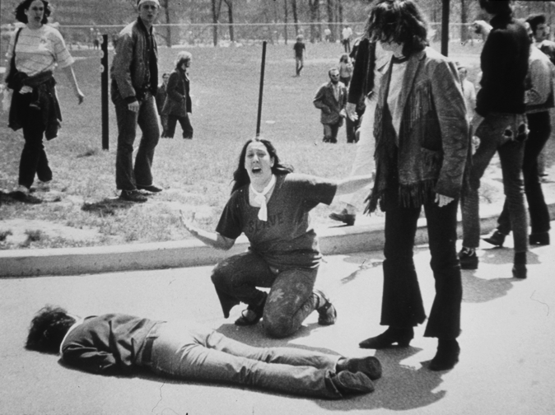

Slide 15
Vietnam: By the Numbers
# of Soldiers: 3.4 million men; 6,421 women
Killed in Battle: 47,415 + 10,785 other
Draft evasions: 600,000
Cost of War: $173 billion
Tons of bombs dropped on North V – 822,054
% of Americans who said Vietnam was a mistake in 1968: 55%
# of Vietnamese dead – 2 million

