Slide 1
United States History
Nixon’s Foreign Policy
Dr. King-Owen
[13.04]

Slide 2
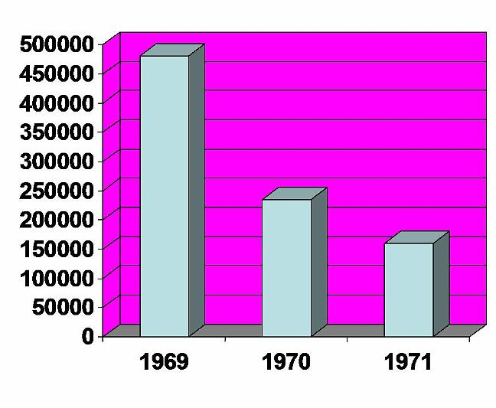
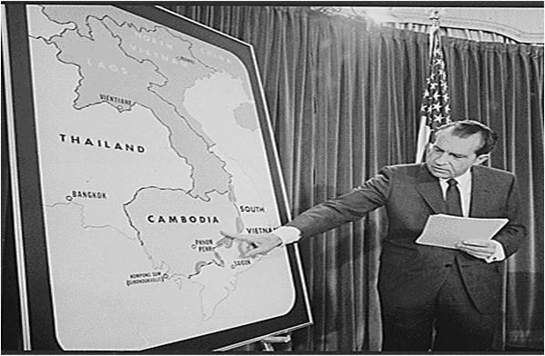
Vietnam
Vietnamization
“Vietnamization” = making South Vietnam fight the war
U.S. troops left in 1973
Bombing of Cambodia, 1970
Nixon ordered (secretly) bombing of Cambodia to attack communists

Slide 3
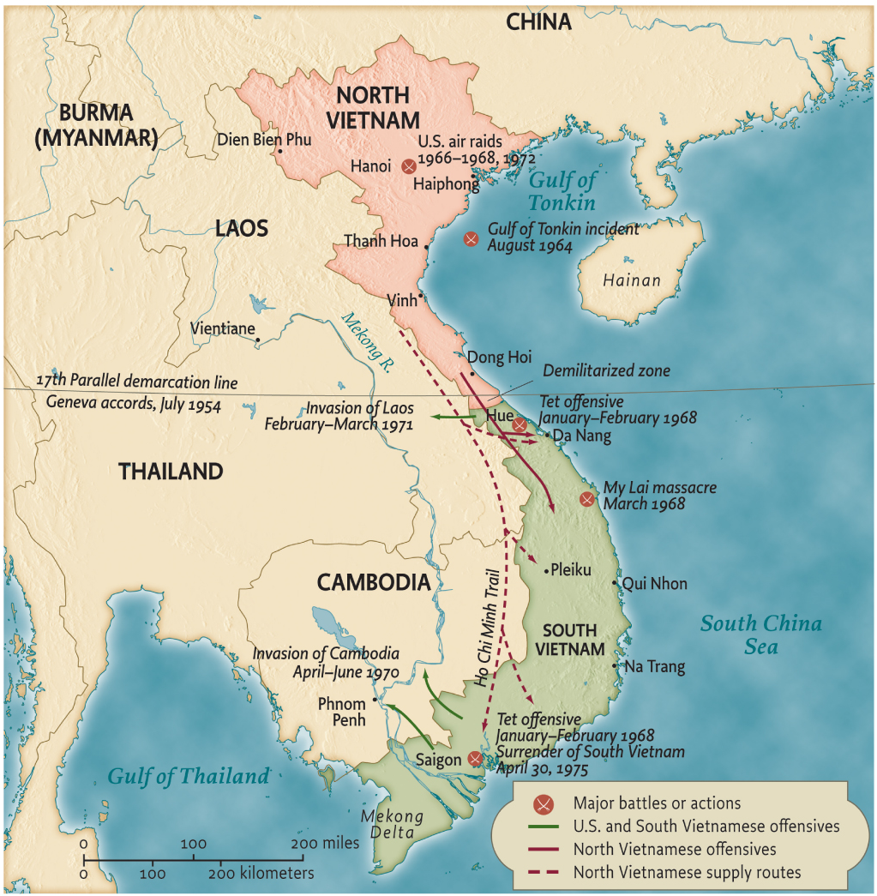
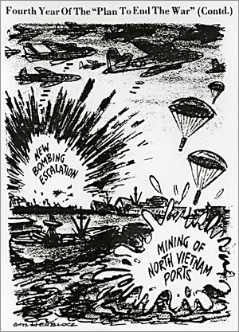

Slide 4
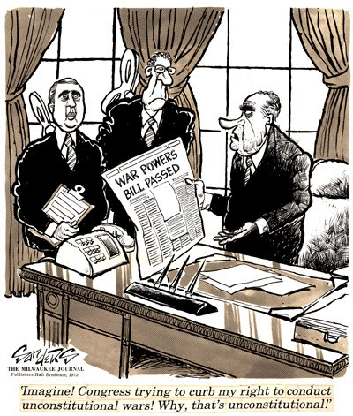
Aftermath
War Powers Act, 1973
President has 60 days to ask Congress for permission for war after he sends troops
No president has supported the act
26th Amendment, 1971
Granted 18 year olds the right to vote

Slide 5
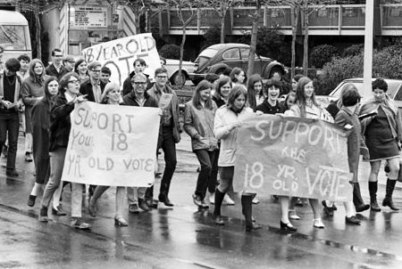
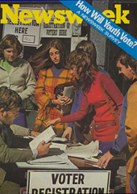
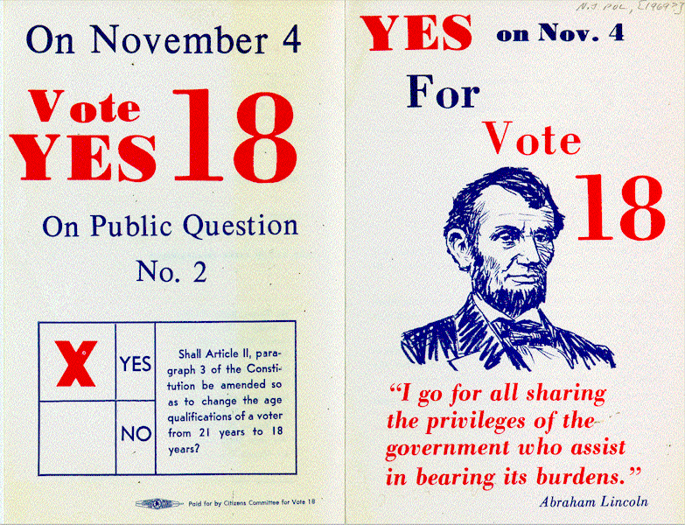
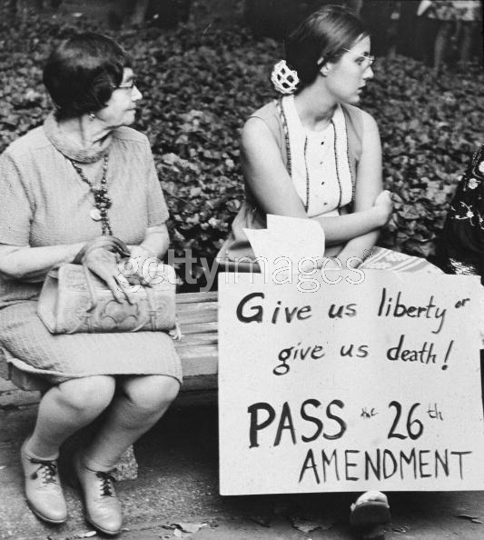

Slide 6
Detente
Realpolitik
Nixon thought that “reality,” not “ideas,” should determine foreign policy
Nixon opened relations with Communist China in 1971-1972
U.S. signed the SALT I treaty to limit the arms race
Détente – Nixon’s policies led to a “thaw” in the Cold War, a relaxing of tensions known as “détente”

Slide 7
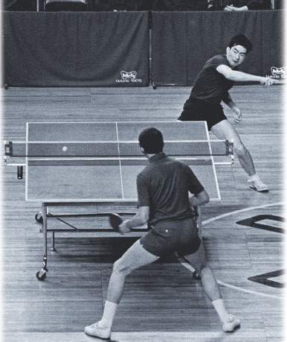
In 1971, China invited American athletes to play table tennis as a sign of China’s willingness to discuss relations with America.

Slide 8
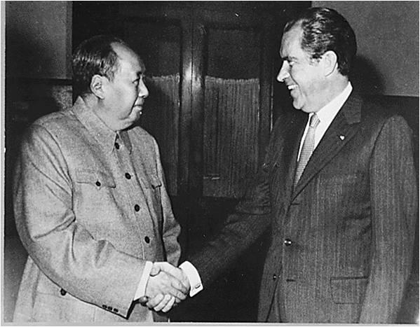

Slide 9
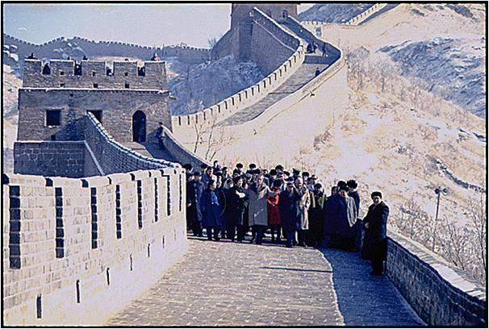

Slide 11
