Slide 1
UNITED STATES HISTORY
Environmental Armageddon
Dr. King-Owen
[13.03]

Slide 2
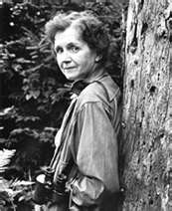
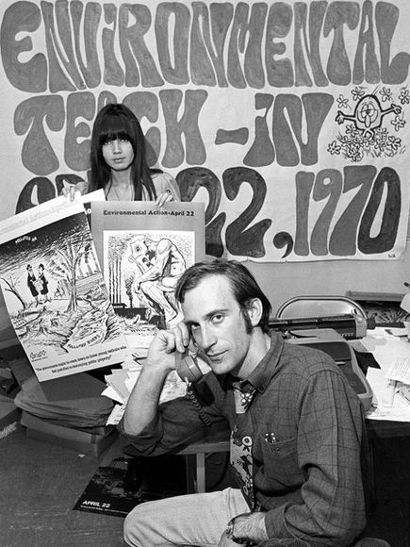
Ecological Awareness
Rachel Carson, Silent Spring
DDT, a pesticide, was shown to harm reproduction in birds
Earth Day, 1970
Started as teach-ins about the Earth
More popular than other rights movements

Slide 3
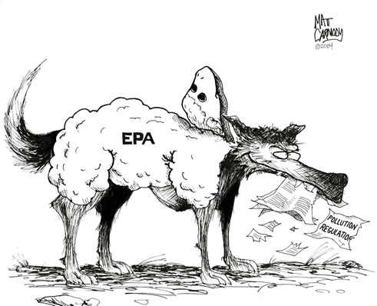
Clean Air and Water
Clean Air and Water Acts (1970-1972)
Clean up waterways; established pollution standards
Environmental Protection Agency
Enforces anti-pollution standards
Seen by some conservatives as harming business growth

Slide 4
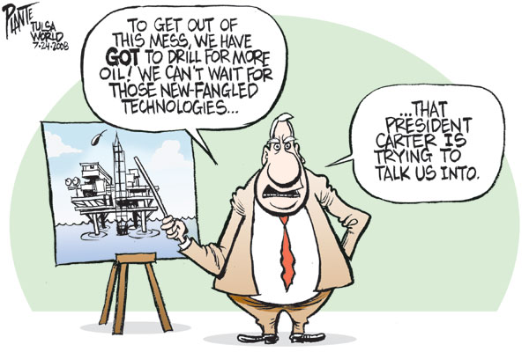
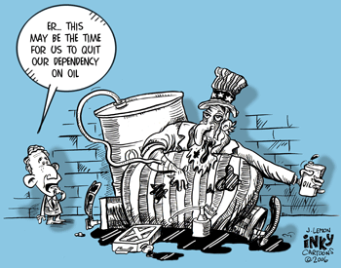
Energy Crisis
Energy Consumption
American dependence on fossil fuels increased
Cars were gas-guzzlers
Domestic production of oil declined
Energy Independence
Pressure for solar power, synthetic fuels, public transportation
Oil/gas lobby stopped these plans

Slide 5
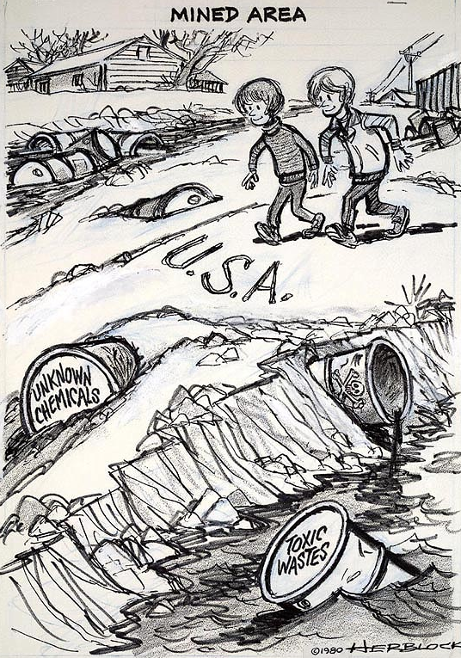
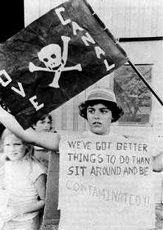
Love Canal, 1978
Love Canal, New York
21,000 tons of toxic waste buried; schools and homes built on top of it
Waste seeped into the water
High rates of illness, mental problems, miscarriages
Superfund Cleanup, 1980
Federal $$ used to clean up toxic sites

Slide 6
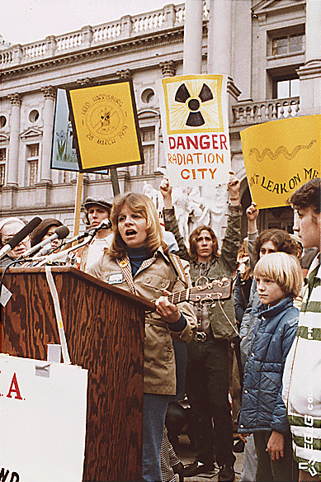
Three Mile Island
Partial nuclear meltdown in PA (1979)
Minor radiation leakage
Increased focus on nuclear power safety
Decline in building of nuclear reactors
Cleanup costs $1 billion; lasted until 1993

Slide 7
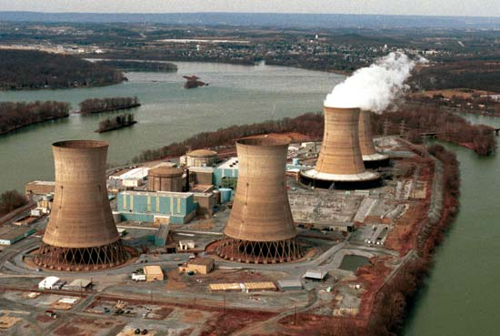
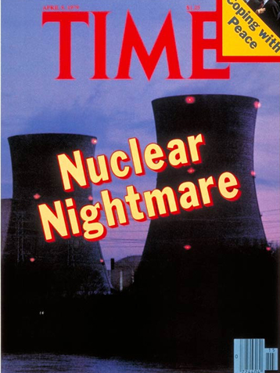
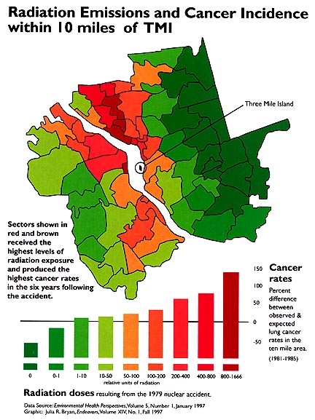

Slide 8
True or False?
T
Richard Nixon was elected in 1968 on a promise of restoring “law and order.”
Conservatives believed that the solution to problems was increasing the size of government.
The Pentagon Papers contained secret documents showing how the government had lied about Vietnam.
A peaceful demonstration at Kent State University in 1970 helped convince President Nixon to stop bombing Cambodia.
F
T
F

Slide 9
True or False?
T
A break-in at the Watergate hotel in 1972 uncovered the illegal activities of President Nixon’s re-election campaign.
The Supreme Court case of U.S. v. Nixon protected the President’s right to executive privilege.
President Nixon resigned in 1974 because the Senate found him guilty of tax evasion.
Supreme Court Chief Justice Earl Warren presided over a very conservative court.
F
F
F

Slide 10
True or False?
Many of the decisions in the Earl Warren court involved applying the 18th amendment to the states.
Conservatives accused Earl Warren of judicial activism—making law instead of merely interpreting it.
One of Nixon’s positive achievements was the creation of the Environmental Protection Agency.
The Three Mile Island nuclear power plant did not cause the public to fear nuclear power.
F
T
T
F

