Slide 1
United States History
Origins of ‘Nam
Dr. King-Owen
[12.04]

Slide 2
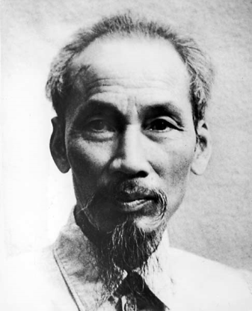
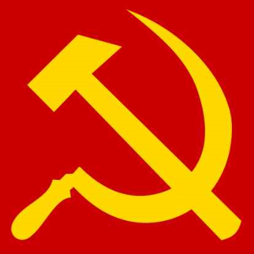
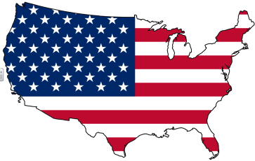
Ho Chih Minh France is ruining Vietnam!
September 2, 1945 • Comment • Like
France Liar!
September 3, 1945 • Like
Soviet Union Yo Ho Chih! We got your back comrade!
September 5, 1945 • Like
United States Ummm…we don’t like commies….!
September 5, 1945 • Like

Slide 3
France was at Dienbienphu
May 7, 1954 • Comment • Like
Ho Chih Minh likes this.
United States We paid for 80% of your war against these commies and you lost? ARRAARRHGHGH!
May 7, 1954 • Like

Slide 4
United States Domino Theory!
September 2, 1954 • Comment • Like
United States If we leave Vietnam alone, communism will spread from North to the South
September 3, 1954 • Like
Ho Chih Minh Is that why you won’t allow free elections in Vietnam? You KNOW I’ll win hehe….
September 5, 1954 • Like

Slide 5
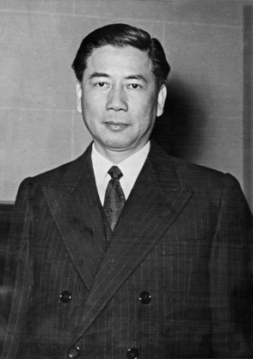
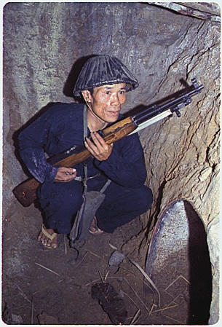
United States is in a relationship with South Vietnam
April 4, 1959• Comment • Like
Ngo Dinh Diem Thanks for helping me with all those advisors and cash ;-)
April 5, 1959 • Like
Vietcong GAG! Diem is such a trashy dictator. South Vietnamese communists are gonna get you Diem!!!!!!!!
April 6, 1959 • Like

Slide 6
Ho Chih Minh Ngo Dinh Diem is dead!
November 2, 1963 • Comment • Like
Ho Chih Minh Also, I had nothing to do with it.
November 2, 1963 • Like
United States So much for the 16,000 “advisors” we sent to Vietnam. Looks like the commies will win ☹
November 3, 1963 • Like

Slide 7
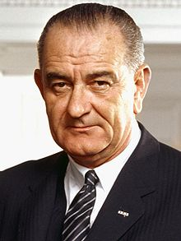
United States The Vietnamese attacked us!
TWICE!!!!!!!!! At the Gulf of Tonkin!!!!
August 4, 1964 • Comment • Like
President L. B. Johnson Let me at them commies!!!!
August 7, 1964 • Like
U.S. Congress likes this.
U.S. Congress How about a “Gulf of Tonkin” Resolution to escalate the war? That good enough for ya?
August 7, 1964 • Like

