Slide 1
United States History
The Gulf War
Dr. King-Owen
[13.04]

Slide 2
Iran-Iraq War (1980-1989)
Iraq invaded Iran in 1980
Iraqi dictator Saddam Hussein feared “radical Islam” in Iran
Iraq wanted to be the leading Arabic country
U.S. involvement
U.S. secretly (under Reagan) sold weapons to Iran
U.S. publicly supported Iraq, however
U.S. (under Reagan) backed $5 billion in loans to Iraq

Slide 4
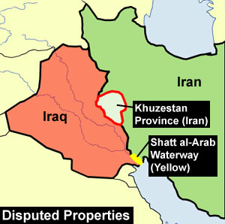

Slide 5
Kuwait, 1990
Saddam Hussein invaded Kuwait, 1990
Kuwait was a very oil-rich nation
Iraq claimed Kuwait used to be one of its territories
Claimed that Kuwait overproduced oil
United Nations used economic sanctions against Iraq
January, 1991 – Congress gave President Bush permission to free Kuwait
February, 1991 – Iraq surrendered after 100 hours of ground fighting

Slide 6
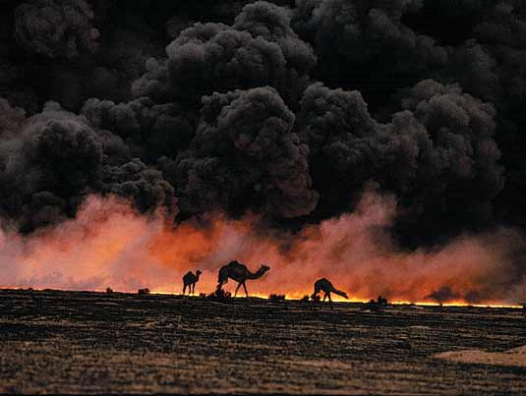

Slide 8
Oil Hunger
Outcomes of the war:
Middle Eastern Muslims resent American involvement
America accused of only being involved in Middle East because of the need for oil
Gulf War Syndrome
Affects 35% of Gulf War veterans
Federal government denied that exposure to chemicals was a cause (until 1996)

Slide 9
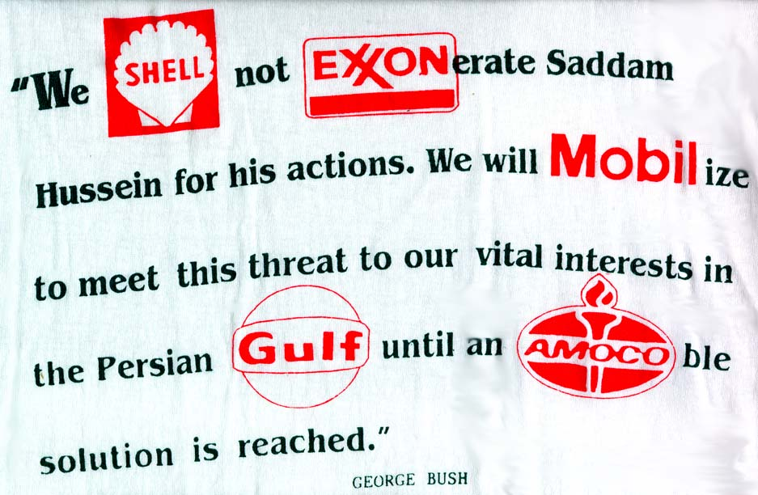

Slide 10
