Slide 1
[United States History]
[Losing Faith in Uncle Sam]
Dr. King-Owen
[13.01]

Slide 2
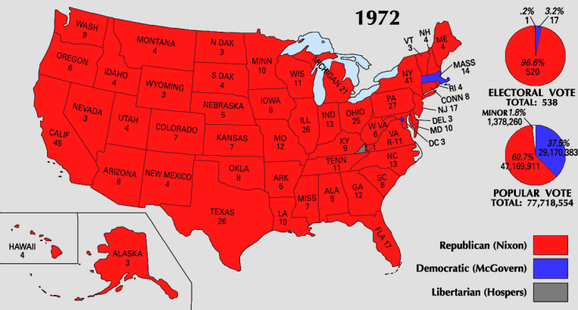
[Nixon’s Problems]
Election of 1972
Nixon won 60.7% of the popular vote
Stagflation (stagnant economy + inflation)
Deficit spending for Vietnam and the Great Society increased inflation
U.S. industry loses productivity
Rising energy costs (oil, gas)
Increasing unemployment

Slide 3
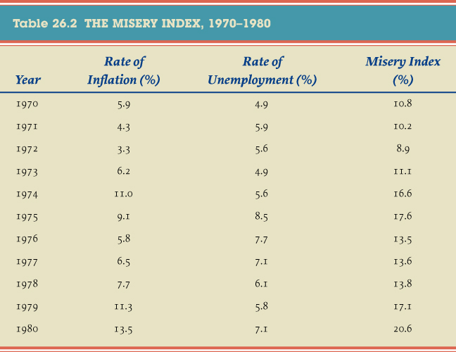
Give Me Liberty!: An American history, 3rd Edition
Copyright © 2011 W.W. Norton & Company

Slide 6
[The Watergate Tapes]
The Tapes
Investigation of Watergate uncovered a set of tapes of all presidential conversations
Citing “executive privilege” Nixon refused to hand over the tapes
U.S. v. Nixon, 1973
Supreme Court ruled that Nixon must hand over the tapes
Provided evidence (despite erasures) that Nixon was guilty; Congress prepared impeachment charges

Slide 7
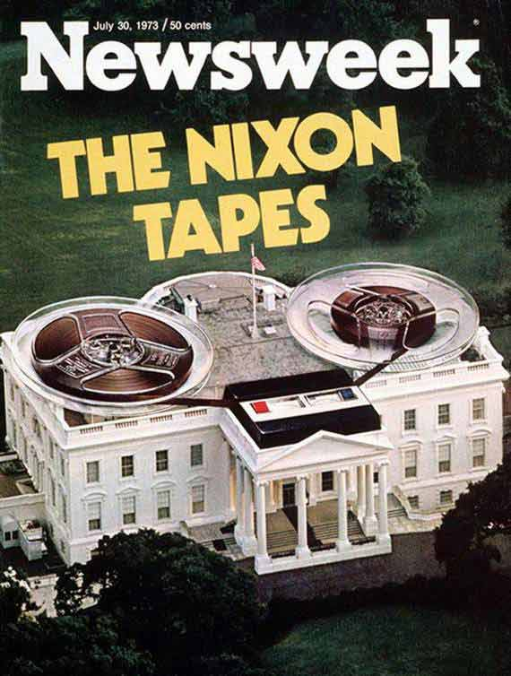
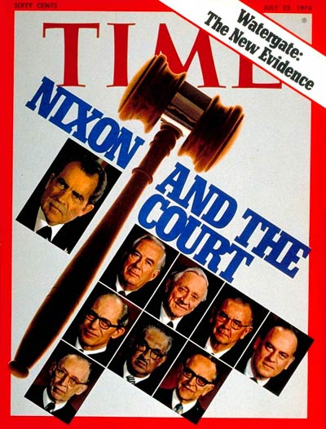

Slide 8
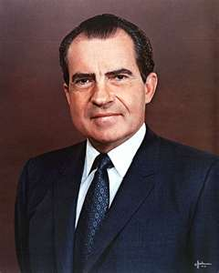
“Of course, this is a, this is a Hunt, you will-that will uncover a lot of things. You open that scab there's a hell of a lot of things and that we just feel that it would be very detrimental to have this thing go any further.”
President Richard Nixon, 1972

Slide 10
Cartoon Analysis
Cartoonists had a field day with Nixon—especially with the “tapes.”
On the back of your cartoon, explain the meaning in a few sentences.
Write your name on the front of your cartoon.

Slide 11
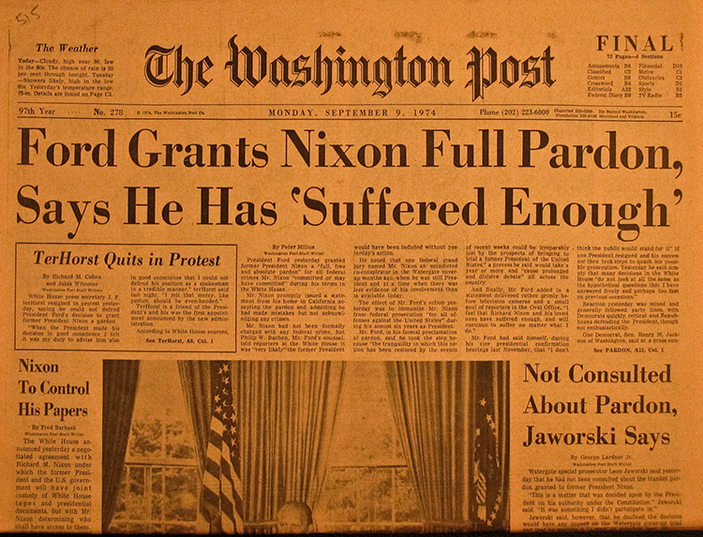
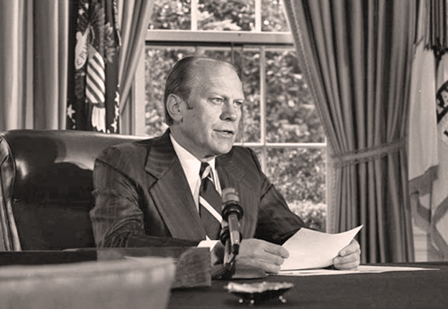
[Nixon’s Pardon]
“Long National Nightmare”
August 8, 1974 President Nixon resigned rather than face a trial before the Senate
VP Gerald Ford became President
Offered Nixon a full pardon to spare the nation more suffering

Slide 12
[The Church Committee]
Domestic Spying, 1975
Congress found that the CIA had spied on Americans and attempted assassinations of foreign leaders
FBI had opened 215,000 letters
Privacy Act of 1974
Updated FOIA (Freedom of Information Act) to protect access to records
Protects private information of citizens
Government in the Sunshine Act, 1976
Requires public meetings for most agencies

Slide 13
