Slide 1
United states history
Reaganomics * Dr. King-Owen
[13.03]

Slide 2
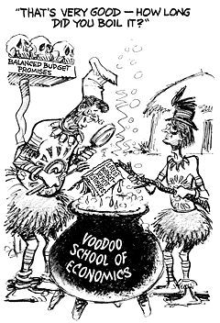
Supply-Side Economics
Cutting taxes for wealthy stimulates growth
Extra $$ would be invested
Production would increase
Workers would be hired
Stagflation was under control by 1983

Slide 4
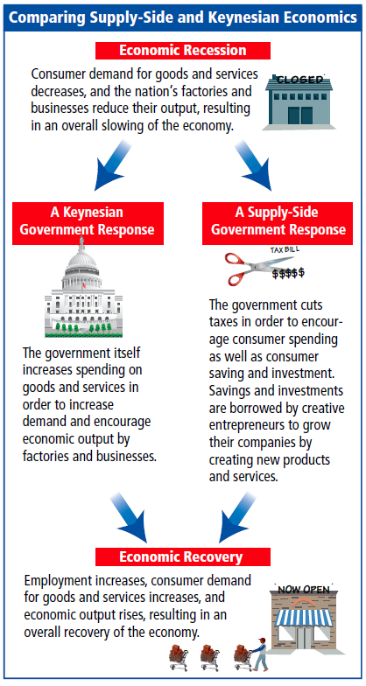
What are the consequences of using government spending to help the economy?
What are the consequences of using government tax cuts to help the economy?

Slide 5
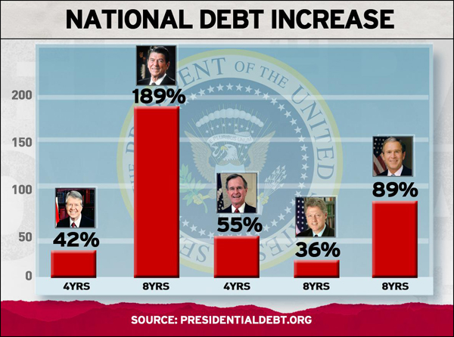
Deficit Spending
U.S. was a debtor nation by 1985
Military spending increased 40%
Refused to raise taxes

Slide 6
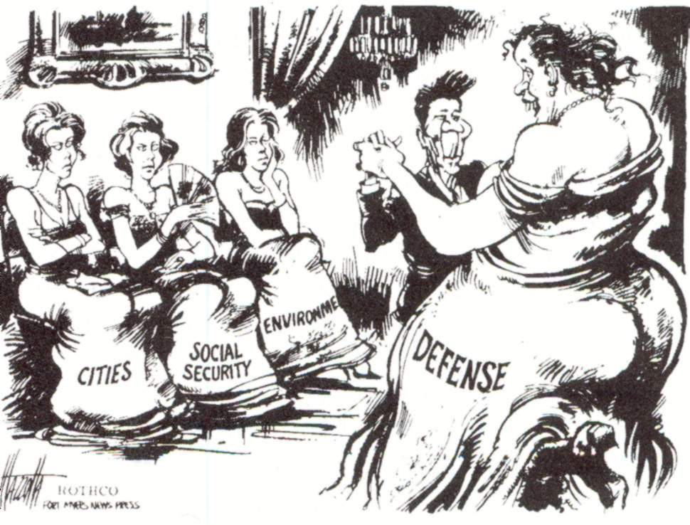

Slide 7
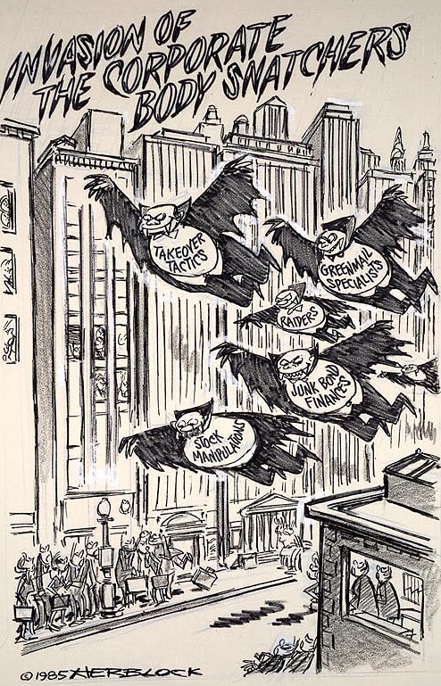
Deregulation
Relaxed environmental regulation
Opening of federal lands for mining, oil, gas, and lumber industries
Relaxed rules for banking and the stock market
Stock Market Crash of 1987 – caused by speculation

Slide 8
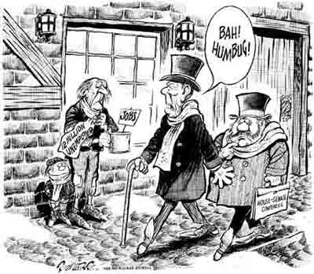
Tax Reform
Tax Reform Act, 1981
Taxes were cut by 25%
Tax Reform Act, 1986
Loopholes allowed the richest Americans to pay middle-class tax rates
Gap between rich and poor widened
Top 1% of Americans owned 37% of wealth
Increase in child poverty

Slide 9
