Slide 1
United States History
Activist Judges: The Warren Court
Dr. King-Owen

Slide 2
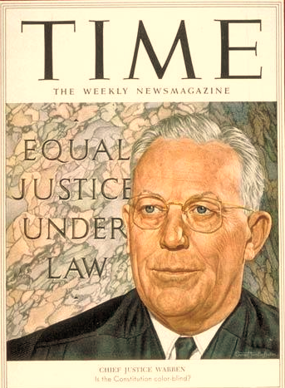
The Warren Court
Earl Warren (1953 – 1969)
Appointed Chief Justice of the Supreme Court by Pres. Eisenhower
14th Amendment
Warren’s court was very liberal
“equal protection” and “due process” clauses of the 14th amendment was used to apply the Bill of Rights to states – limiting state powers

Slide 3
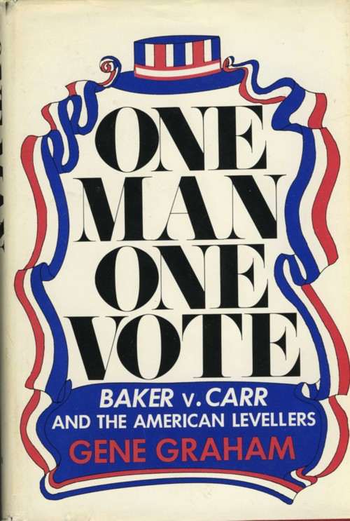
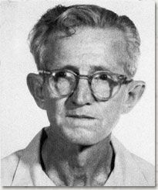
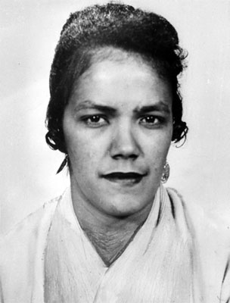
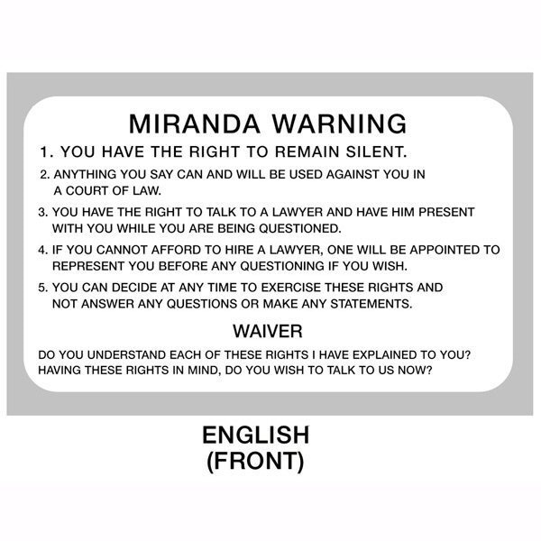
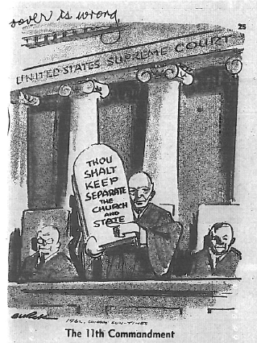
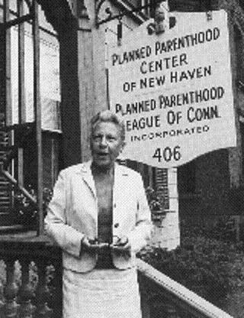
United States History Name:_________________________
Decisions of the Warren Court Date:____________ Period:_______
Mapp v. Ohio
Baker v. Carr
Gideon v. Wainwright
1961
Exclusionary rule
4th, 14th amendments
1962
One man, one vote
14th amendment
1963
Right to a lawyer
14th/6th amendment
Escobedo v. Illinois
Miranda v. Arizona
1964
Right to a lawyer
6th amendment
Cases
1966
Be informed of rights
Engle v. Vitale
Griswold v. Connecticut

Slide 4
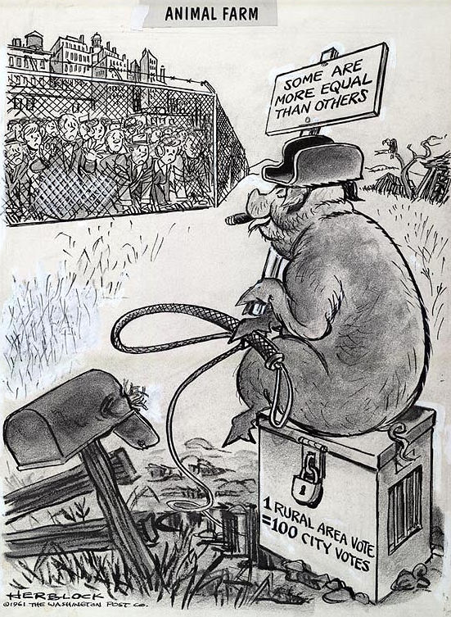
Equal Rights
Decisions requiring (a) lawyers for accused, (b) reading of rights, and (c) limited search warrants
Critics believed these decisions undermined the power of the police to stop crime
Baker v. Carr led to the principle of “one man = one vote”
It increased urban voting power (thus increasing minority power) by forcing states to redraw voting districts

Slide 5
United States History Name:_________________________
Decisions of the Warren Court Date:____________ Period:_______
Mapp v. Ohio
Baker v. Carr
Gideon v. Wainwright
1961
Exclusionary rule
4th, 14th amendments
1962
One man, one vote
14th amendment
1963
Right to a lawyer
14th/6th amendment
Escobedo v. Illinois
Miranda v. Arizona
1964
Right to a lawyer
6th amendment
Cases
1966
Be informed of rights
Engle v. Vitale
Griswold v. Connecticut
1962
No school-sponsored
prayer
1st amendment
1964
Right to privacy
1, 3, 4, 9 amendments

Slide 6
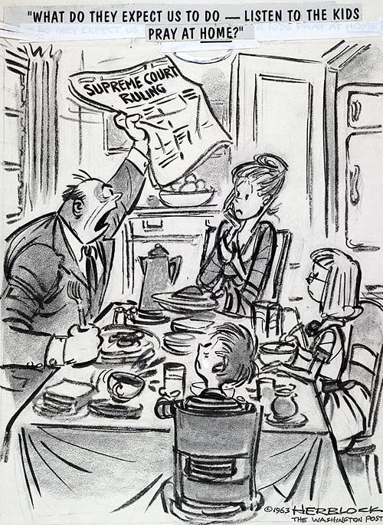
Social Issues: Prayer, Marriage, Sex
Engel v. Vitale, 1962
1st Amendment – requiring students to pray in school was unconstitutional
Griswold v. Connecticut, 1963
Birth control is private
Loving v. Virginia, 1967
States cannot prohibit interracial marriages

Slide 7
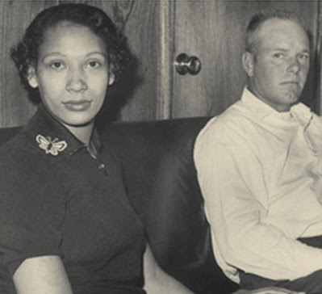
Almighty God created the races white, black, yellow, malay and red, and he placed them on separate continents. And but for the interference with his arrangement there would be no cause for such marriages. The fact that he separated the races shows that he did not intend for the races to mix.
~Virginia Trial Judge in the Loving Case, 1959

Slide 8
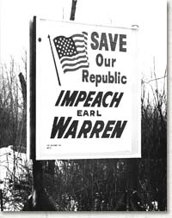
Activist Judges
Conservative critics argued:
Supreme Court judges were making laws, not just interpreting them
These “activist” judges were undermining federalism by meddling in state matters (education, marriage, police powers)

Slide 9
Importance
Which of the 7 cases from today do you find most important? Why?

Slide 10
Vocabulary Quiz – 4-27-2012
Conservative
Liberal
Watergate
Judicial activism
Stagflation
New Right
Ronald Reagan
Reaganomics
Sandra Day O’Connor
Three Mile Island

