Slide 1
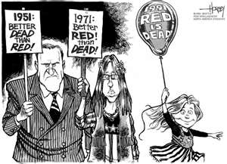
United States History
[13.04]
Communism is Dead (*Except in China, North Korea, Cuba, Laos, and Vietnam)
Dr. King-Owen

Slide 2
And the Wall Come Tumblin’ Down
1987 – “Tear Down this Wall”
President Reagan made a speech in Berlin urging Gorbachev to remove the Berlin Wall
1989 – “Peaceful Revolution”
As Soviets weakened, Berlin leaders opened the checkpoints
By 1990, the wall was largely dismantled

Slide 3
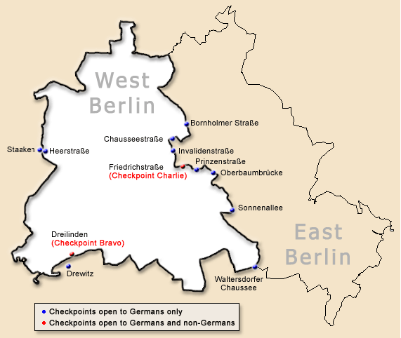

Slide 4
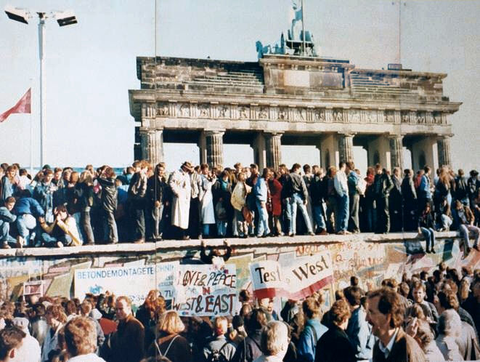

Slide 5
Revolutions of 1989
1989 – Gorbachev rejects use of force to keep Soviet satellites in the Warsaw Pact
One-by-one, eastern European satellites began to experience internal revolutions – Poland, Hungary, Czechoslovakia, Bulgaria
Countries held elections
Communist dictators were overthrown
Capitalist economies grew (slowly)

Slide 6
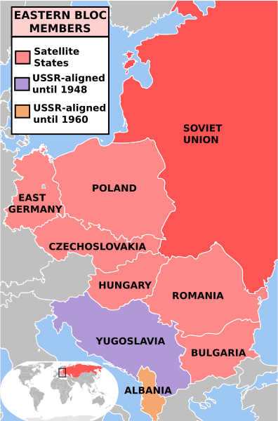

Slide 7
1991: Cold War Ends
1991: Warsaw Pact dissolved
Soviet Union broke into 15 separate republics
1991: START Treaty I
President George W. Bush and Mikhail Gorbachev
Most forceful nuclear weapons reduction treaty signed to date
40% of nuclear weapons in U.S. and Russia removed
Expired in 2009

Slide 8
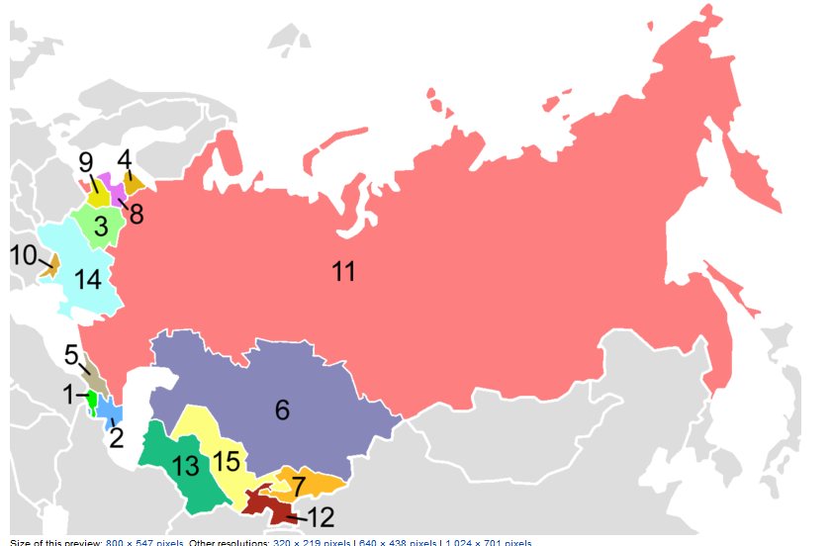
1. Armenia 2. Azerbaijan 3. Belarus 4. Estonia 5. Georgia 6. Kazakhstan
7. Kyrgyzstan 8. Latvia 9. Lithuania 10. Moldova 11. Russia 12. Tajikistan
13. Turkmenistan 14. Ukraine 15. Uzbekistan

Slide 9
Who Killed Communism?
Stagnant Economy – 1970s
Declines in agriculture and industry
Soviet War in Afghanistan – 1979-1989
Heavy costs to Soviets and unpopular
Gorbachev – 1980s
Perestroika and glasnost – encouraging openness and free market
Revolutions of 1989
Satellites sensing weakness in Soviets
Ronald Reagan, 1983-1989
Tough talk and defense spending

Slide 10
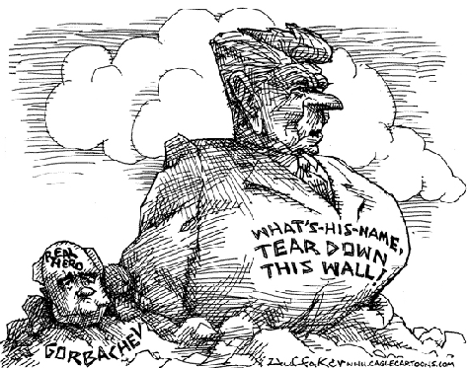

Slide 11
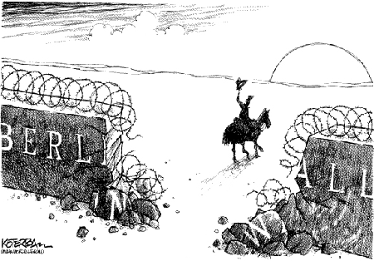

Slide 12
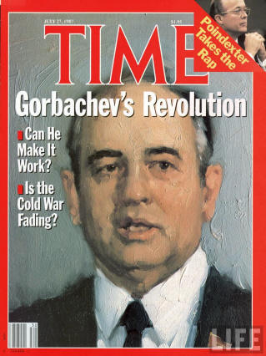
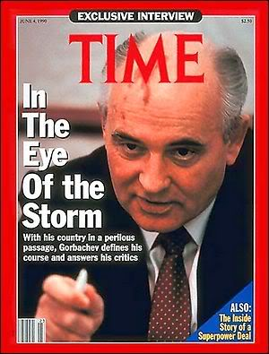

Slide 13
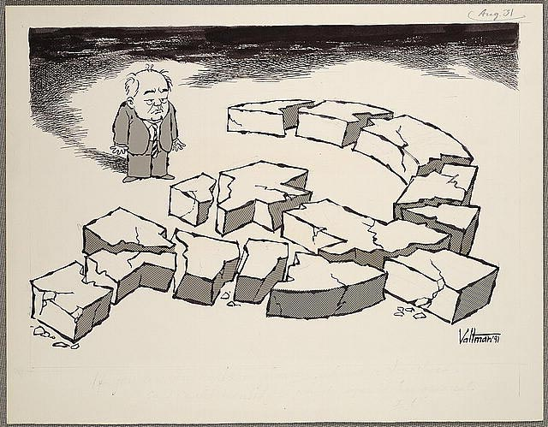

Slide 14
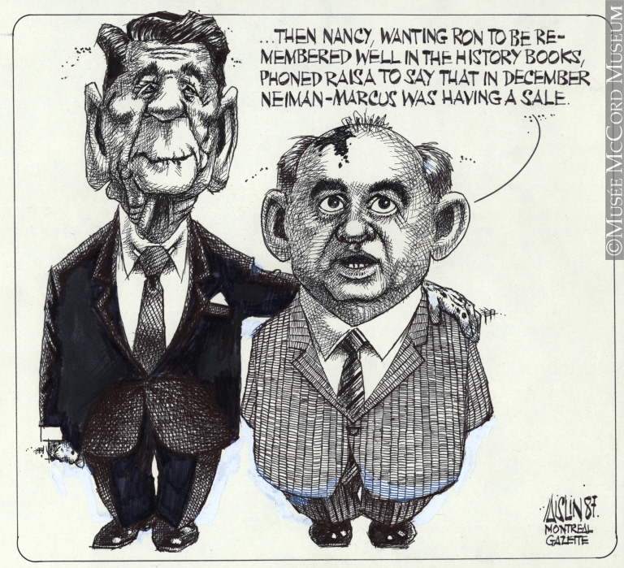

Slide 15
