Slide 1
United states history
Hooked on Oil
Dr. King-Owen
[13.03]

Slide 2
America and Israel
Israel had a rocky relationship with its Arab neighbors since 1948
Competing claims for land
Six Day War (1967) -- Israel extended control over land, furthering angering Arabs
Yom Kippur War (1973) – Egypt/Syria attack Israel
U.S. “shuttle diplomacy” – U.S. Secretary of State Henry Kissinger shuttled back-and-forth to Israel and Arab neighbors to get peace

Slide 3
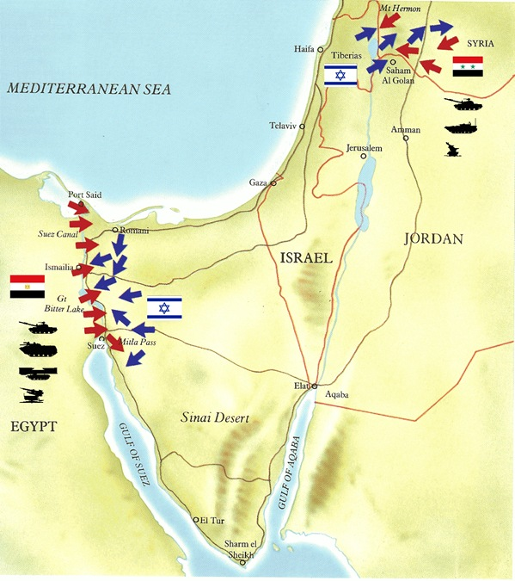
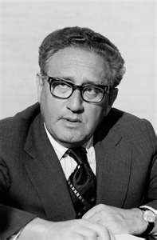

Slide 4
Embargo, 1973
October 1973 -- Organization of Petroleum Exporting Countries [OPEC] embargoed oil to U.S. for helping Israel
Price of oil (per barrel) quadrupled ($3 → $12)
Price of a gallon of gas went from 38.5 cents 55.1 cents (43% increase)
Kissinger increased his “shuttle diplomacy” and the embargo was ended by March 1974

Slide 5
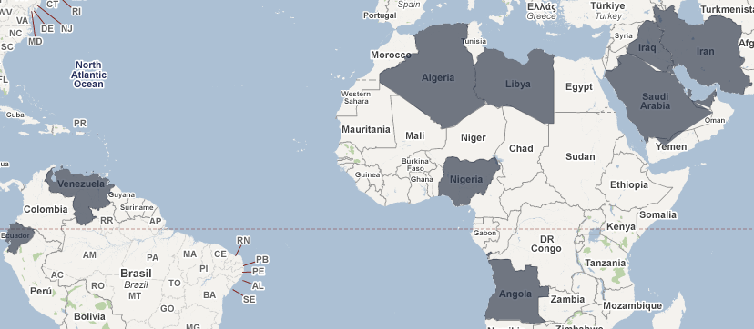

Slide 6
Yom-Kippur War
1973

Slide 7
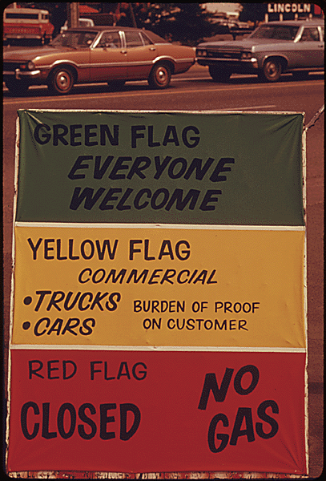
Saving Resources
1974 – national maximum speed limit of 55 mph imposed
1974-1975 year-round daylight savings time imposed
Luxury cars declined
Rationing of gasoline
Fuel efficiency became important

Slide 8
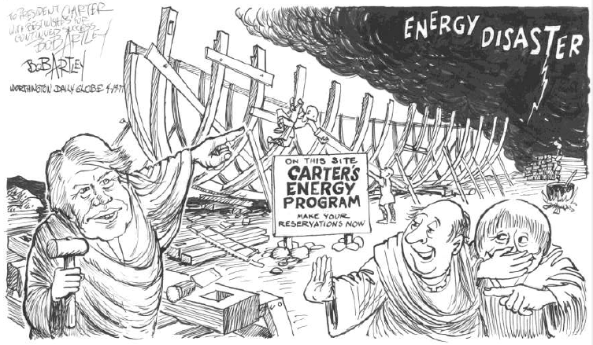
“Malaise Speech”
President Carter’s “Malaise” Speech, 1979
Called for alternate energy sources

Slide 9
Iranian Revolution
1979

Slide 10
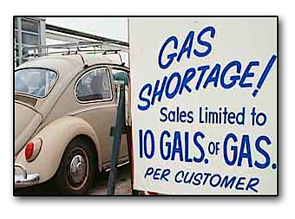
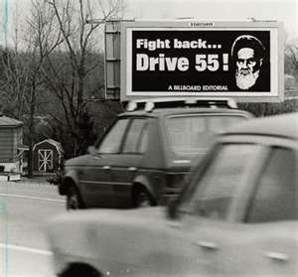
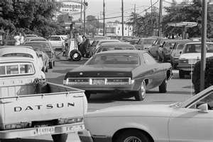
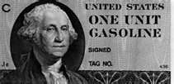

Slide 11
Consequences
Rising price of gas contributed to the 1970s stagflation
Bankruptcy at Chrysler, 1979
American car maker Chrysler got $1.5 billion
Unions gave up rights to get the bailout
Calls for Americans to sacrifice were ignored

Slide 12
