Slide 1
United States History
The Red Menace Falls
Dr. King-Owen
[13.04]

Slide 2
Afghanistan
1979: Soviets invaded Afghanistan
Soviets were supporting a communist government against Islamic militants
#AfghanistanequalsSovietversionofVietnam
War ends by 1989
War was an enormous strain on Soviet economy
#justlikeVietnamwastoAmerica!
American CIA provided help to anti-Soviet forces
#whichincludedayoungOsamabinLadenOOPS

Slide 3
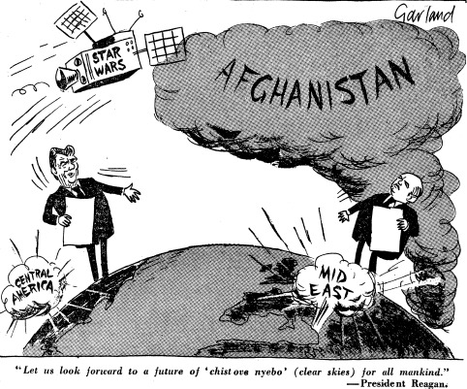

Slide 4
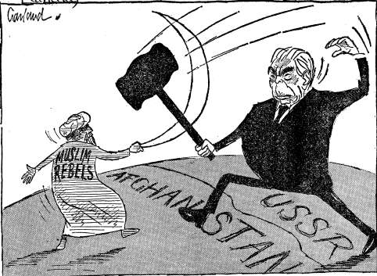

Slide 5
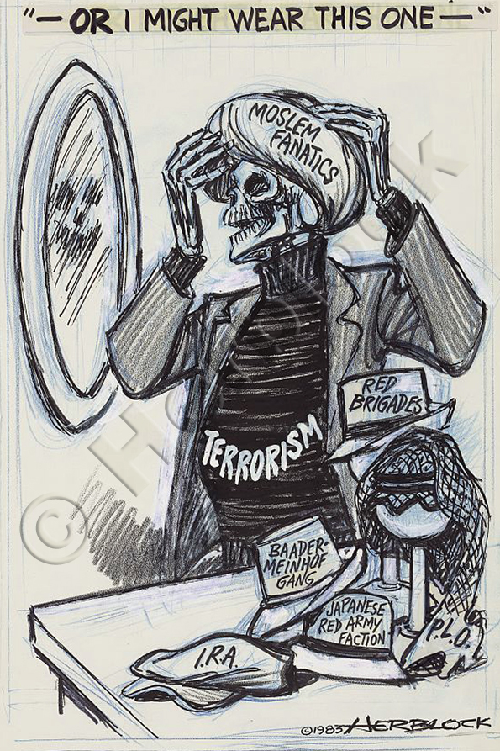
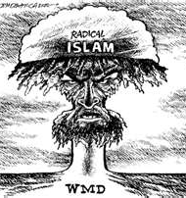

Slide 6
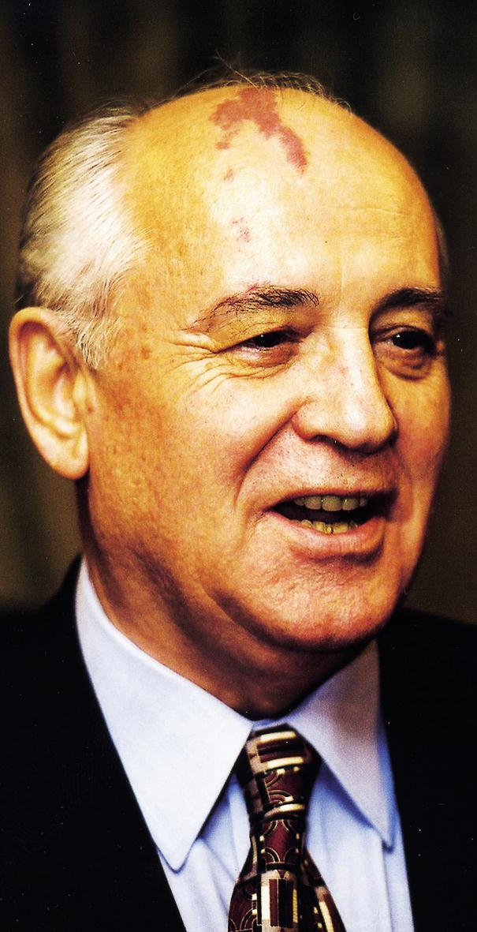
Gorbachev
President Reagan called the Soviets an “evil empire”
#soundstoughontheSovietslikehesinamovie
1985, Mikhail Gorbachev becomes Soviet Premier
Starts policies of glasnost (political freedom) and perestroika (economic freedom)
Soviets cannot afford to keep up with America in defense spending
#dontstareatthebirthmarkonhisheaditsrude

Slide 7
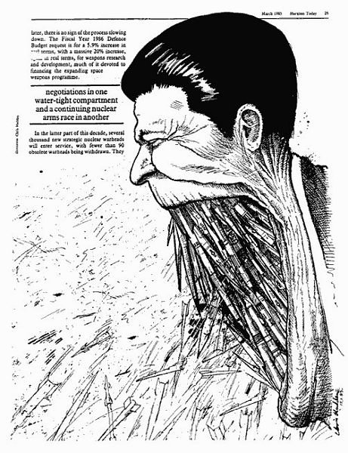
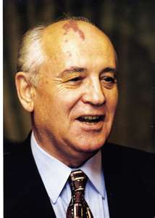

Slide 8
Star Wars
1983 – Reagan proposes using space lasers to shoot down incoming missiles
#Reaganconfusesreallifewithmoviesagain
Critics noted that most of plans were technically impossible
From 1984-1994 the program cost $70 billion
Soviets complained that it increased Cold War tensions
#70billionwouldbuyawholelotofotherstuffthatwouldnthavebeennearlyasuseless

Slide 9
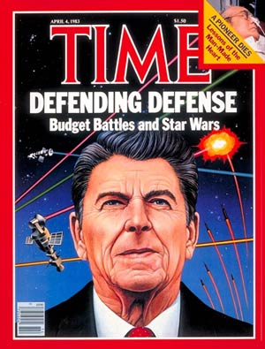
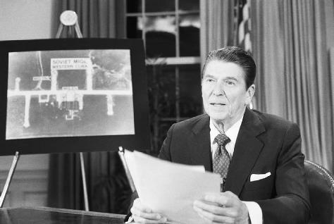

Slide 10
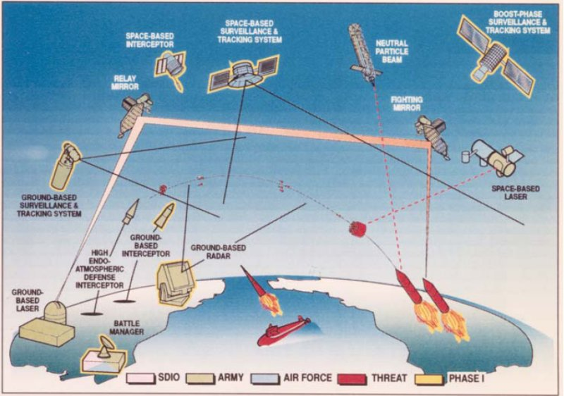

Slide 12
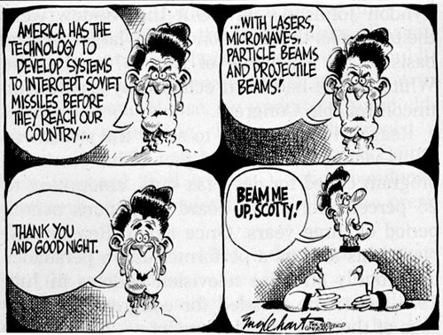

Slide 13
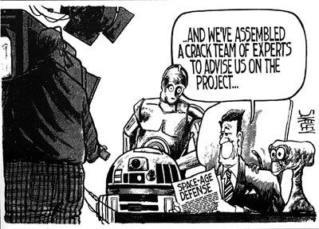

Slide 14
