Slide 1
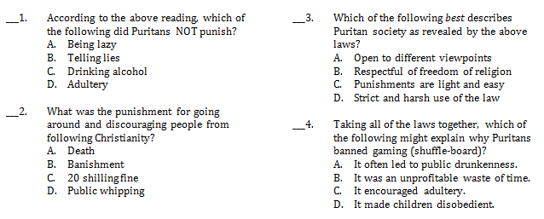
C
D
B
B

Slide 2
United States History
Self-Rule
[1.05]
Dr. King-Owen

Slide 3
Origins
Three Kinds of Colonies:
Charter – company with rights to make its own rules (MA)
Proprietary – colony given to an investor for a profit (PA)
Royal – colony ruled by the King directly (VA)
All three kinds had:
flexibility to self-govern
rights of Englishmen

Slide 4
Baby Steps
1619 – House of Burgesses (Virginia)
Legislature
Set its own taxes; laws had to be approved by English officials
Mayflower Compact, 1620 – Pilgrims agreed to live by majority rule
New England Town Meetings – all town citizens vote on laws and taxes
Fundamental Orders of Connecticut – 1634 – first written constitution in America

Slide 5
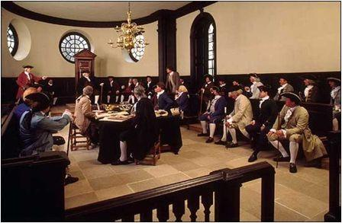

Slide 6
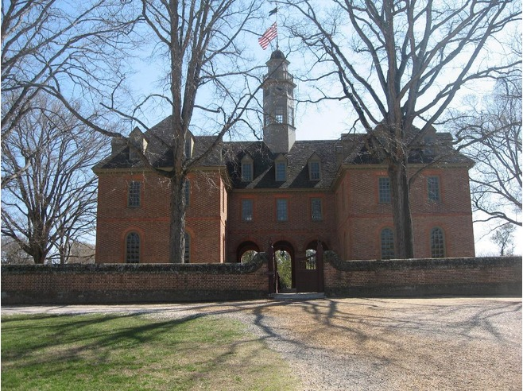

Slide 7
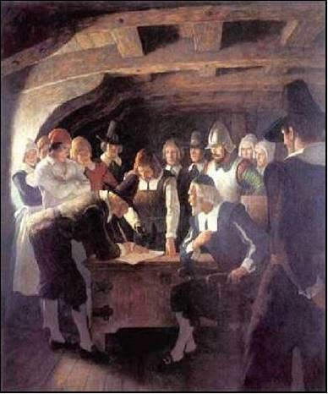
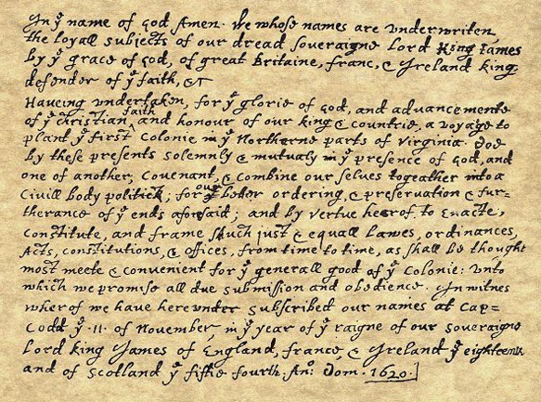

Slide 8
Colonial Expectations
Colonists assumed that they:
Had a right to make their own laws
Britain could NOT directly tax them
Had rights of Englishmen
What made America different?
No aristocracy (lords, nobles, dukes)
Basically middle-class society with some wealthy gentry

Slide 9
Self-Government
Open your textbooks to page 11.
Which of the developments in self-government in the colonies do you think is most important? Why? Defend your answer on your post-it note and place it on the blue wall.
Possible Choices:
House of Burgesses
Mayflower Compact
Magna Carta
English Bill of Rights
Enlightenment
Something is important when it:
Affects more people
Affects people for a long time
Has more influence than others

