Slide 1

The Baby Boomers
11.02
Dr. King-Owen
United States History

Slide 2
Boom! Babies!
1950s focus on family living in a perfect suburb led with strict gender roles led to:
  1 baby born every 7 seconds in 1957
  75 million babies born 1946-1964: Baby Boomers
  Families had (on average), 3.7 children
Causes?
CAUSES
Prosperity of 1950s
Cold war fears
Gender role stereotypes
CONSEQUENCES
Focus on childhood
Consumer spending
Stress on mothers

Slide 3
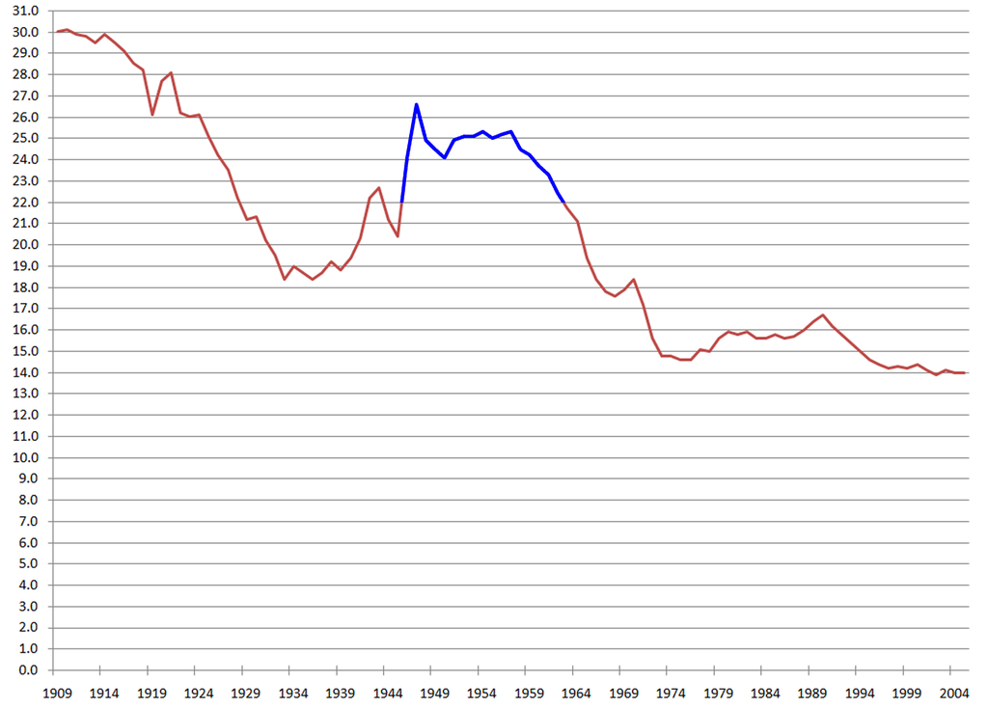

Slide 4
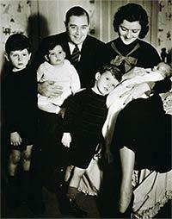

Slide 5
Fatherhood
The Organization Man, 1956
  More white-collar workers after World War II
    Professional men, managers: “guys in suits”
  Emphasis on being an “organization man”
    Conform to corporate rules: teamwork, loyalty
    Life of “keeping up with the Joneses”
    Loss of individuality

Slide 6
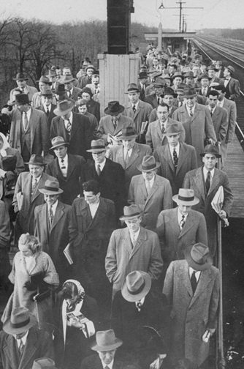


Slide 7
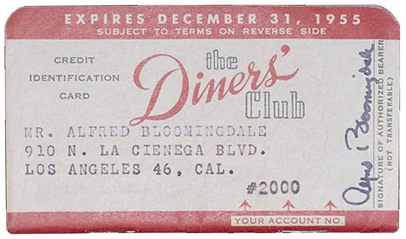
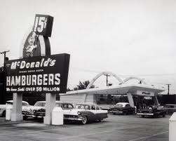
Prosperity
Consumerism of the 1950s
  Buying goods = success
  Materialistic society
  Credit cards invented (1950)
  Throwaway society – products are made to be replaced (“planned obsolescence”)
  Advertising increases

Slide 8
Does History Repeat Itself?
Are you thinking that the 1950s are starting to sound like the 1920s?
  Period of war
    Time of prosperity
      Lots of social conformity
        Materialism
          Challenges to dominant gender roles

