Slide 1
1920s and 1950s: Rhymes
 | 1920s | 1950s
WAR | WW1 Short war U.S. enters to make world safe for democracy | WW2 Long war U.S. enters after attack at Pearl Harbor
ECONOMY | Booming until 1929 Tax cuts on rich Wealth is unequal Weak unions | Boom lasts until 1970s Taxes on all Welfare spending Weak unions

Slide 2
1920s and 1950s: Rhymes
 | 1920s | 1950s
WOMEN | Flappers Women work Birthrate declines Consumerism strong | Dom. Goddess Women at home Birthrate increases Consumerism strong
FOREIGN POLICY | Red Scare (1919) Isolationism | Red Scare (1953) U.S. a world leader Containment of communism

Slide 3
UNITED STATES HISTORY
Two Americas
11.02
Dr. King-Owen

Slide 5
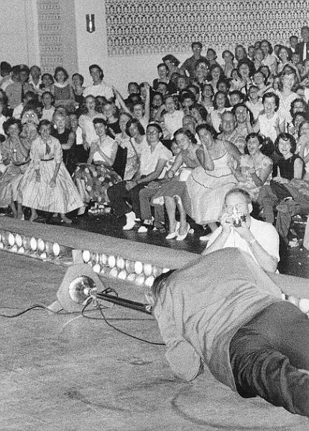
Youth Culture
Age of “Rock ‘n’ Roll”
Popular with teens
Critics: rock ‘n’ roll leads to juvenile delinquency
Are You a Hep-cat, Daddy-O?
Beatniks rejected conformist culture of 1950s
Sought “authentic” life – often in drugs
Often accused of promoting juvenile delinquency
Jack Kerouac and Allan Ginsburg were most famous beatnik writers

Slide 6
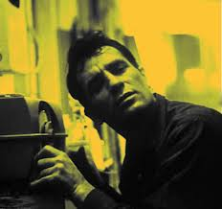
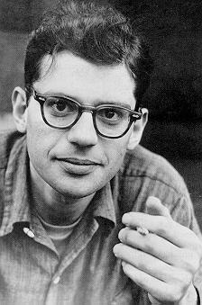

Slide 7
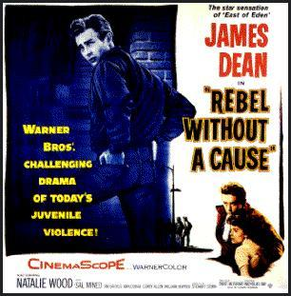
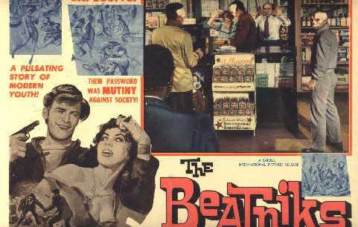
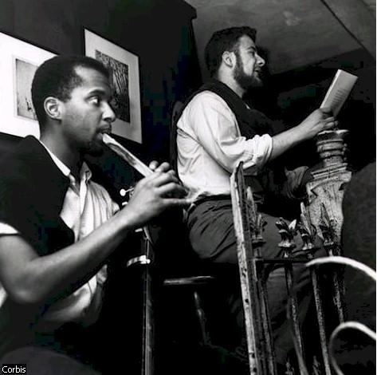
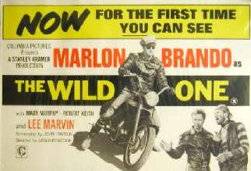

Slide 8
Poverty
Suburbs led to “white flight” out of cities
Cities lost tax revenue and could not fund programs for poor anymore
Urban areas decayed
Poverty affected Mexicans, Indians, and Black Americans more than whites
1 out of 5 families lived in poverty (30 million people) in the late 1950s

Slide 9
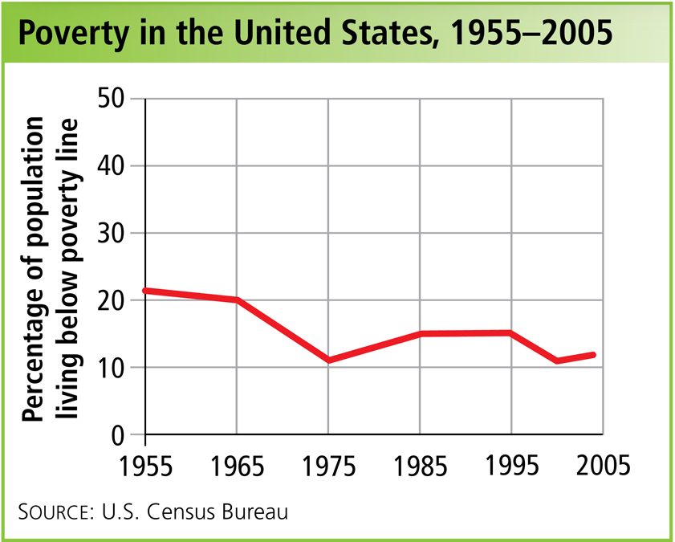
The top 1% of Americans owned 35% of the nation’s wealth by 1960.
(in 1929, it was 32%)

Slide 10
Race
1950s – Black Americans challenge racism
1954 – segregation in schools is made unconstitutional by Brown v. Board
It overturns Plessy v. Ferguson (1896)
1955 – boycott of buses in Montgomery, AL to force them to stop segregating
1957 – high school is integrated in Little Rock, AR (Little Rock 9)
Fierce resistance from whites who link black civil rights with communism

