Slide 1
United States History
Revolutions in Transportation, Industrialization, and Urbanization
Letter-Writing Activity

Slide 2
Directions
You are write a letter to a relative back home in a rural area. It will be based on your travels to Cincinnati, Ohio in 1850, from a tiny village in Maine. You are to describe the changes in transportation, patterns of work, urbanization, and industry that have taken place over the past thirty years. Remember that you grew up on a rural farm and your family has only known a rural life in a primitive, small home in the middle of no-where, surrounded by pigs, goats, horses, cows, and lots of fields. They will be amazed at all you tell.
As you write, use the Document letter to identify where you are getting your information: (Doc A). Just put the Document letter in parenthesis after you use the document. You must use at least 8 of the 10 documents in your letter.

Slide 3
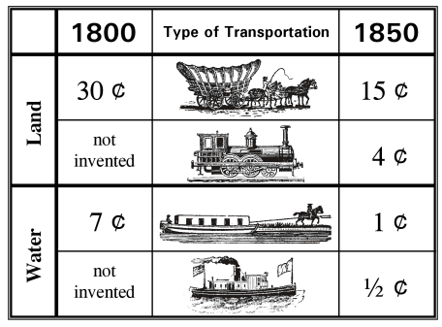
Document A: Cost to Transport One Ton of Goods in Cents Per Mile

Slide 4
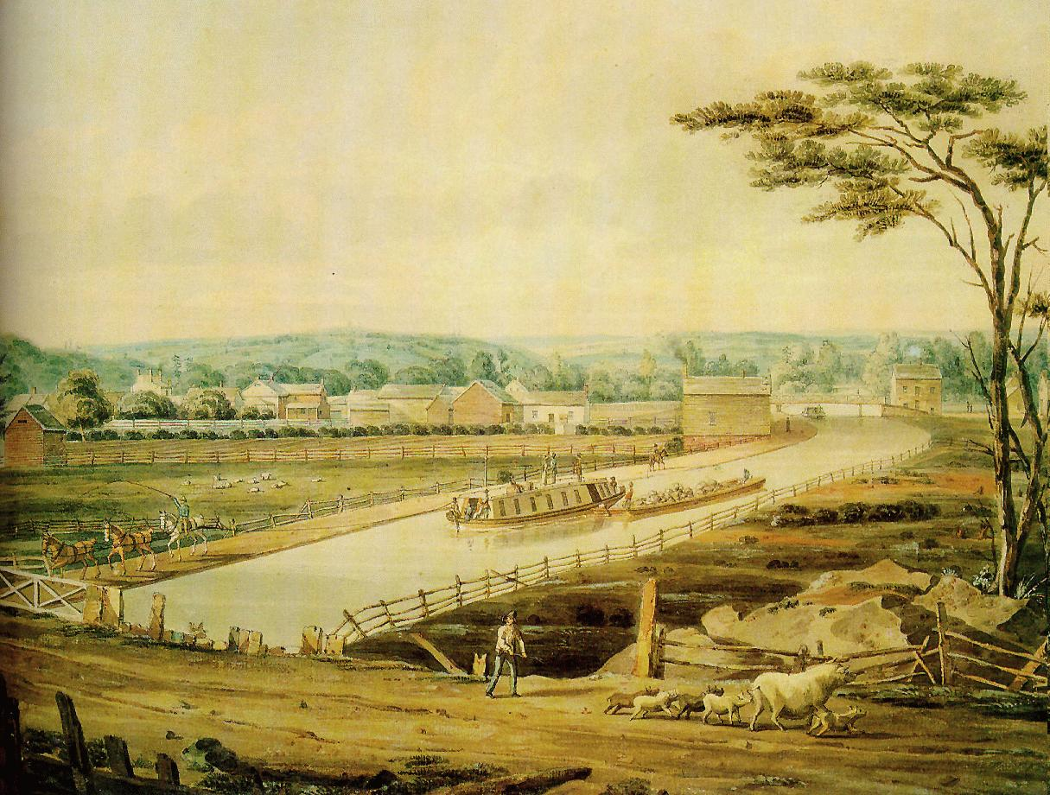
Document B: Erie Canal
Set up in New York, the Erie Canal linked the Great Lakes to the Atlantic Ocean. All along the canal, towns sprang up to take advantage of the cheap all-water route for shipping goods. Passengers even traveled the canal on pleasure trips.

Slide 5
Document C: Harriet Robinson Remembers the Days before Industry
"Before 1836 the era of mechanical industry in New England had hardly begun, the industrial life of its people was yet in its infancy, and nearly every article in the domestic use that is now made by the help of machinery was the "done by hand." It was, with few exceptions, a rural population, and the material for clothing was grown on the home-farm, and spun and woven by the women..."
"...This was the genius of mechanical industry, which would build the cotton-factory, set in motion the loom and the spinning-frame, call together an army of useful people, open wider fields of industry for men and (which was quite as important at that time) for women also..."
"...Before 1840, the foreign element in the factory population was almost an unknown quantity. The first immigrants to come to Lowell were from England. The Irishman soon followed; but not for many years did the Frenchman, Italian, and German come to take possession of the cotton-mills..."

Slide 6
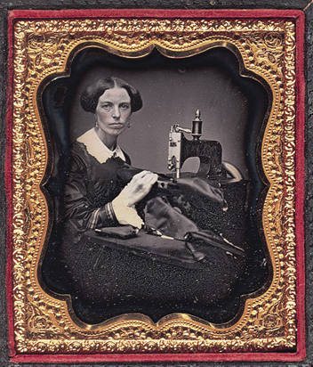
Document D: Woman with Sewing Machine

Slide 7
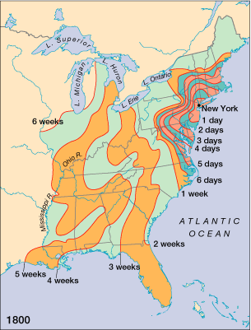
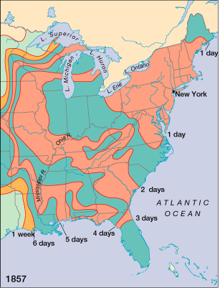
Document E: Travel Times in 1800 and 1857

Slide 8
Document F: Wealth Owned in Boston and New York, 1771-1848
BOSTON | 1771 | 1833 | 1848
Amount of Wealth Owned by the Top 1% of People | 16% | 33% | 37%
Amount of Wealth owned by the Top 10% of People | 65% | 75% | 82%
Amount of Wealth owned by to the Lowest 80% of People | 29% | 14% | 4%
NEW YORK | 1828 | 1845
Amount of Wealth Owned by the Top 1% of the People | 40% | 50%
Amount of Wealth Owned by the Top 4% of the People | 63% | 80%
Amount of Wealth Owned by the Bottom 95% of the People | 37% | 20%

Slide 9
Document G: The Spirit of American Improvement (The American Whig Review)
All strangers who come among us remark the excessive anxiety written in the American face. It is not poverty, nor tyranny, nor over-competition which produces this anxiety. It is our perpetual improvement of our outward condition. There are no bounds among us to the restless desire to be better off; and this is the ambition of all classes of society. No man in America is content to be poor, or expects to continue so.
We call our country a happy country; happy, indeed, in being the home of the noble political institutions, the abode of freedom; but very far from being happy in possessing a cheerful, light-hearted joyous people. Labor to support oneself is dignified. But we labor for bread, and labor for pride, and labor for pleasure. A man’s life with us does consist of the abundance of things which he owns. To get, and to have the reputation of getting, is the ruling passion.

Slide 10
Document H: Urban Populations, 1790-1850 Percent of the American Population Living in Cities
 | 1790 | 1800 | 1810 | 1820 | 1830 | 1840 | 1850
New England | 7.5% | 8.2% | 10.1% | 10.5% | 14.0% | 19.4% | 28.8%
Middle Atlantic | 8.7% | 10.2% | 11.5% | 11.3% | 14.2% | 18.1% | 25.5%
Midwest | * | 0% | 0.9% | 1.2% | 3.0% | 3.9% | 9.6%
South Atlantic | 2.3% | 3.4% | 4.5% | 5.5% | 6.2% | 7.7% | 9.8%
Southwest | 0% | 0% | 0.6% | 0.8% | 1.5% | 2.1% | 4.2%
TOTAL | 6.1% | 7.2% | 8.7% | 9.1% | 11.4% | 15.0% | 21.3%

Slide 11
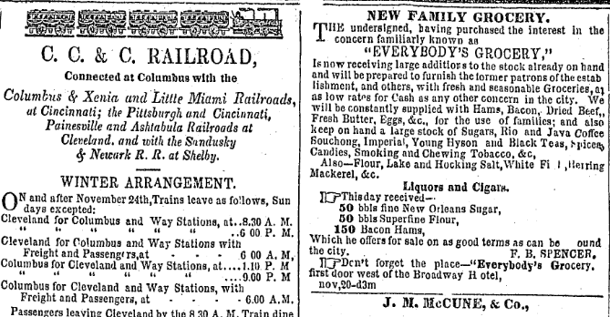
Document I: Advertisements in the Columbus Ohio Daily Statesman

Slide 12
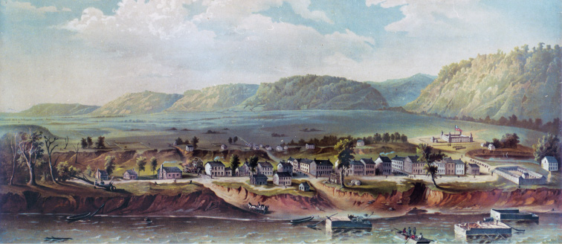
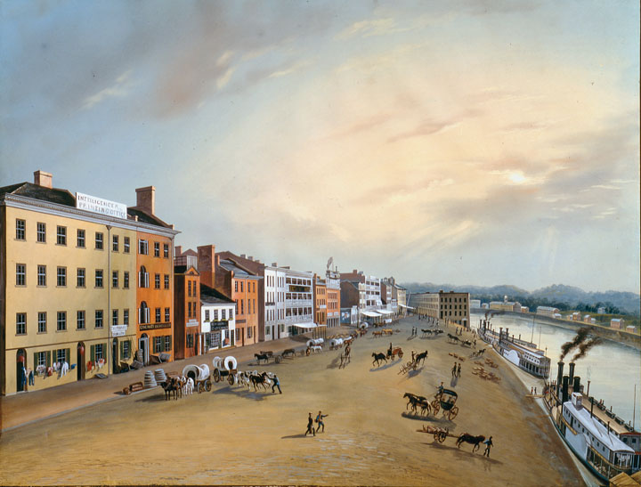
Document J: Cincinnati in 1800 and 1850

