Slide 1
United States History
1950s: Women
11.02
Dr. King-Owen

Slide 2
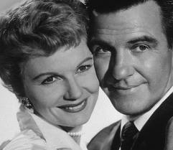
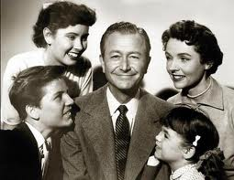
Well-Defined Gender Roles
The ideal modern woman married, cooked and cared for her family, and kept herself busy by joining the local PTA and leading a troop of Campfire Girls. She entertained guests in her family’s suburban house and worked out on the trampoline to keep her size 12 figure. -- Life magazine, 1956
The ideal 1950s man was the provider, protector, and the boss of the house. -- Life magazine, 1955

Slide 3
Ideal Women
Wife, mother, homemaker
Women were expected to obey husbands
Baby Boom meant that they spent most of their days raising children
Often the center of consumerism – purchasing appliances for the kitchen
Women’s roles reinforced by Christianity – church membership rose 50% during the 1950s

Slide 4
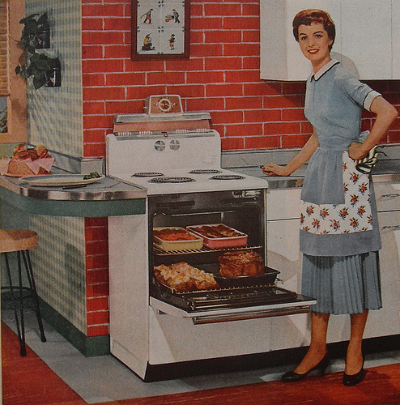

Slide 5
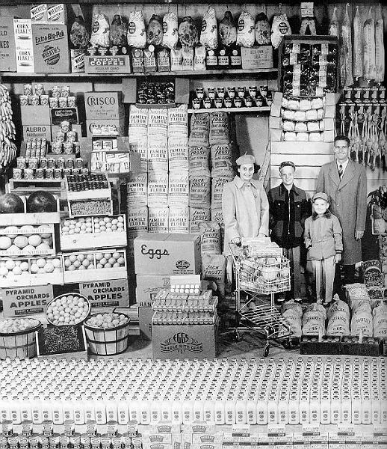

Slide 6
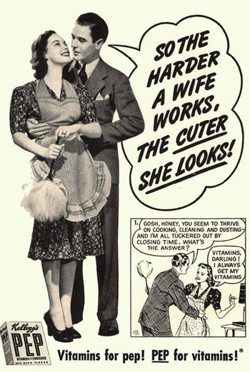

Slide 7
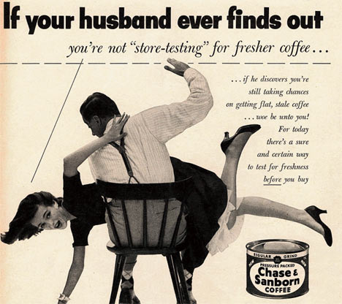

Slide 8
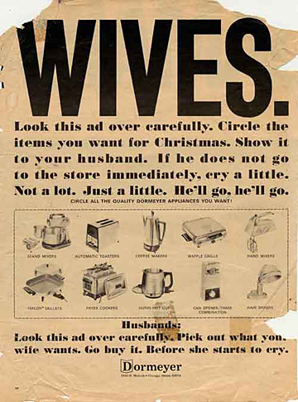

Slide 9
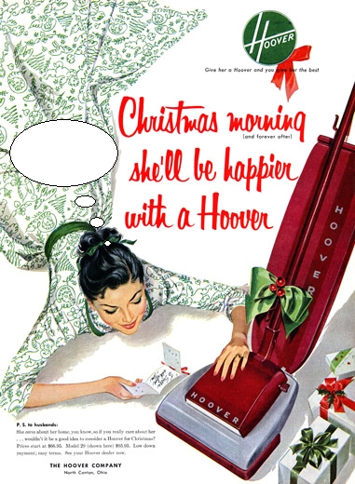

Slide 10
Real Women
1/5 of suburban wives were unhappy with their lives in the 1950s
By 1960, 40% of mothers with children (6 to 17) worked outside the home
Betty Friedan, The Feminine Mystique (1963)
Identified the “problem” that women faced – lack of fulfillment

Slide 11
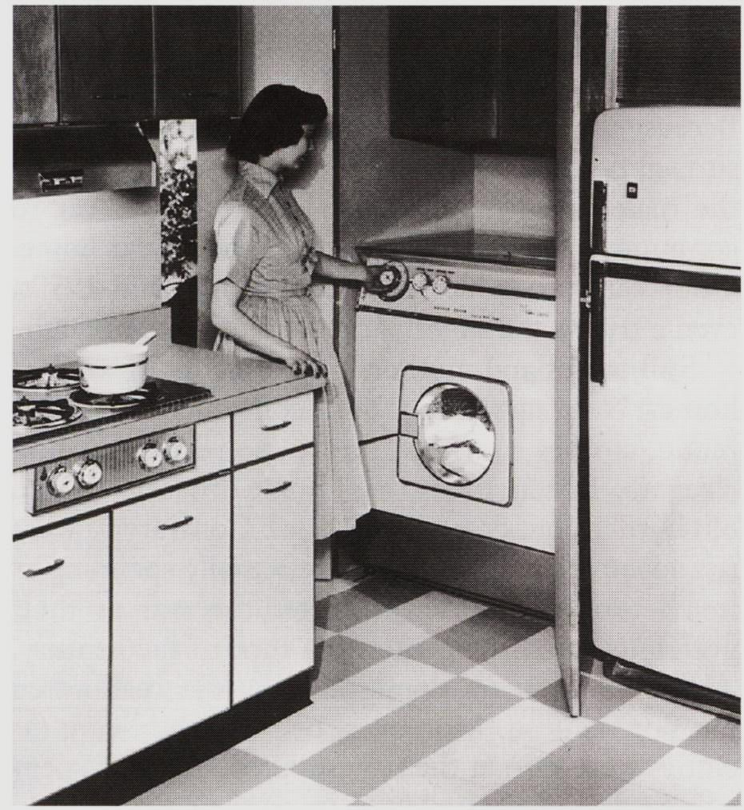
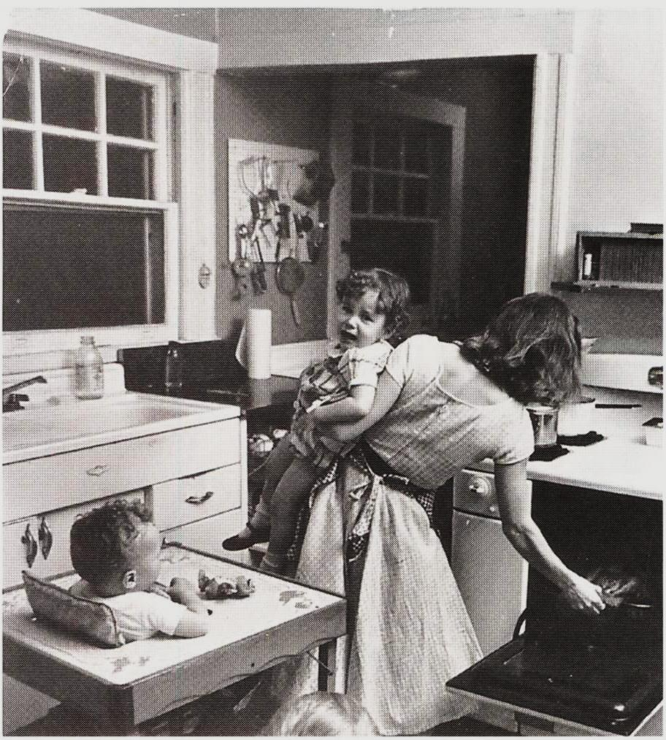

Slide 12
Women Challenge Roles
1966, National Organization for Women
Worked to promote equal pay for equal work
Wanted an equal rights amendment
Wanted to eliminate sexist language in the laws and jobs

