Slide 1
United States History
Grading Lincoln’s Performance
Dr. King-Owen

Slide 2
Directions
You will be taking notes on Abraham Lincoln’s leadership during the Civil War. After we take a section of notes, you will grade Lincoln’s performance as a war-time leader.

Slide 3
Emancipation Proclamation, 1863
Frees slaves in areas “under rebellion” – so it does not end slavery everywhere
Lincoln’s intent was to prevent England and France from helping the South by making the war about slavery
Lincoln therefore redefines the war’s moral purpose –from saving the Union to ending slavery

Slide 4
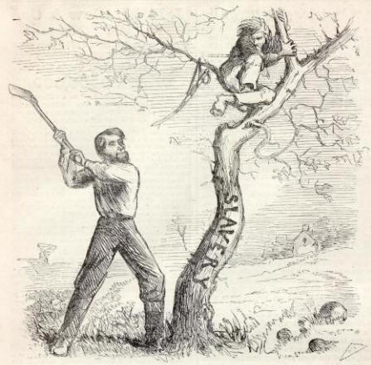

Slide 5
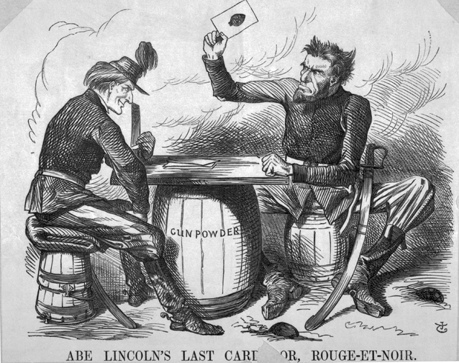

Slide 6
Civil Liberty
Lincoln stopped people from using a “writ of habeas corpus” [legal document requiring an arrested person to be brought to court]
Lincoln used the army to arrest people who might be helping the South and held them in jail without trial
About 13,000 people were held for war-related reasons

Slide 7
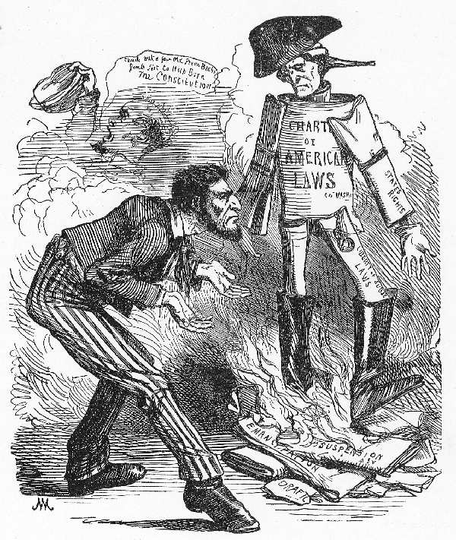
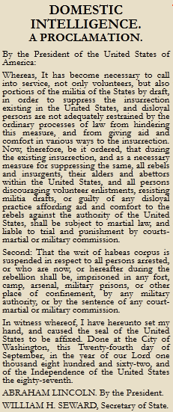

Slide 8
Gettysburg Address, 1863
Given to honor those who died at Gettysburg in July 1863
Defined the purpose of the war:
that we here highly resolve that these dead shall not have died in vain -- that this nation, under God, shall have a new birth of freedom -- and that government of the people, by the people, for the people, shall not perish from the earth.” – Abraham Lincoln

Slide 9
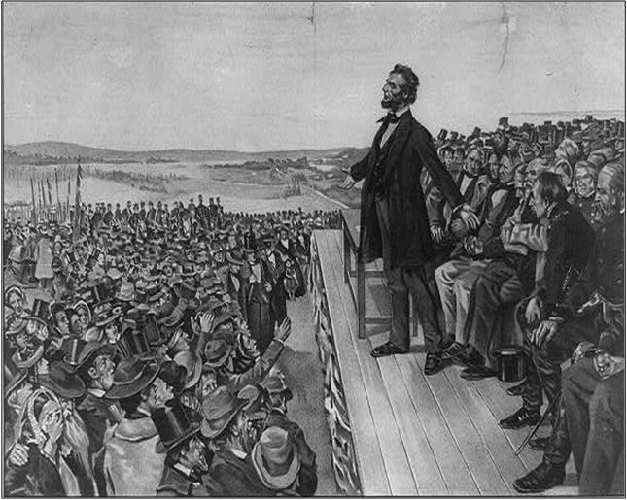

Slide 10
Total War, 1864
Lincoln and his generals – William T. Sherman and Ulysses S. Grant – attack southern civilians, not just soldiers
Belief that they must destroy the South’s will to keep fighting
Must destroy South’s resources
Fall of Atlanta, 1864 – Sherman burns Atlanta and other cities
Does about $100 million in damage

Slide 11
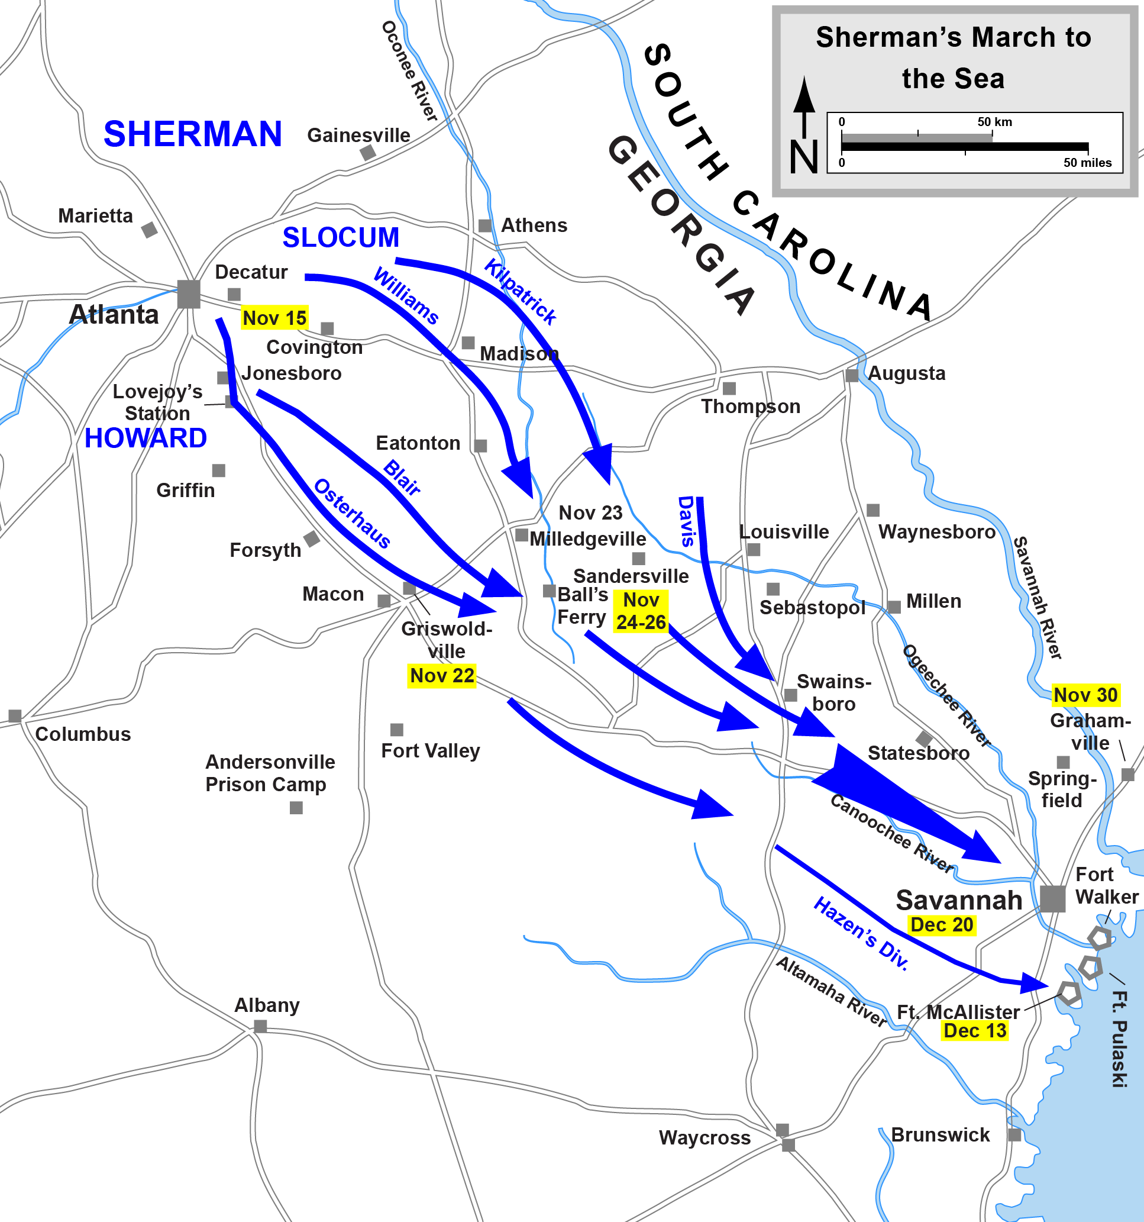
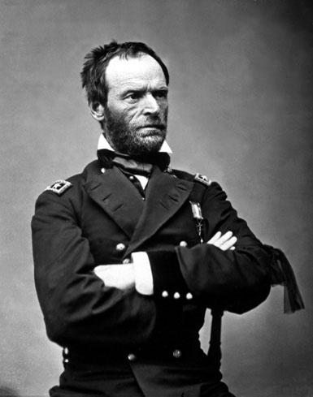

Slide 12
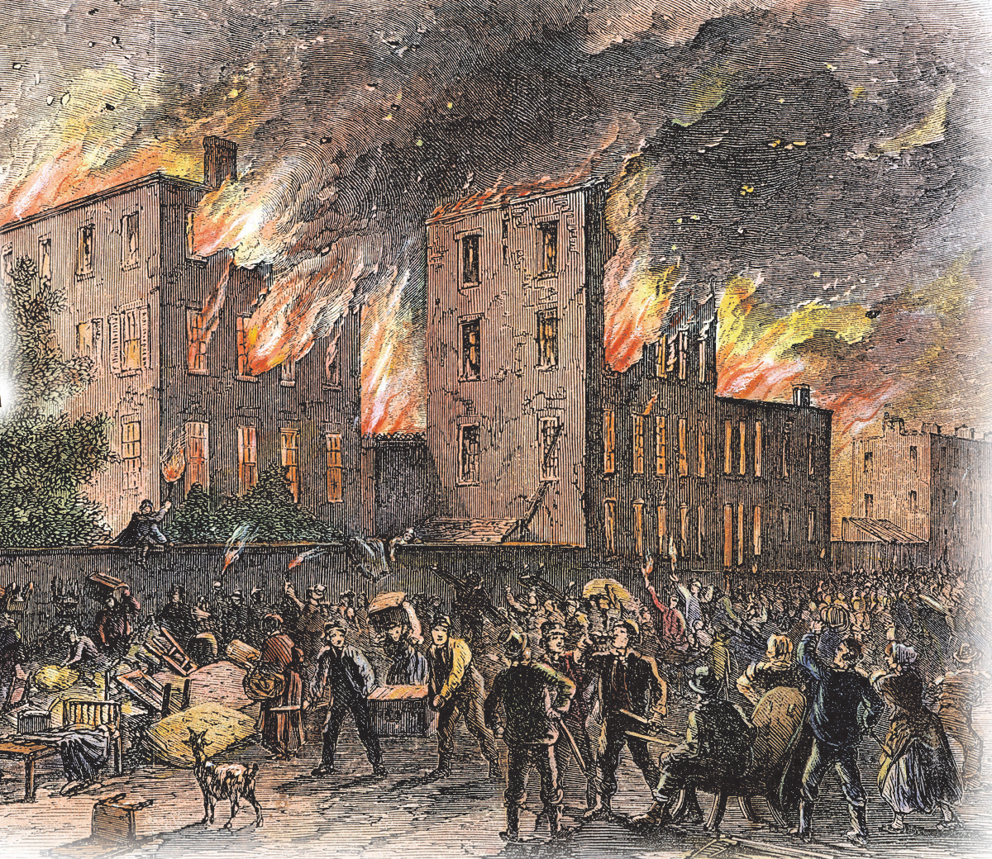

Slide 13
Costs of the Civil War
UNION
Cost of war - $2.3 billion
Inflation rate: 182% by 1864
Deaths: 437,413
CONFEDERATE
Cost of war - $1 billion
Inflation rate: 7000% by 1864
Deaths: 312,960
UNION
CONFEDERATE

Slide 14
Grading Lincoln
Look back over the grades you’ve given Lincoln so far. Based on the war and its costs, what overall grade do you give Lincoln. Why?

