Slide 1
Western Railroads/Cattle Trails
Where are most railroads located?
NORTH – North had a headstart on building railroads because South focused on agriculture
Why do cattle trails go North?
To meet the railroads – cows go to northern cities to be turned into steaks
What happened to towns along trails/railroads?
Grew rapidly by trade with cowboys and people on trains

Slide 2
United States History
Dr. King-Owen
People on the Plains: Environments
[6.01]

Slide 3
Migration to the West
1862 Homestead Act
Grants 160 acres to settlers
4 million claims for land (only 40% granted)
Exodusters
Former slaves went west (Kansas) to escape racism in the South – 15,000 by 1880

Slide 4
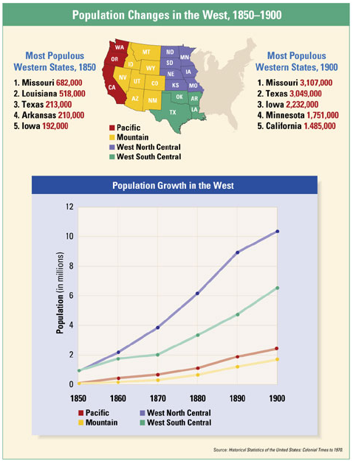

Slide 5
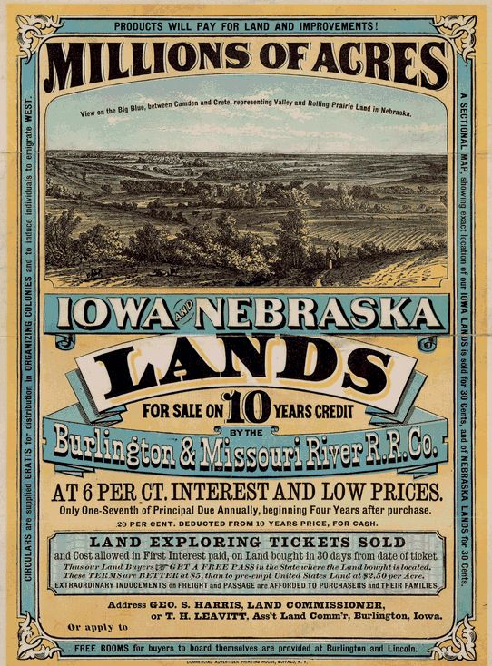
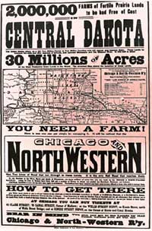

Slide 6
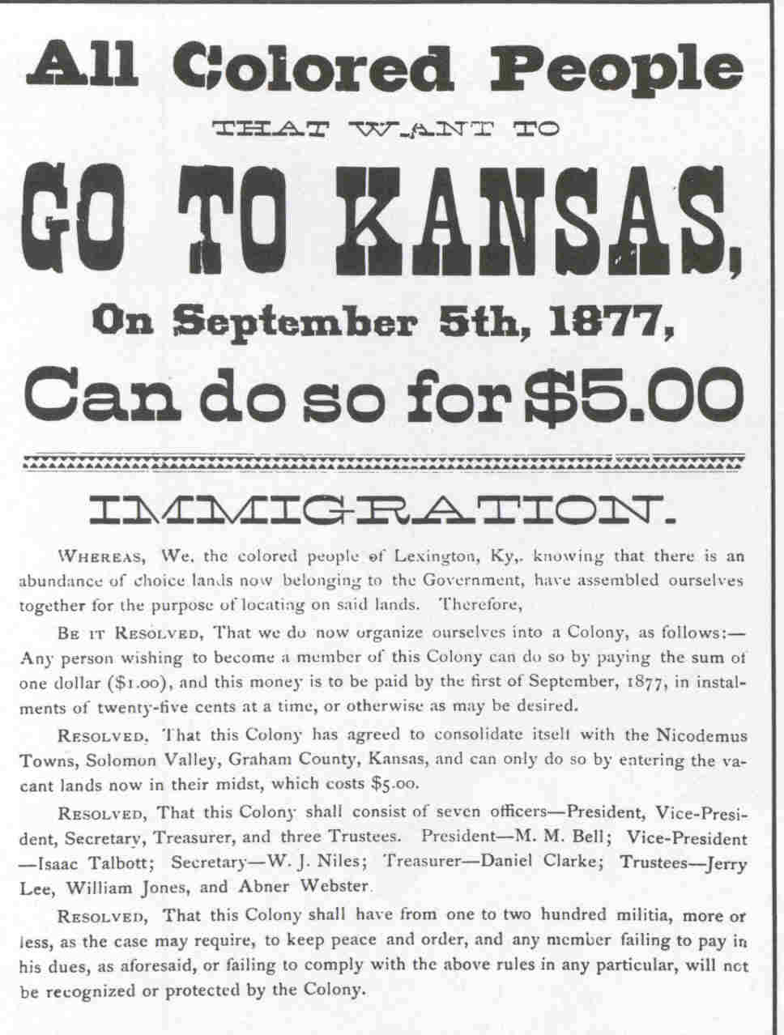
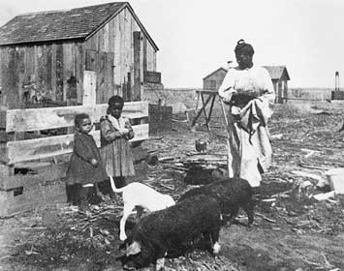

Slide 8
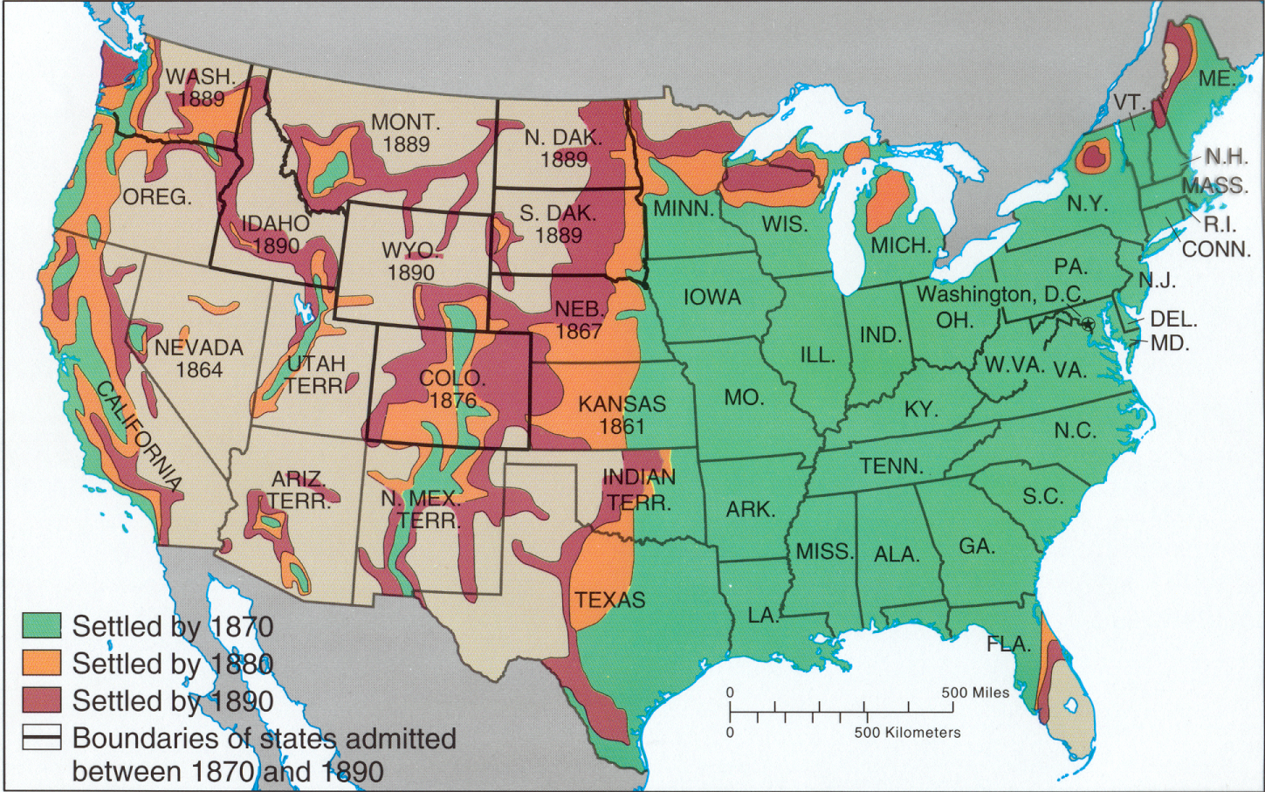

Slide 9
Problems of the West
“Rain follows the Plow”
Myth that if settlers moved West and farmed, it would start raining
Reality: droughts, no trees to stop winds
Sodhouses
Lack of trees – how do you build a house?
Use of “bricks” made of dirt held together by grass roots

Slide 10
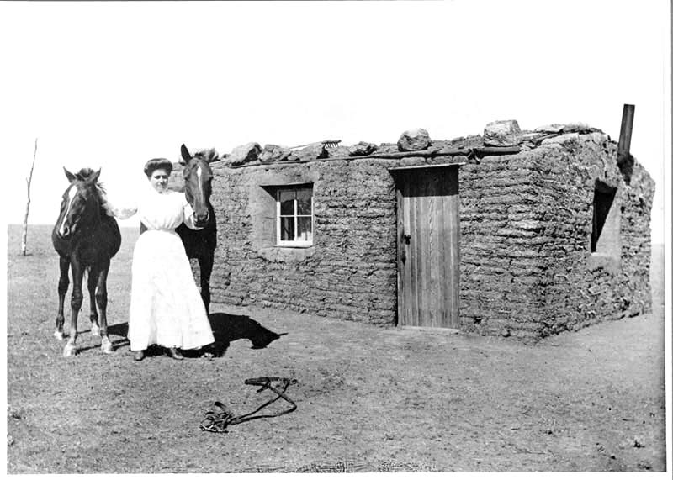

Slide 11
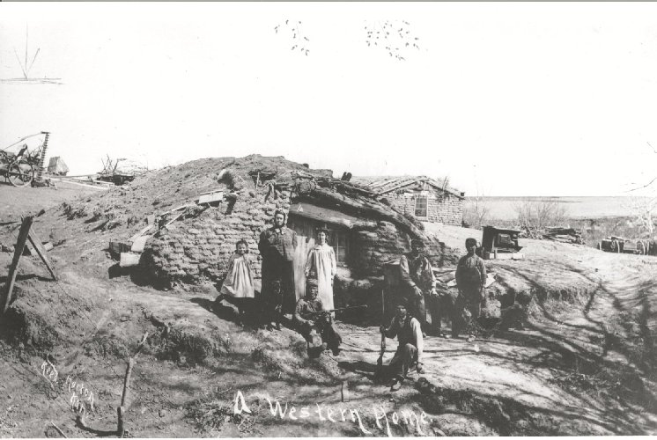

Slide 12
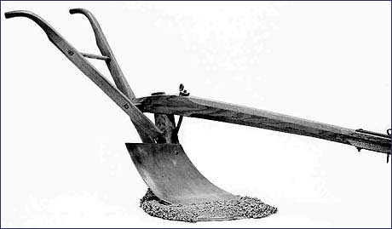
Problems of the West
Farming
use of steel plow to break up soil – causes soil erosion
Growth of big farms – bonanza farms – large corporate farms
Mining
Stripping of the soil, leaving gullies
Development of ghost towns

Slide 13
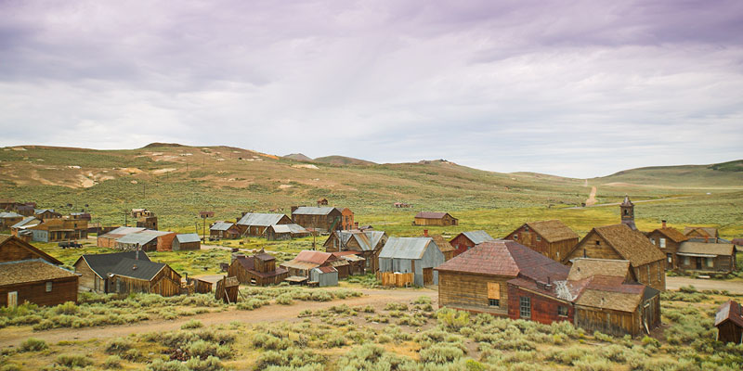
Notes:
Town of Bodie (Sierra near Nevada) in 1880 the population was 8000.

Slide 14
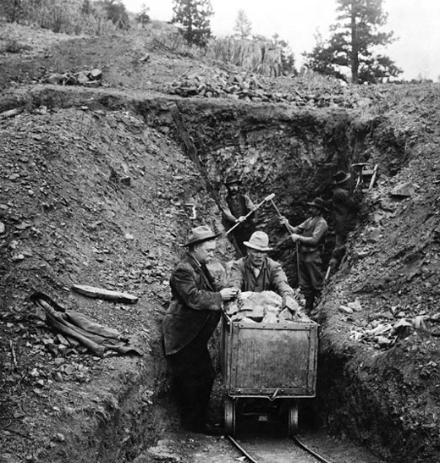

Slide 15
Cattle Frontier
Cows versus Sheep
Cattle drives – cows moved for fresh grass and water which led to overgrazing
Cattlemen hated sheep (sheep eat all the grass)
Fencing the West – use of barbed wire to define property
Killing Buffalo
Buffalo an important food source for Indians
Killed by buffalo hunters – 250 a day

Slide 16
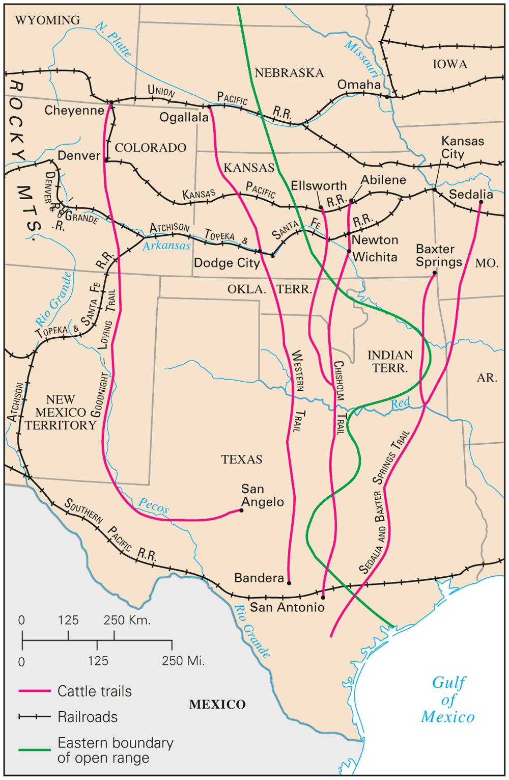
Cattle Trails
Notice that the trails go North to the railroads!

Slide 17
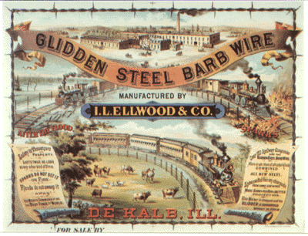

Slide 18
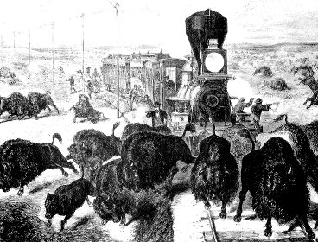
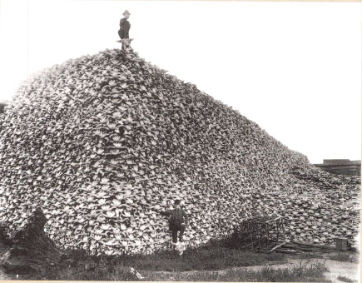
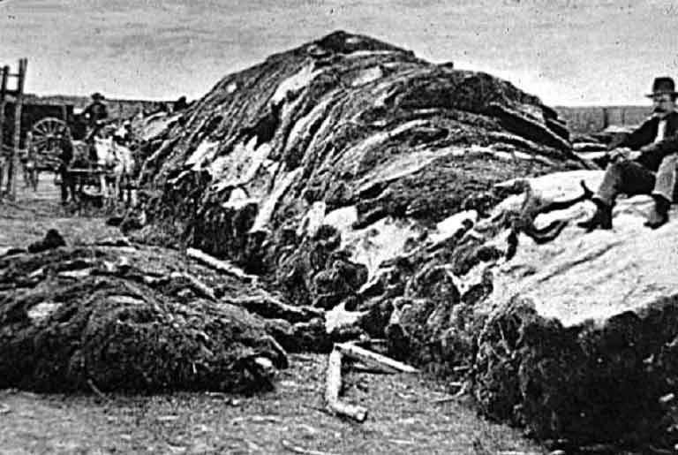

Slide 19
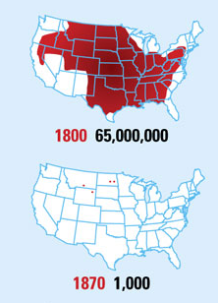
Buffalo Populations, 1800-1870

Slide 20
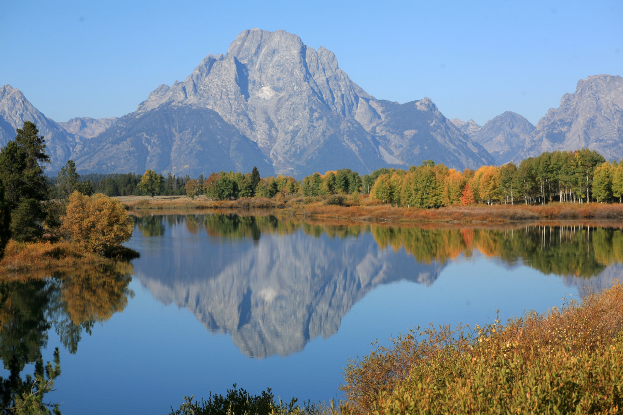
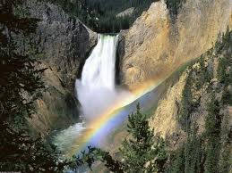
Saving the West
Conservation Movement
Yellowstone National Park created, 1872
Saving “wild” places to preserve them from human waste

Slide 21
Western Conflicts Chart
Group | Wanted | Conflicts/Problems
Indians | Freedom, peace | Forced on reservations by whites; Ghost Dance – forced to give up
Miners | Gold, silver | Ghost Towns; fights with Indians over land; damaged environment
Cattlemen | Grassland for cows | With Indians; sheep herders
Farmers | Land for farming | With Indians; environment – weather/sodhouses

