Slide 1
Inventions Activity
In your groups, read about the invention. 2 minutes
As a group, write down the effects of the invention on American life and work. 2 minutes
Choose a person to share your ideas with the class.
Inventions Chart

Slide 2
United States History
Dr. King-Owen
The SECOND Industrial Revolution [6.03]

Slide 3
Second Industrial Revolution
United States became the world’s leading industrial nation by 1920
The industrial revolution that began in the 1820s continued after the Civil War

Slide 4
Causes and Effects
Cause #1:
Abundant natural resources
Effect #1
Conflict with labor
Effect #2
Environmental destruction
Second Industrial Revolution
Cause #2
Government is pro-business
Effect #3
urbanization
Cause #3
Large supply of labor
Effect #4
Growth of monopolies

Slide 5
Monopolies
When one business makes a product
Are monopolies bad?
YES
Hurts consumer choice
Discourages competition
Stops innovation
NO
Reflects law of nature: strong survive
Drives out inferior businesses

Slide 6
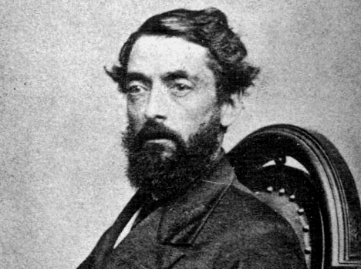
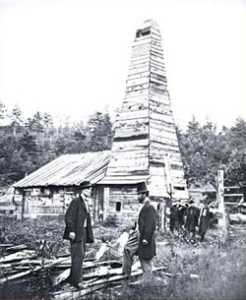
What Industries?
Industry | Major Effects
Oil | Steam engine drilling increases fuel supply
Steel | Increased supply for machines, buildings
Coal | Increased mining supplies factories with power
Edwin Drake and his oil derrick

Slide 7
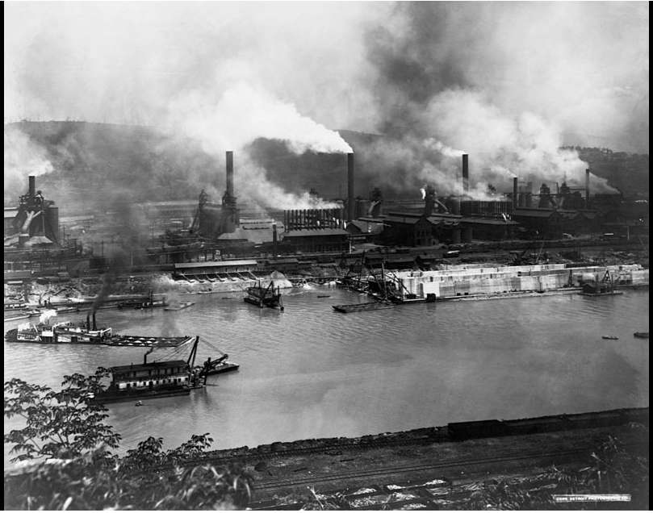

Slide 9
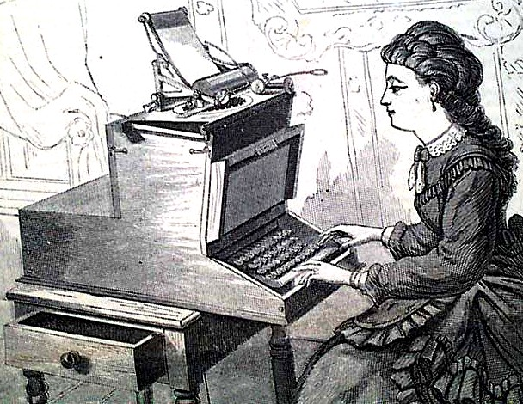
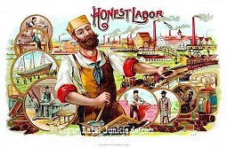
Long-Term Impacts of Technology
More women in the work force
working as secretaries, sewing
Increase in consumption of factory-made products
Use of machines further reduces the value of human labor and skill

