Slide 1
United States History
Dr. King-Owen
Assimilation and Nativism
[6.04]

Slide 2
The Melting Pot
Immigrants to the United States, 1870-1920
About 20 million came to the US
Left because of religious persecution or lack of land and jobs in Europe
More immigrants from China, Japan, Russia, Mexico, and eastern Europe than before
Would they “melt” into American society and lose their identity?

Slide 3
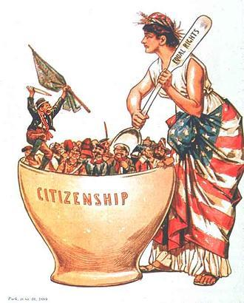
Americans worried that immigrants would not become fully American.

Slide 5
Nativism
Americans who believed in protecting America for native-born citizens believed in NATIVISM
They believed the BEST immigrants are Anglo-Saxon (English) in origin
They disliked Catholics and “anarchists”
They wanted literacy tests to keep out bad immigrants

Slide 6
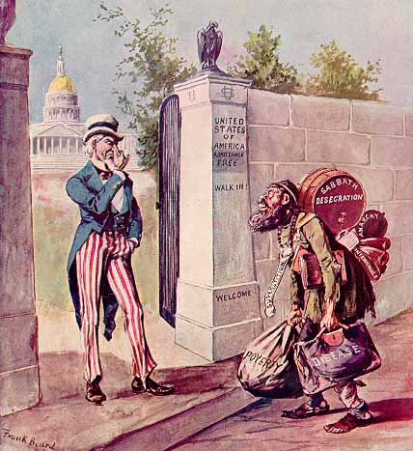

Slide 7
Restricting Asian Immigrants
1882, Chinese Exclusion Act
Banned Chinese immigrants (except students, teachers, merchants, officials)
1906, Gentlemen’s Agreement
Japanese children were in segregated schools in San Francisco
Agreement – if schools were desegregated, the Japanese would limit migrants to America

Slide 8
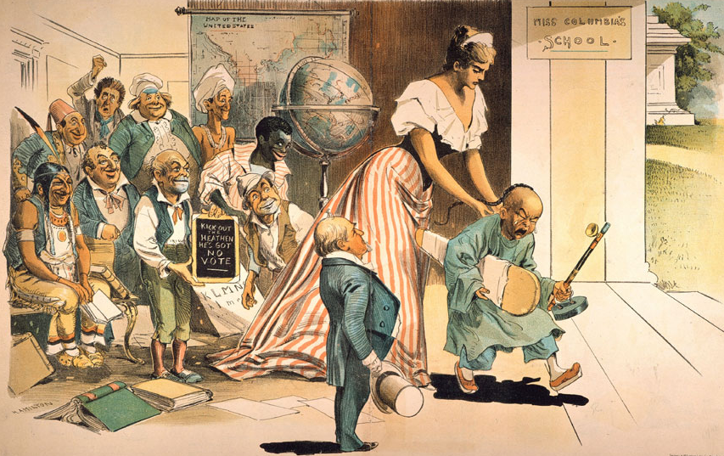

Slide 9
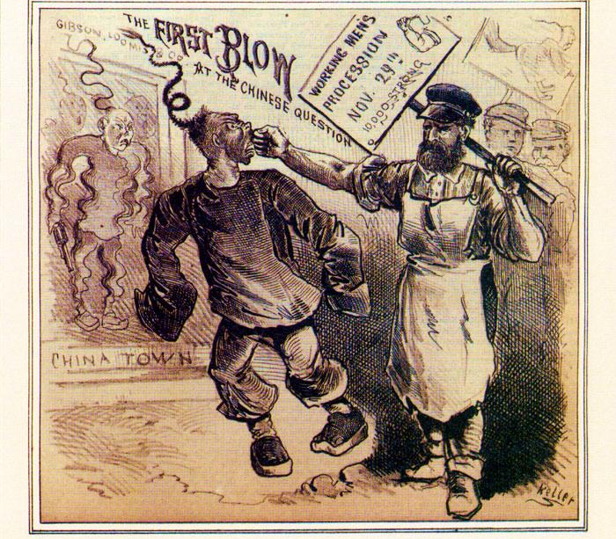

Slide 10
Settlement Houses
Americanization
Immigrants had to learn American ways– literacy, citizenship, housekeeping
Immigrants chose to keep their traditions AND learn to be American
Settlement Houses
Houses run by for the welfare of poor and immigrants – one run by Jane Addams in Chicago
Taught citizenship, reading, housekeeping

Slide 11
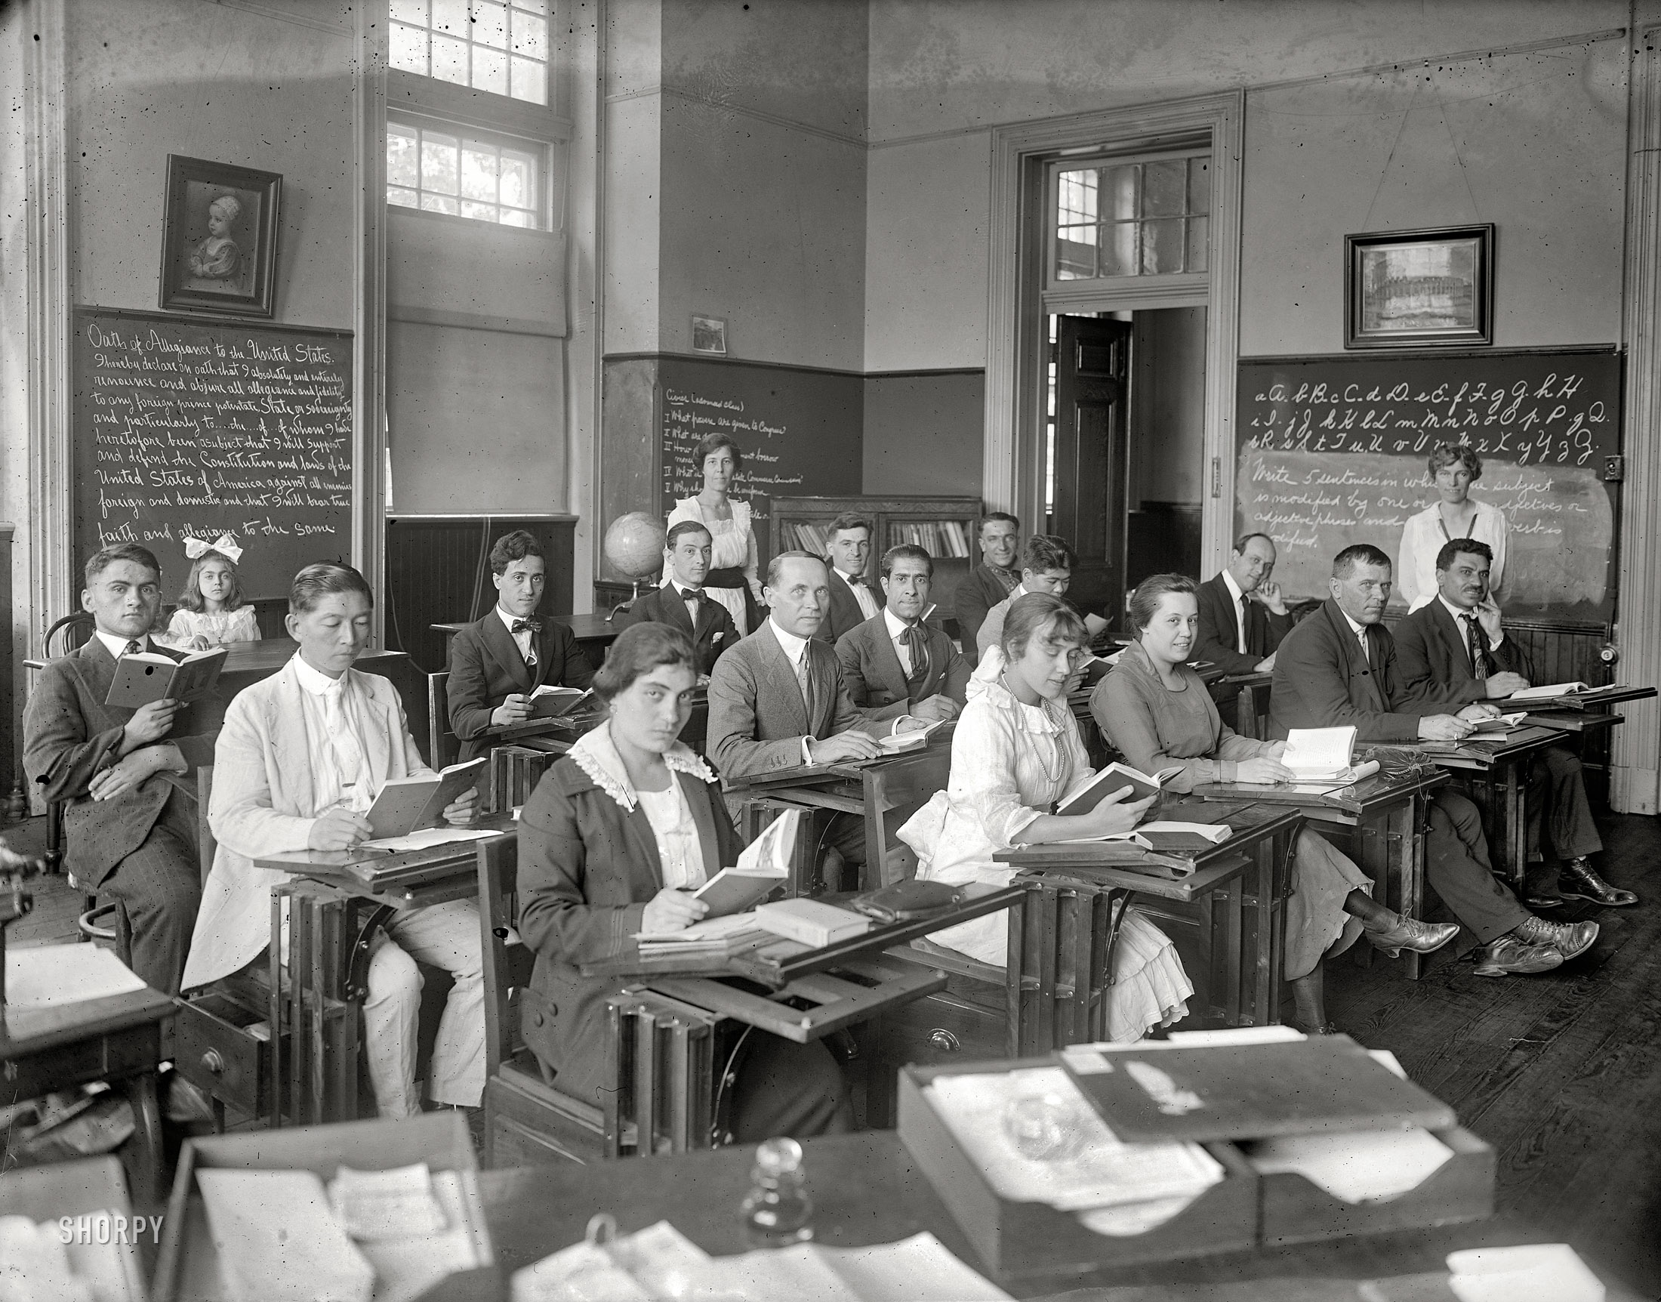

Slide 12
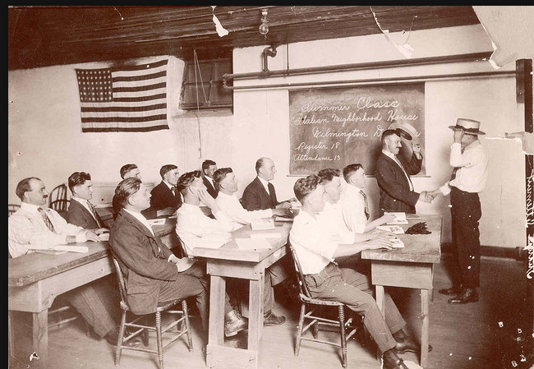

Slide 13
Immigrants and Indians
In what ways were the experiences of Indians and Immigrants alike? Were they both expected to give up their culture and become like Americans?

Slide 14
