Slide 1
United States History
Dr. King-Owen
Urban Life in the 19th Century

Slide 2
Directions
You are now a Housing Inspector about to view some apartments.
As you view these apartments, write down PROBLEMS that you see.

Slide 3
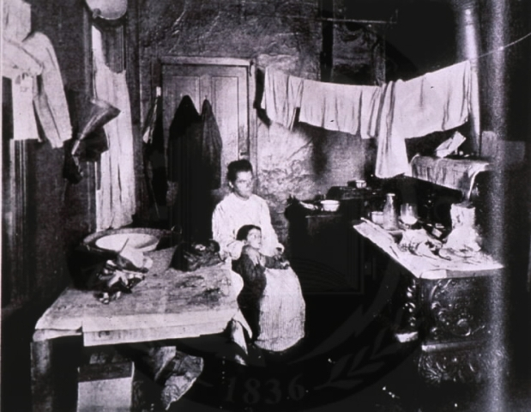

Slide 4
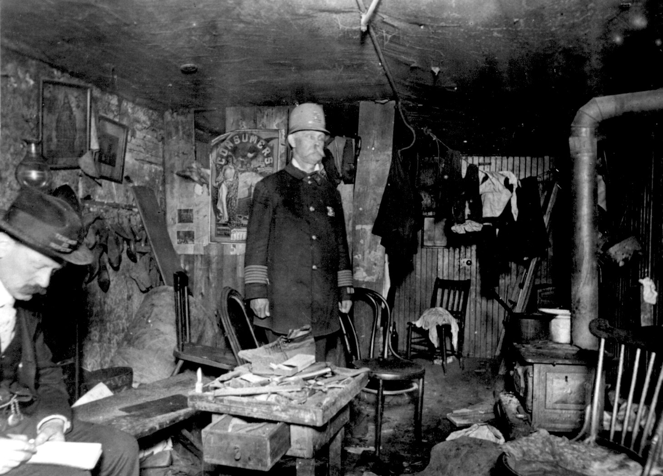

Slide 5
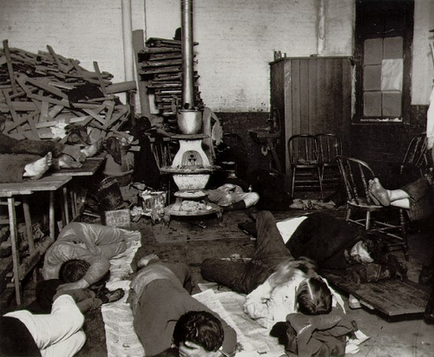

Slide 6
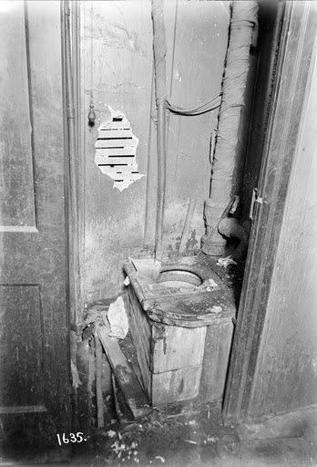

Slide 7
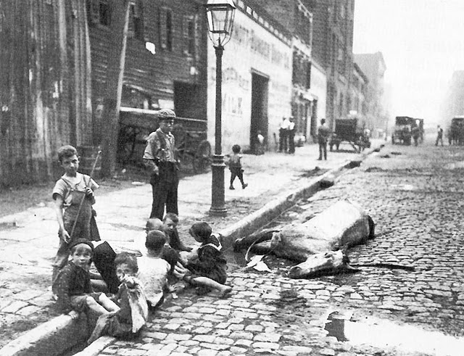

Slide 8
Solving the Problems?
I am the building owner. Try and convince me that I need to fix the problems you have noticed.

