Slide 1
Activity
April 1871
Repairs are needed on the New York Courthouse. The authorized amount is $250,000. Submit your bids for the amounts below. I’ll accept the usual.
1. Furniture __________________
2. Carpets __________________
3. Carpentry repairs __________________
4. Brooms, supplies, etc. __________________
5. Plastering __________________
6. Plaster Repairs __________________
7. Plumbing __________________
As ever,
Tweed

Slide 2
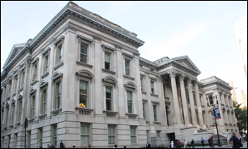
Activity - Answers
April 1871
Repairs are needed on the New York Courthouse. The authorized amount is $250,000. Submit your bids for the amounts below. I’ll accept the usual.
1. Furniture __________________
2. Carpets __________________
3. Carpentry repairs __________________
4. Brooms, supplies, etc. ___________
5. Plastering _______________
6. Plaster Repairs _______________
7. Plumbing __________________
Total Cost (plus additional items) = $13,000,000 (Tweed and his men took home about 65% of that = $8,450,000 (= $200 million today)
$1,575,782
$675,534
$2.189.690
$41,190
$531,594
$1,294,684
$1,500,000

Slide 3
United States History
Dr. King-Owen
The Gilded Age
[6.04]

Slide 4
Video on Boss Tweed

Slide 5
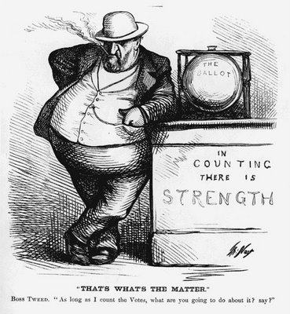
“As long as I count the votes, what are you going to do about it?”

Slide 6
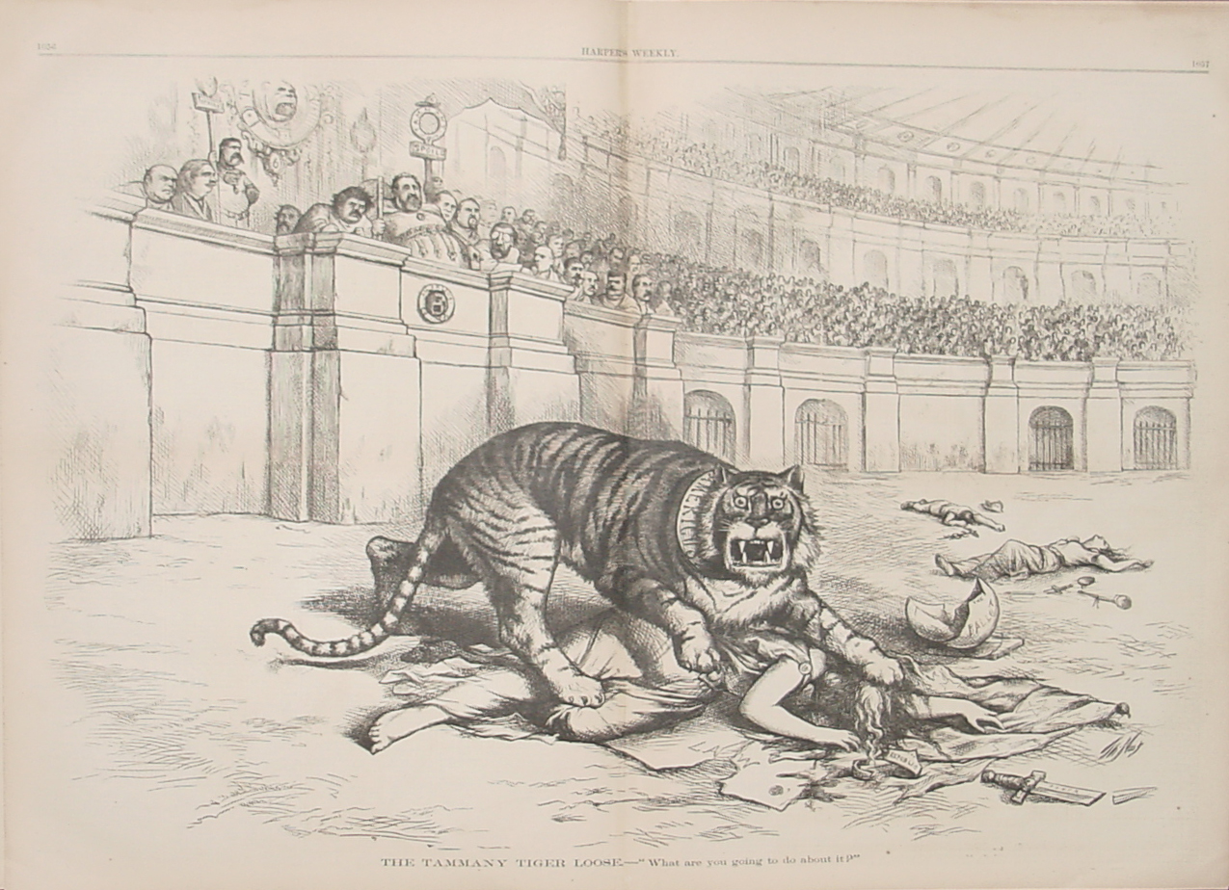
“THE TAMMANY TIGER LOOSE – What are you going to do about it?”

Slide 7
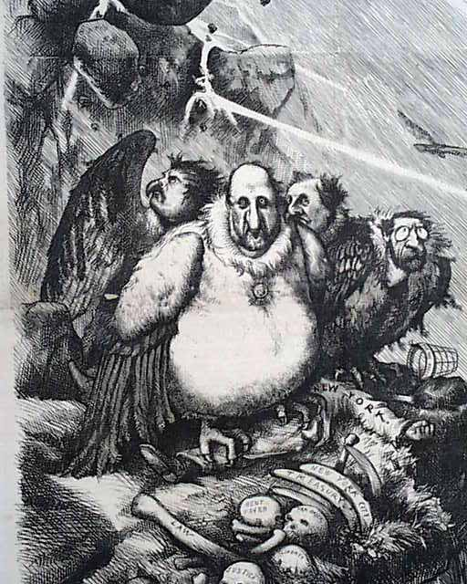
“Let us Prey.”

Slide 8
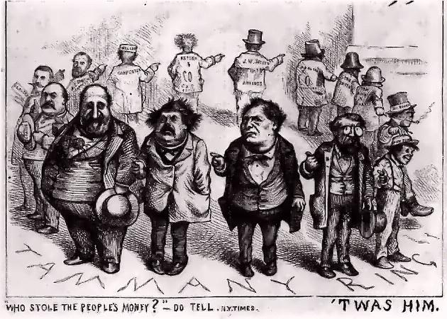

Slide 9
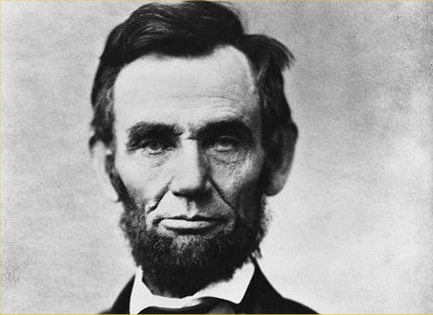
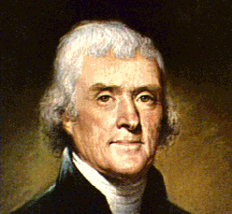
Every Man Belongs to a Party
REPUBLICANS
DEMOCRATS
Farmers, easterners, businessmen
Federal Government should help business
Federal Government should reform morals
Southerners, immigrants, city bosses
States’ rights are most important
Federal Government should be small, spend very little

Slide 11
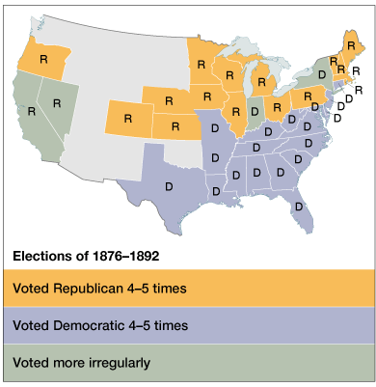

Slide 12
Corruption in Cities
Cities spent large amounts of money – $$ attracts greedy men
Patronage: Leaders “sold” offices to their supporters; did not hire people on ability
City Bosses: political leaders in a district who provided food and aid to poorer citizens in exchange for support for the political party (CRUDE WELFARE SYSTEM)

Slide 13
Assassination of Garfield
166,000 federal jobs – given out on basis of party loyalty
1881 – frustrated office seeker named Charles Guiteau shot President Garfield
1883 – Pendleton Civil Service Act
Gave tests to determine ability to have a federal job
Included ½ of federal jobs by 1896

Slide 14
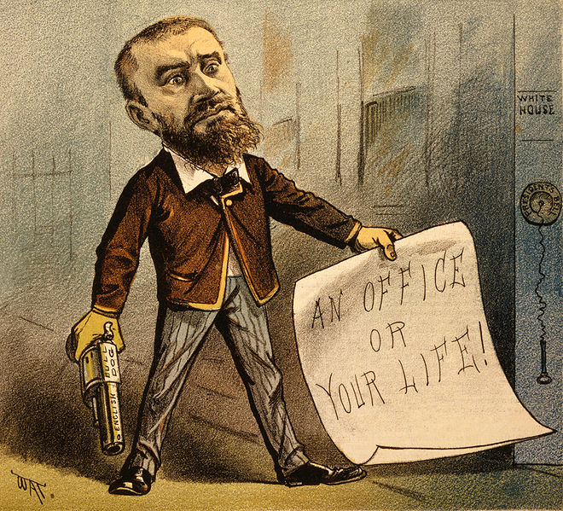
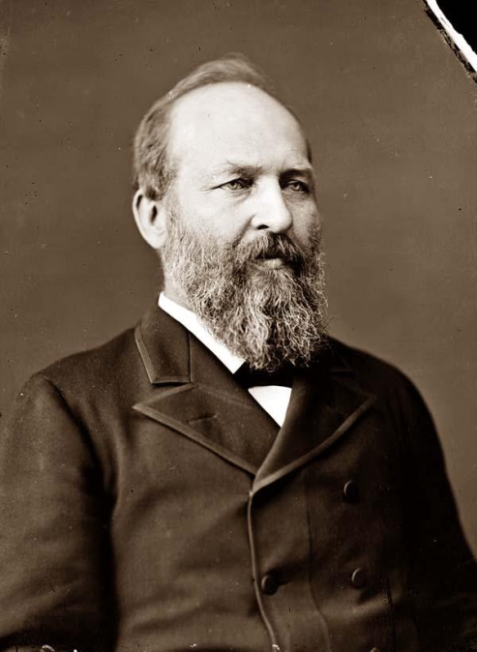
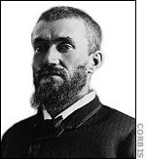
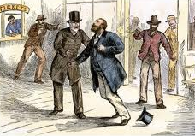

Slide 15
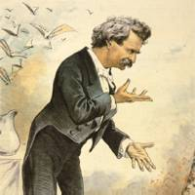
The Gilded Age
The period from 1877 to 1900 is known as the Gilded Age
Named by Mark Twain
Suggests that people are out to get rich
Suggests that people go for “shiny” – appearances over substance

