Slide 1
Welcome to Suburbia! 11.02 Dr. King-Owen

Slide 2
Levittown, P.A.
1949 – Housing Crisis!
William Levitt could build 1 complete home every 16 minutes
$7990 ($60/month)
Strict rules for homeowners
By 1960, 1/3 of Americans live in suburbs
Levitt homes not for sale to blacks

Slide 3
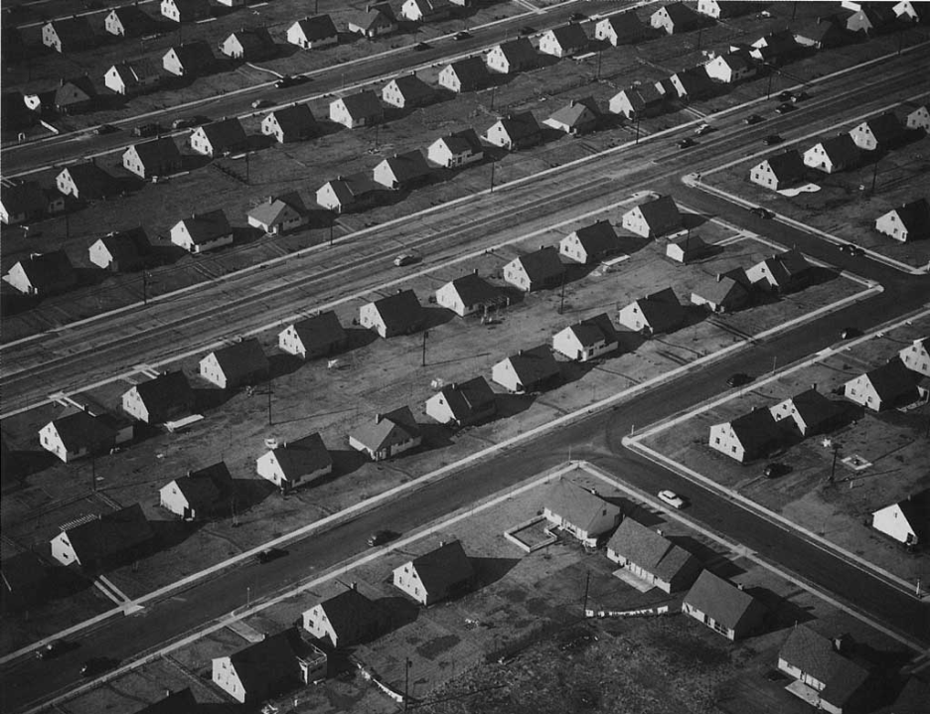

Slide 4
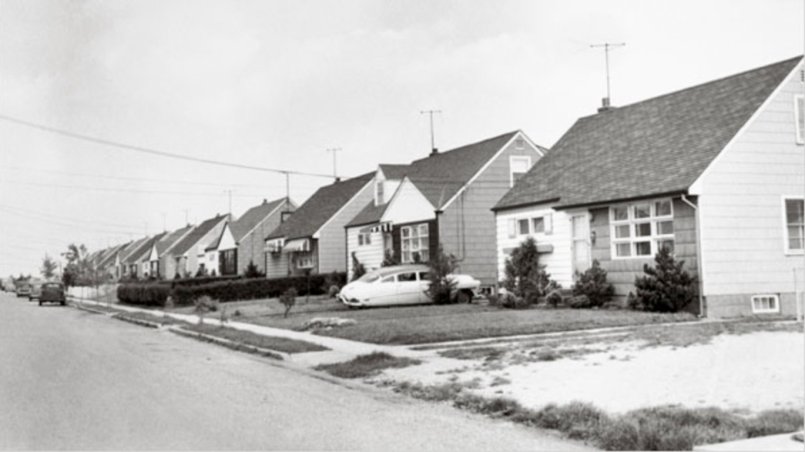
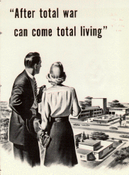
Little boxes on the hillside, Little boxes made of ticky tacky, Little boxes on the hillside, Little boxes all the same. There's a green one and a pink one And a blue one and a yellow one, And they're all made out of ticky tacky And they all look just the same.
And the people in the houses All went to the university, Where they were put in boxes And they came out all the same, And there's doctors and lawyers, And business executives, And they're all made out of ticky tacky And they all look just the same.

Slide 5
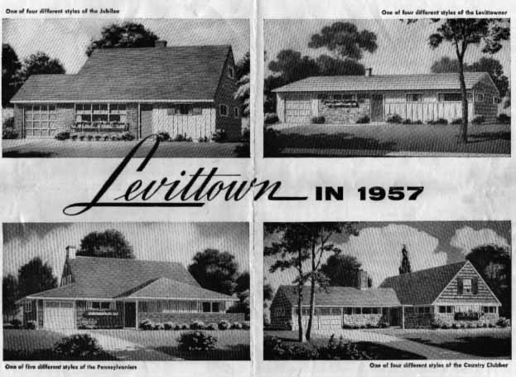

Slide 6
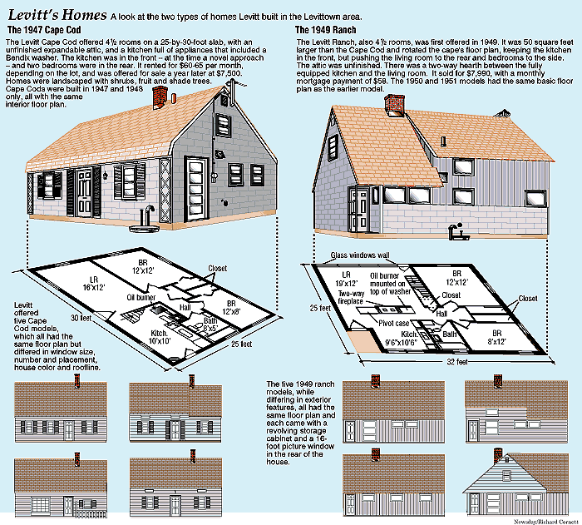

Slide 7
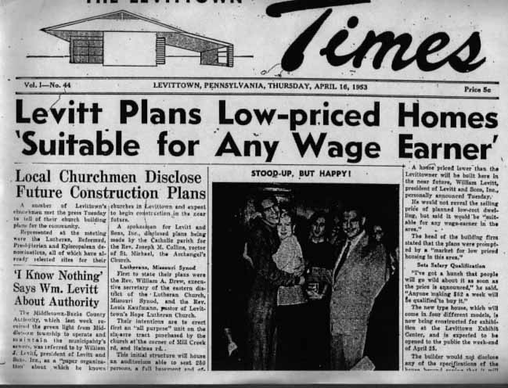

Slide 8
SHIFTS IN POPULATION DISTRIBUTION, 1940-1970
1940 1950 1960 1970
Central Cities 31.6% 32.3% 32.6% 32.0%
Suburbs 19.5% 23.8% 30.7% 41.6%
Rural Areas/ 48.9% 43.9% 36.7% 26.4%
Small Towns
U. S. Bureau of the Census.

Slide 9
Consumerism
Why did the U.S. not return to a Depression after World War II?
GI Bill (1944) gave $$$ to veterans
High government defense spending
Prosperity used to argue against communism
New consumer economy
New cars and items for suburban homes (especially televisions!)
Credit and advertising increase
Prosperity creates middle class

Slide 10
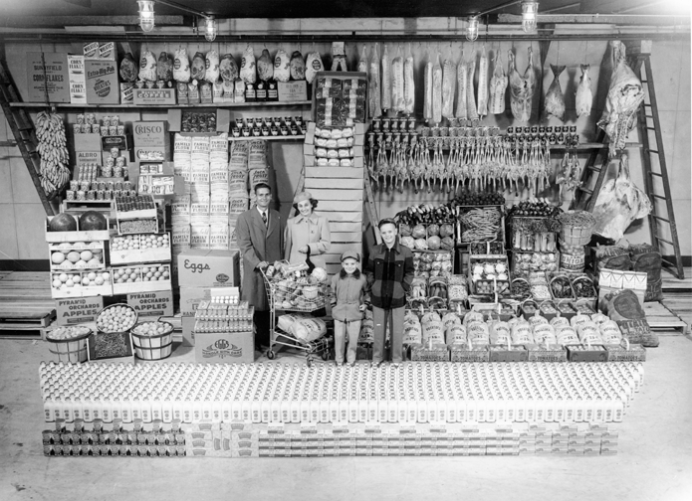

Slide 11
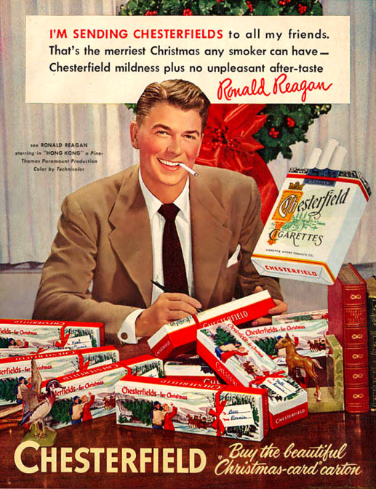
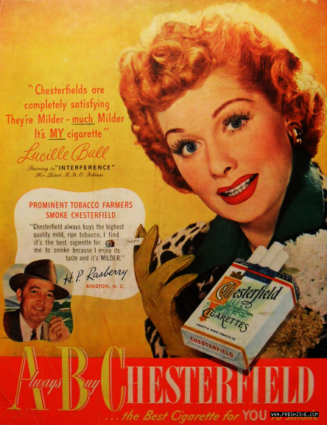

Slide 12
The Car Culture
Suburbs require cars
Auto ownership increases 50%
1956 – Interstate Highway Act
Creates 41,000 miles of interstates (for defense)
Boom in:
Travel and tourism
Drive-ins (movies & restaurants)
Gas consumption

Slide 13
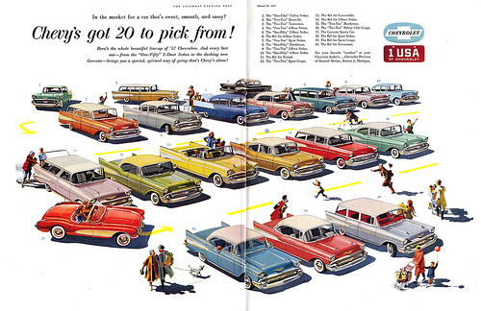

Slide 14
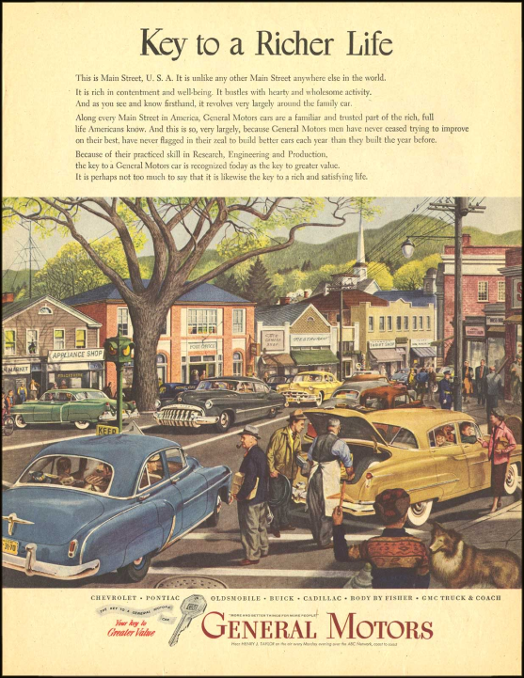
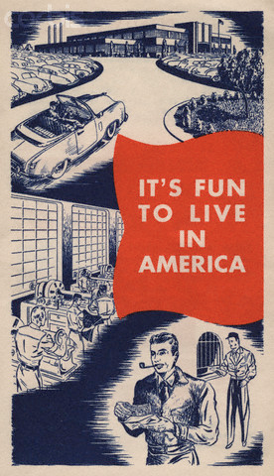

Slide 15
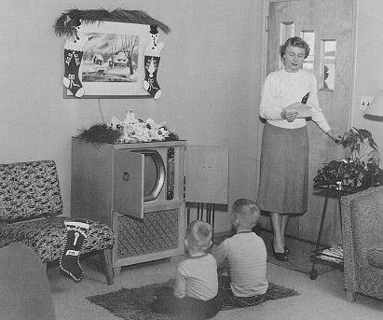
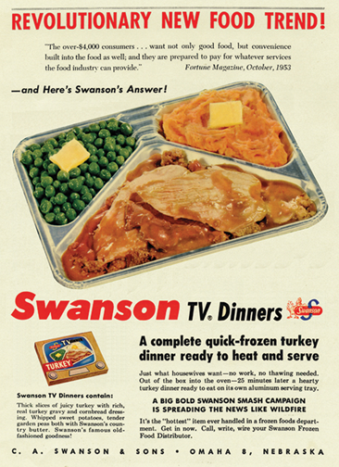

Slide 16
Golden Age of Television
Television Culture
1950 – 9% of Americans have TV
1962 – 90% of Americans have TV
New medium of advertising
Political ads become important
Shows celebrated wholesome American goodness
Almost all-white
TV is accused of being a “vast wasteland” in 1961

Slide 17
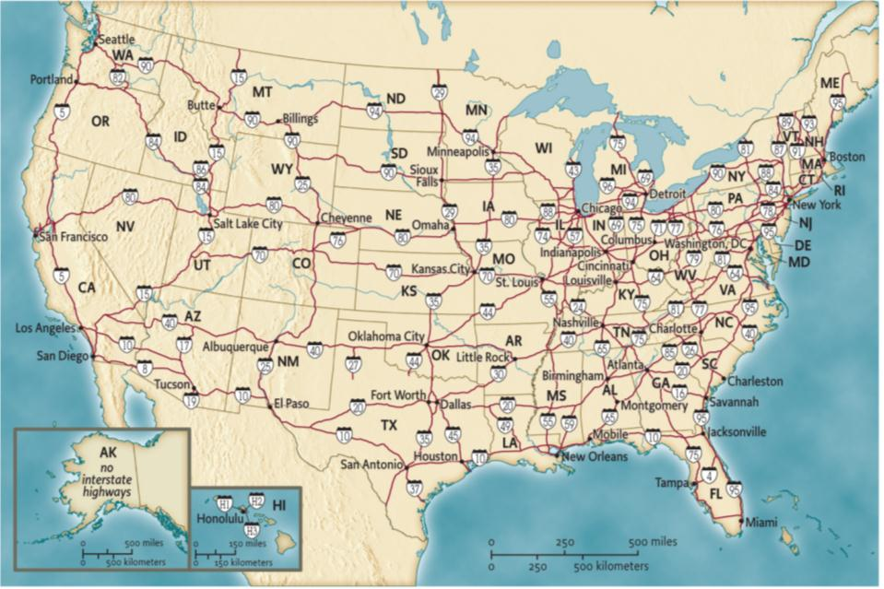

Slide 19
