Slide 1
United States History
Normalcy
Dr. King-Owen

Slide 2
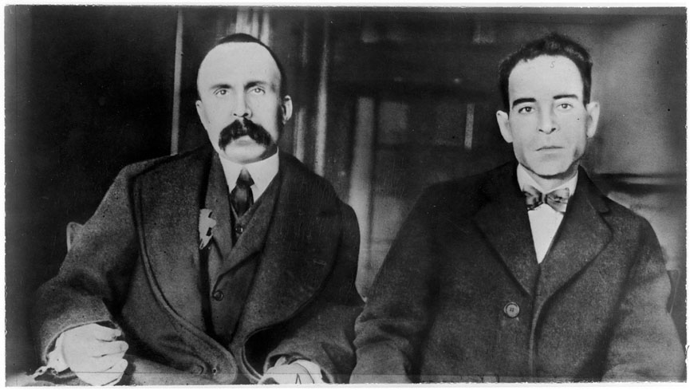

Slide 3
Fears of Foreigners
1920 Sacco and Vanzetti Case
Two Italian immigrants accused of murder
Case increased anti-foreign feelings
Executed in 1927
1921 Emergency Quota Act
Set limits on how many immigrants could enter the U.S.
Immigration dropped 62% from 1920 to 1922
Quotas favored “Anglo-Saxons”

Slide 4
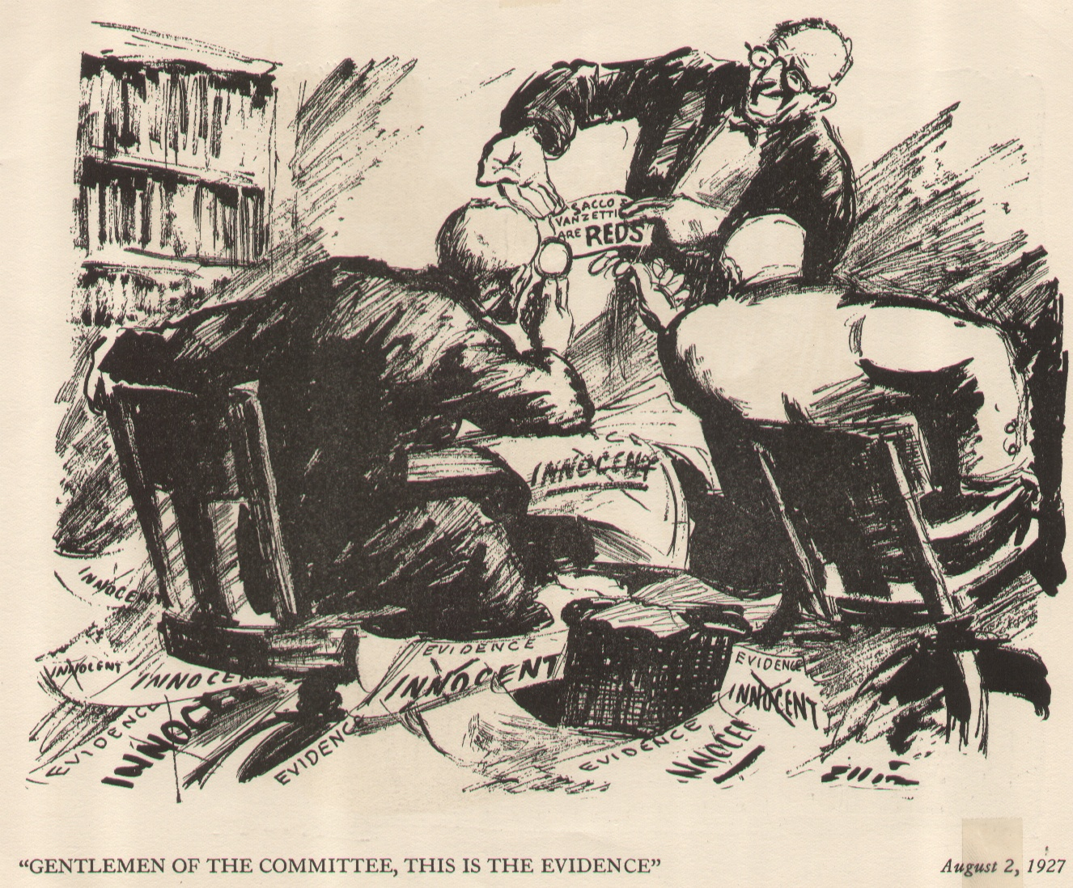

Slide 5
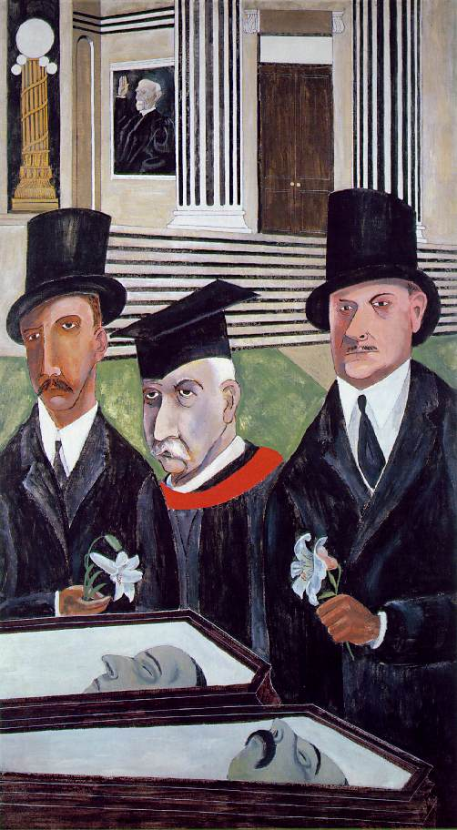
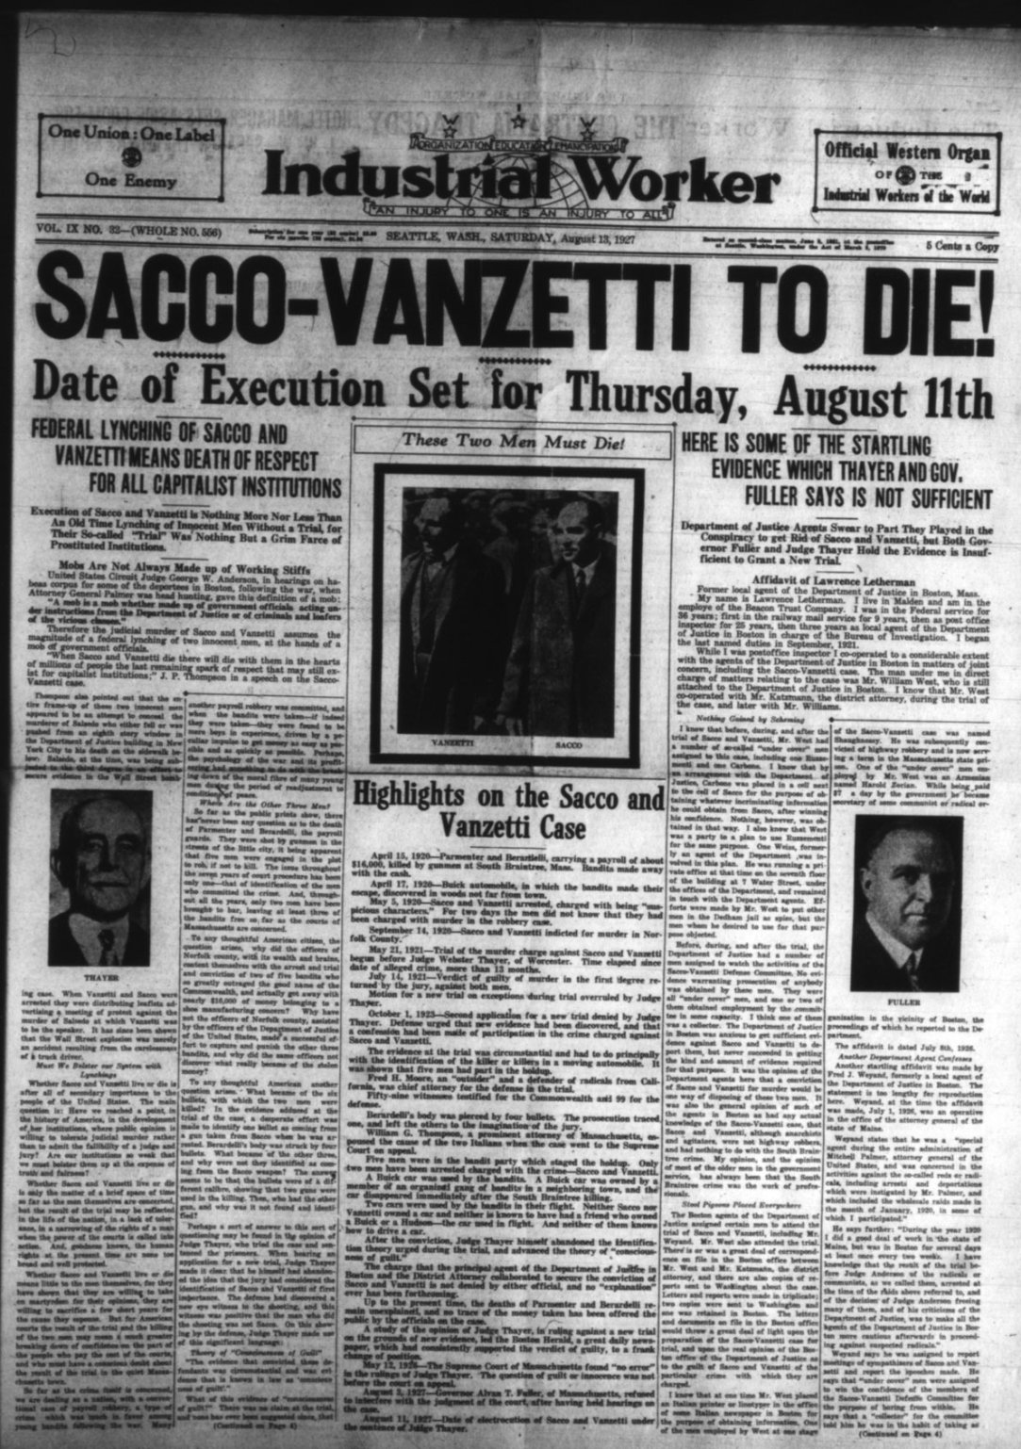

Slide 6
Red Scare
1919-1920
Russian Revolution led to fear of communists and anarchists destroying America
1919 – 36 bombs mailed by anarchists
1920 – U.S. Attorney General A. Mitchell Palmer raided “anarchists” after his house was bombed
Palmer arrested 5,000 people but only found 3 pistols

Slide 8
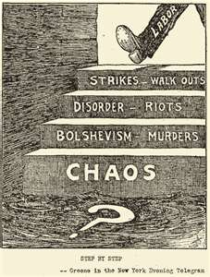

Slide 9
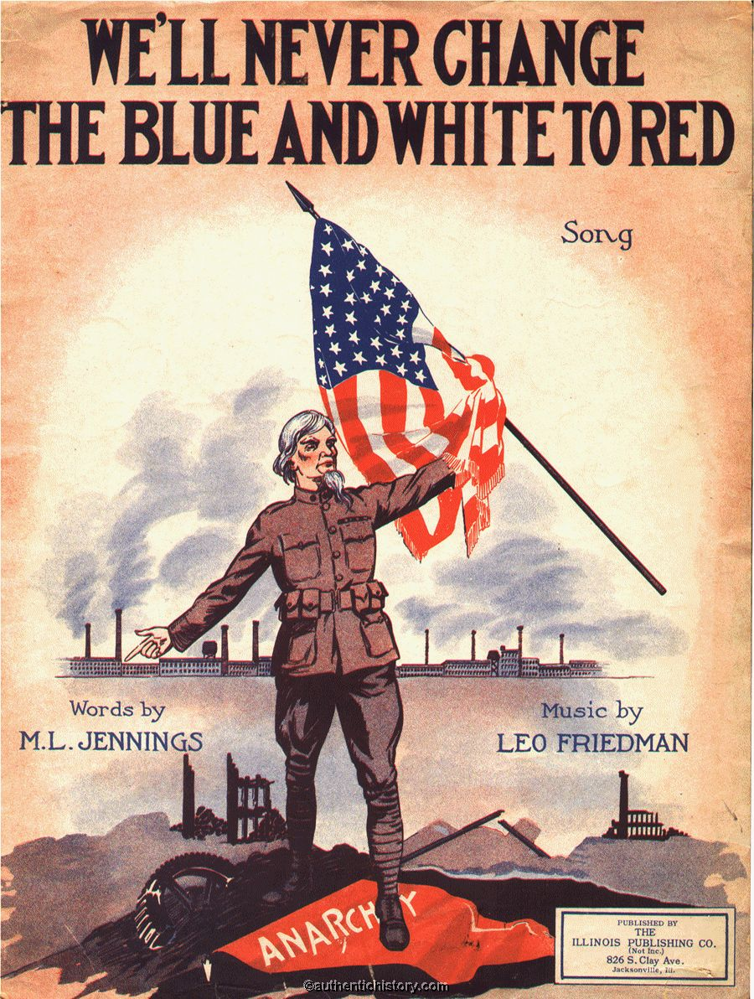

Slide 10
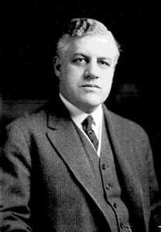
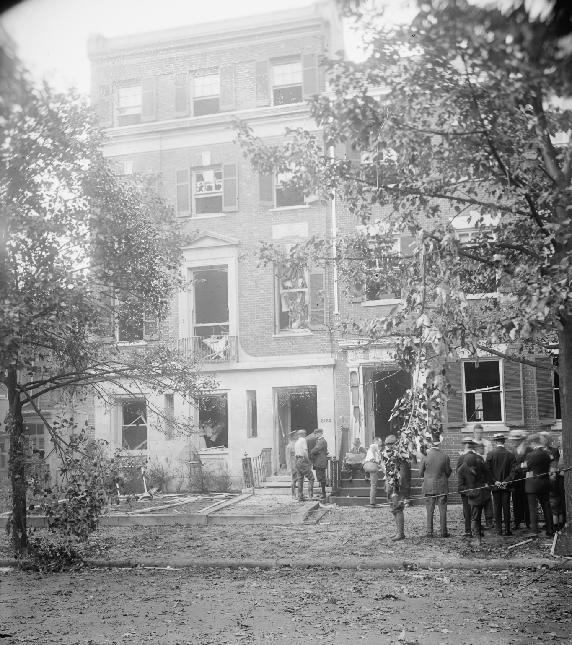

Slide 12
Scandalous President
Return to “Normalcy”=
Laissez-faire government
Lower taxes on businesses
Not enforce Progressive anti-monopoly laws
Scandals
Charles R. Forbes, 1923 – stole $200 million from Veterans’ Bureau
Teapot Dome -- 1924, Albert B. Fall leased government oil to private industry in return for kickbacks

Slide 13
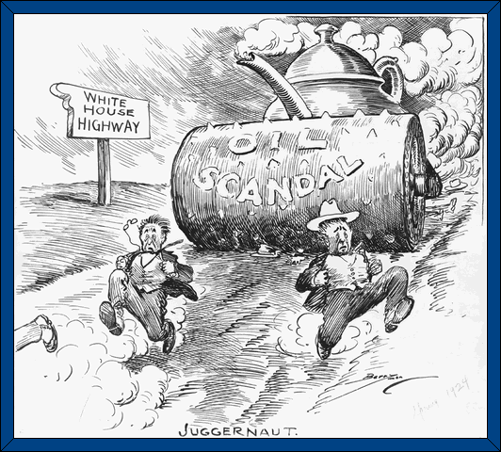

Slide 14
Federal Tax Policy
Andrew Mellon, Secretary of the Treasury
1924 Mellon Plan
Cut taxes on wealthy from 77% to 24%
Supply-Side Economics
If wealthy have extra money, they will spend and invest it
Low taxes on the rich led to unstable economic growth in the U.S.

Slide 15
Tariff Policy
U.S. raised tariffs rates to keep out foreign goods
By the Hawley-Smoot Tariff (1930), tariff rates were raised to 59%
Protected American business BUT
Increased world-wide economic recession by decreasing global trade

Slide 16
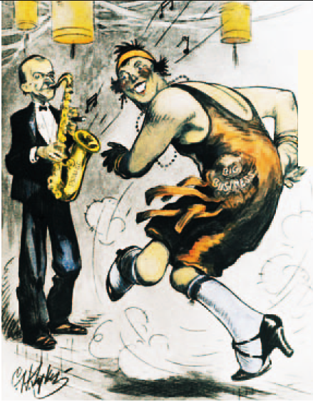
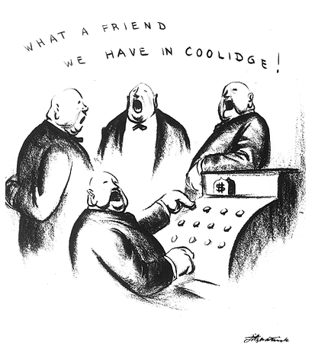
“The Business of Government is Business” ~ President Coolidge

