Slide 1
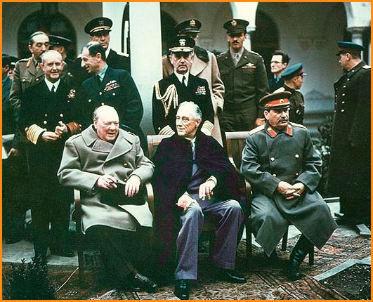
United States History
[10.02]
Wartime Diplomacy * Dr. King-Owen

Slide 2
U.S. + Britain + Soviets
First war priority was to beat Hitler (1941)
“Big Three” met to discuss war goals:
Prime Minister Winston Churchill (BRIT)
President Franklin D. Roosevelt (U.S.)
Chairman Joseph Stalin (SOVIET)

Slide 3
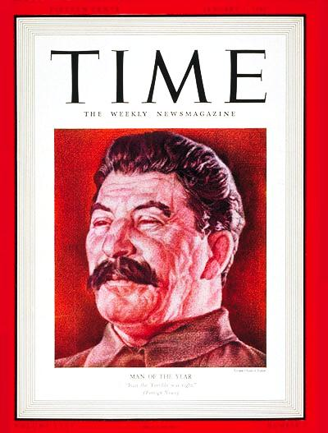
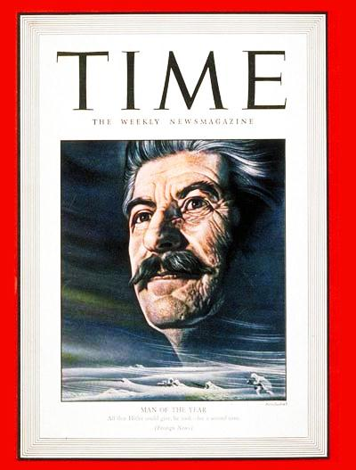
Joseph Stalin? Really?

Slide 4
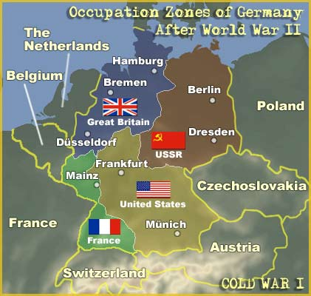
Yalta
Yalta, 1944
Soviets would have a sphere of influence in Europe
Germany and Berlin—would be divided into 4 zones

Slide 5
Post-War Planning, 1945
United Nations, 1945
Replaced League of Nations
Job: collective security (peace in the world)
Potsdam, 1945
Unconditional surrender of Japan demanded
President Truman said that the U.S. had a new weapon
News of atomic bomb made Soviets fearful of U.S. power

