Slide 1
United States History
Communists VS Freedom Fighters
Dr. King-Owen
[13.04]

Slide 2
Monroe + Truman Doctrines
Under the Monroe Doctrine, President Reagan used the “big stick” to stop communists in Latin America
Reagan called pro-U.S. allies in these countries “Freedom Fighters,” even when they were anything but democratic
October 1983 – U.S. invaded Grenada to stop a pro-Soviet government

Slide 3
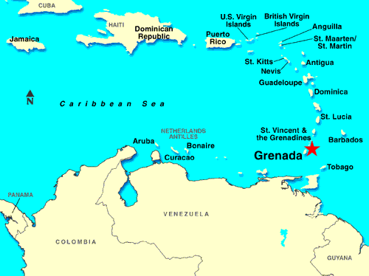

Slide 4
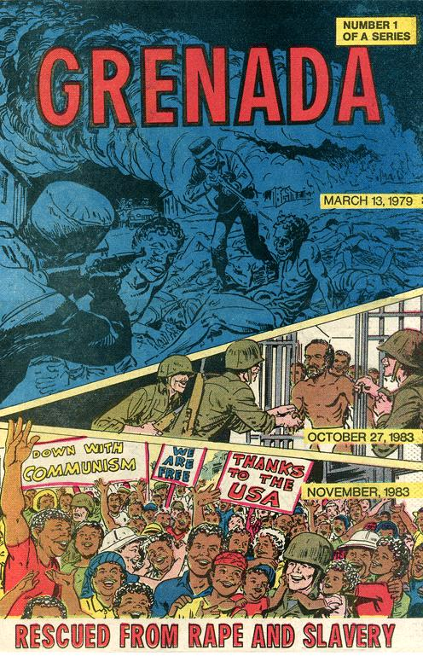
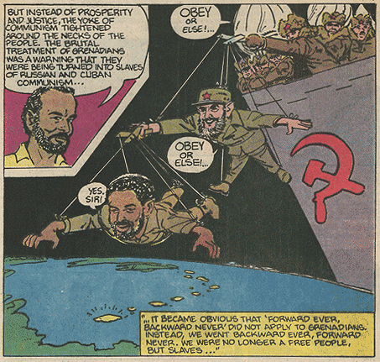
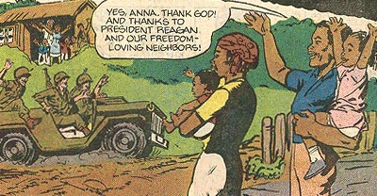

Slide 5
Nicaragua
Sandinistas – pro-communist leaders
Contras – U.S. trained “freedom fighters” against communism
U.S.-backed forces in Nicaragua were guilty of:
Raping American nuns
Selling cocaine
Killing journalists

Slide 6
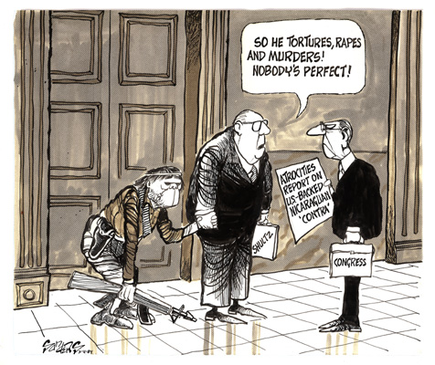

Slide 7
Iran-Contra Affair
1984 – Congress forbid President Reagan from giving money to Contras (Boland Amendment)
1986 – Illegal Activities in the White House
Reagan’s officials sold weapons to Iran to get some American hostages released
$$$ from Iranian arms sales was sent to Contras

Slide 8
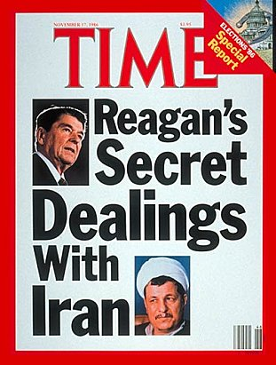
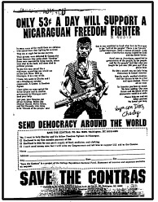

Slide 9
Ollie North
Congress investigated Reagan
Lt. Col. Oliver North headed Iran-Contra deals
Destroyed documents
Lied to Congress
At least 11 officials were guilty of violating laws
Reagan claimed he could not remember anything about the affair [INCOMPETENT]
President G. W. Bush pardoned 6 of the guilty in 1992

Slide 10
