Slide 1
True or False?
T
Americans helped to overthrow the government of Iran in 1953.
Islamic fundamentalists share many ideas in common with Christian fundamentalists: literalism, strict interpretation, and traditional views of family.
The term jihad refers exclusively to violence against non-Muslims.
The P.L.O. has worked to get a Palestinian home state created.
Muslim extremists have used religion to complement their goals for political power.
T
F
T
T

Slide 2
United states history
Middle east peace?
Dr. King-Owen

Slide 3
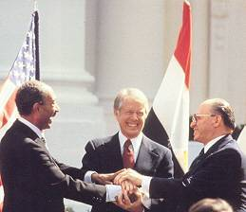
Camp David
President Carter brought Egyptian and Israeli leaders together in 1978 to discuss peace
Camp David Accords were signed
Israel would leave the Sinai peninsula to Egypt
Egypt recognized Israel’s right to exist

Slide 4
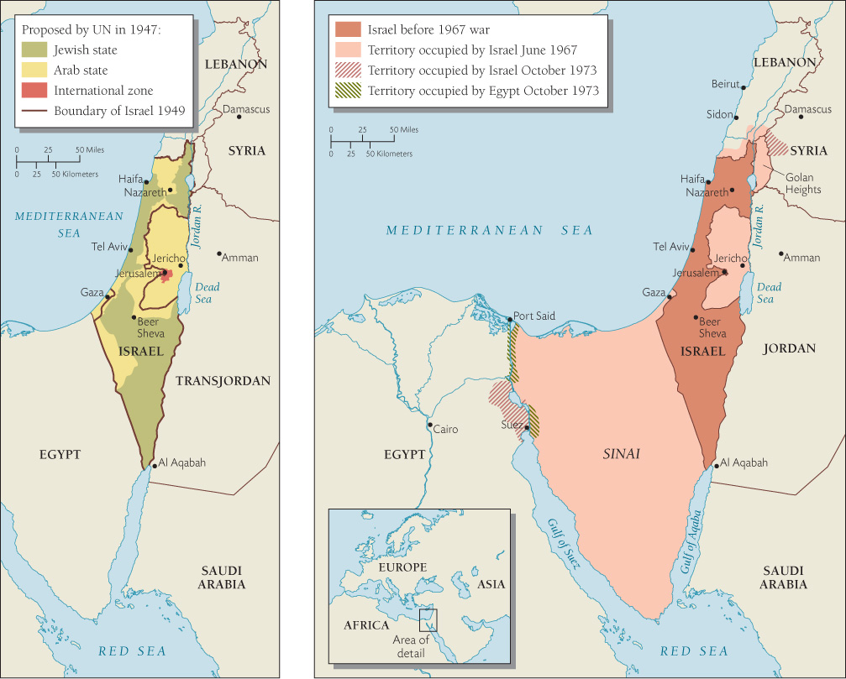

Slide 5
Revolution, 1979
Islamic fundamentalists overthrow the Shah of Iran
Ayatollah Ruhollah Khomeini came to power
Supreme Leader of Iran
Islamic fundamentalist
Strongly anti-American
Americans allowed the Shah to come to the U.S. for medical treatment
In response, Iranian students took 52 Americans hostage from the American embassy in Teheran
Held for 444 days

Slide 6
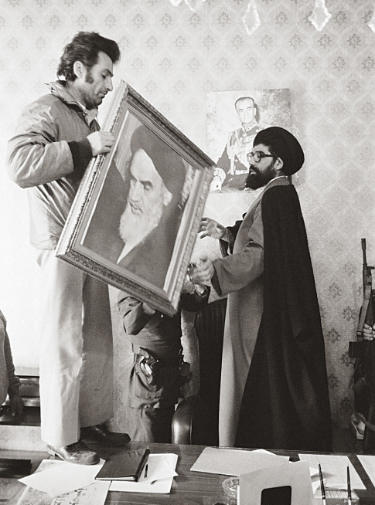
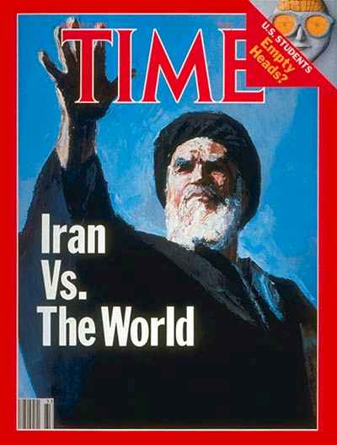

Slide 7
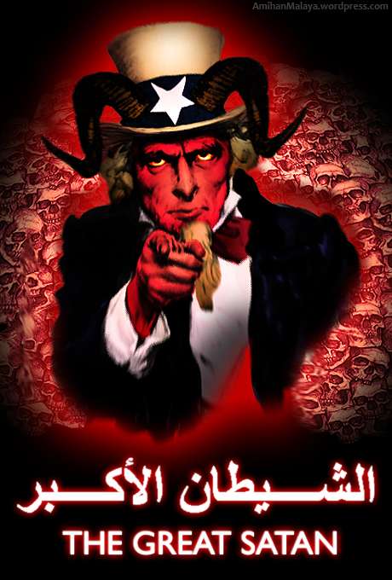
“America is the Great Satan, the wounded snake.”
Ayatollah Khomeini, 1979

Slide 8
Hostage Crisis, 1979
Oil Crisis
Revolution disrupted oil production
President Carter forbid buying oil from Iran
Carter de-regulated the price of gas so gas companies raised prices 149% in 12 months
Operation Eagle Claw, 1980
Failed mission by U.S. to rescue the hostages
Crisis hurt President Carter publicly
Release, 1981
Ronald Reagan defeated Carter to become President in the election of 1980
Just minutes after Reagan’s inauguration, the hostages were released

Slide 9
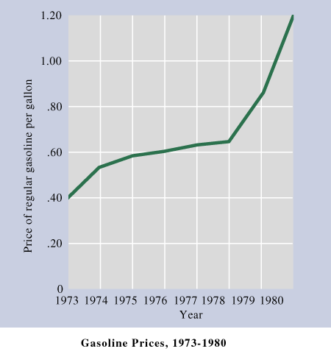

Slide 10
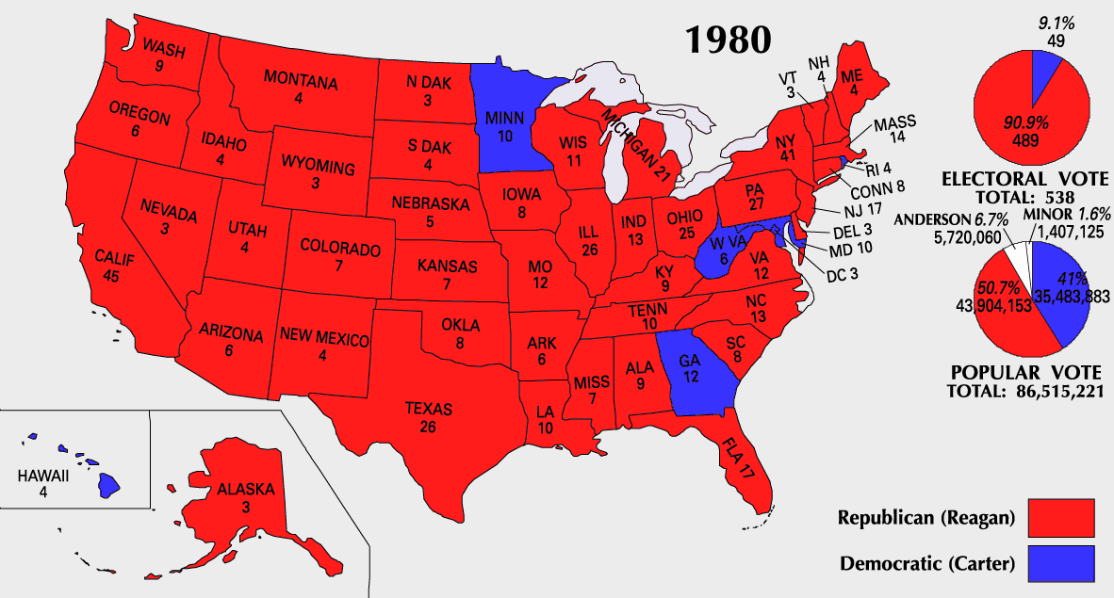

Slide 11
